Slide 1
Module 3

Slide 2
Module 3 Syllabus
Extracting Meaning from Data:
  Feature Generation and Feature Selection ,
  Motivating application: user (customer) retention.
  Feature Generation (brainstorming, role of domain expertise, and place for imagination), Feature Selection algorithms.
  Filters; Wrappers; Decision Trees; Random Forests.
Recommendation Systems:
  Building a User-Facing Data Product,
  Algorithmic ingredients of a Recommendation Engine,
  Dimensionality Reduction, Singular Value Decomposition,
  Principal Component Analysis,
  Exercise: build your own recommendation system.

Slide 3
Exercise: Build your own recommendation system.

Slide 4
Python Inbuilt Libraries to be Used
math
numpy

Slide 5
1.math
Purpose: Provides mathematical functions.
Functions: math.sqrt(x): Returns the square root of x.
Usage in Code: To calculate the root mean squared error (RMSE)
Example1 :
  import math
  result = math.sqrt(16) # result will be 4.0
Example2:
  import math
  # Calculating root mean squared error
  error = math.sqrt(total_error / number_of_elements)

Slide 6
2.numpy
Purpose: Array and matrix operations, linear algebra. Supports large, multi-dimensional arrays and matrices, along with a collection of mathematical functions to operate on these arrays.
Key Functions:
  numpy.mat(data): Creates a matrix from an array-like object or a string of data.
  numpy.zeros(shape): Returns a new array of given shape and type, filled with zeros.
  numpy.eye(N): Returns a 2-D array with ones on the diagonal and zeros elsewhere.
  numpy.linalg.inv(a): Computes the (multiplicative) inverse of a matrix.
  numpy.vstack(tup): Stacks arrays in sequence vertically (row wise).
Usage in Code: For creating and manipulating matrices and performing linear algebra operations.

Slide 7
Example:
import numpy
# Creating a matrix
  V = numpy.mat([[0.15968384, 0.9441198, 0.83651085],
  [0.73573009, 0.24906915, 0.85338239],
  [0.25605814, 0.6990532, 0.50900407]])
# Creating a zero matrix
  U = numpy.mat(numpy.zeros([6, 3]))
# Identity matrix for regularization
  L_identity = L * numpy.mat(numpy.eye(3))
# Inverting a matrix
  inv_matrix = numpy.linalg.inv(some_matrix)

Slide 8
Building a Recommendation System: Sample Code Explanation
The code provided is an implementation of the Alternating Least Squares (ALS) algorithm for collaborative filtering, a popular technique used in recommendation systems.
ALS is used to factorize the user-item interaction matrix into two lower-dimensional matrices, U (user matrix) and V (item matrix), such that their product approximates the original matrix.
This factorization helps to uncover latent factors that explain the observed interactions.

Slide 9
Steps of ALS Algorithm:
Initialize Matrices: Start with random initialization of matrices 𝑈 and 𝑉.
Fix 𝑉, Solve for 𝑈: Using the current estimate of 𝑉, update 𝑈 by solving a least squares problem.
Fix 𝑈, Solve for 𝑉: Using the updated 𝑈, update 𝑉 by solving a least squares problem.
Compute Error: After each iteration, compute the root mean square error (RMSE) to monitor convergence.
Repeat: Iterate the above steps until convergence or for a fixed number of iterations.

Slide 10

Import Libraries

Slide 11
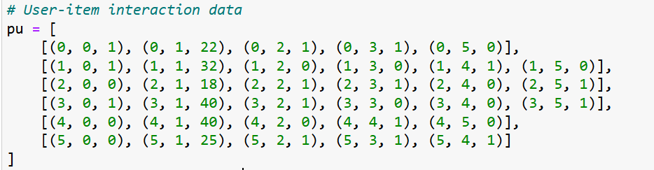
Input Data Structure - User-Item Interactions (pu)
pu: List of tuples representing user-item interactions.
Format: [(user, item, rating), ...]
Explanation: Each tuple (user, item, rating) represents how a user rated an item.

Slide 12
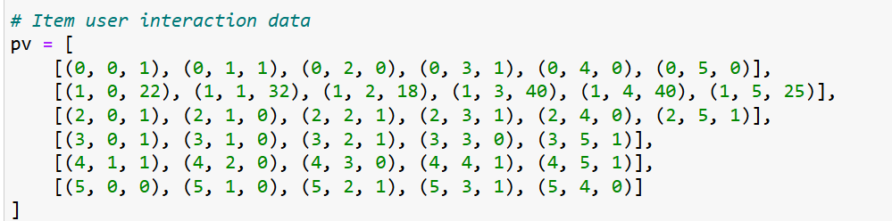
Input Data Structure - Item-User Interactions (pv)
pv: List of tuples representing item-user interactions.
Format: [(item, user, rating), ...]

Slide 13
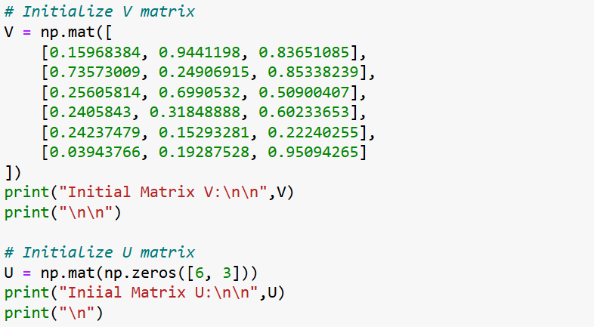
Initializing Matrices V and U

Slide 14

Regularization Parameter
L: Regularization parameter to prevent overfitting.
L =0.03

Slide 15
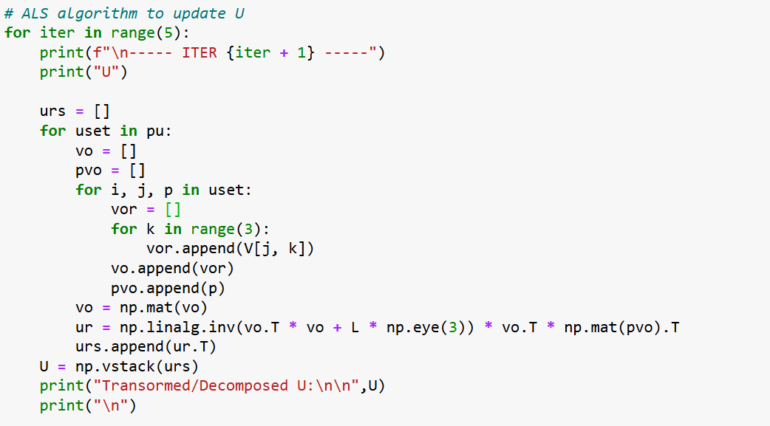
ALS Algorithm - Update User Features (U)

Slide 16
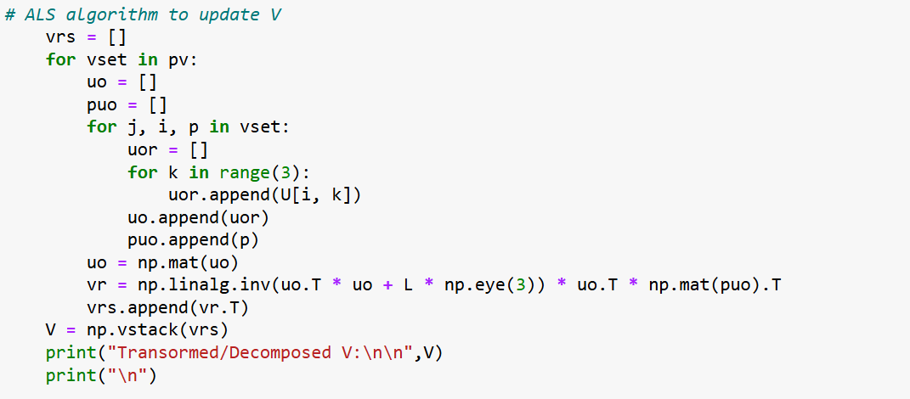
ALS Algorithm - Update Item Features (V)

Slide 17
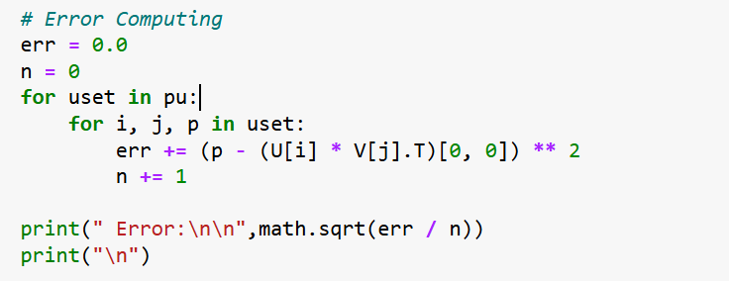
Calculating Error

Slide 18

Final Predictions
print(U * V.T)

Slide 19
Complete Program

Slide 20
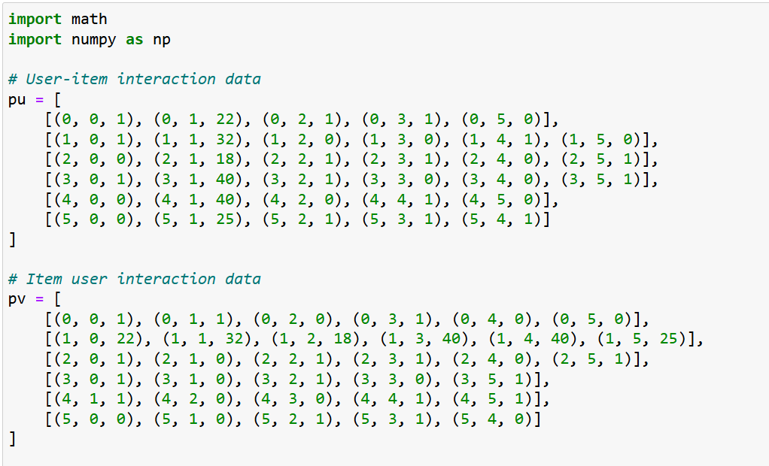

Slide 21
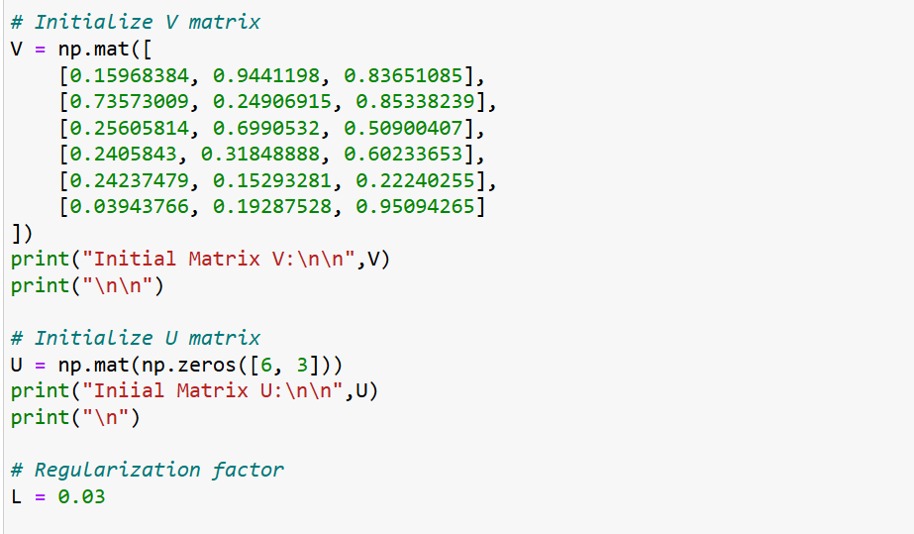

Slide 22
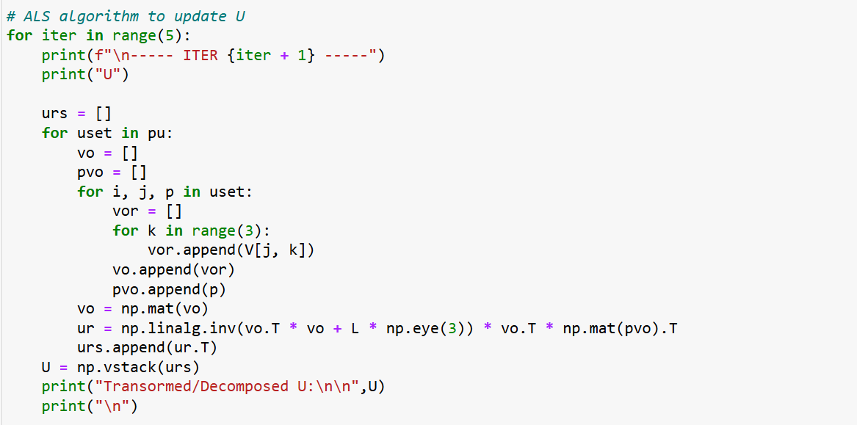

Slide 23
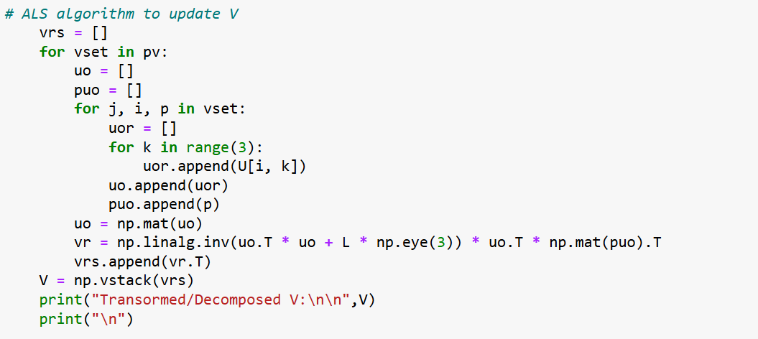

Slide 24
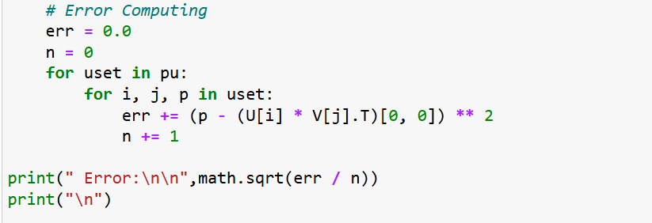
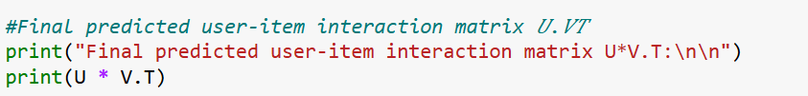

Slide 25
Output

Slide 26
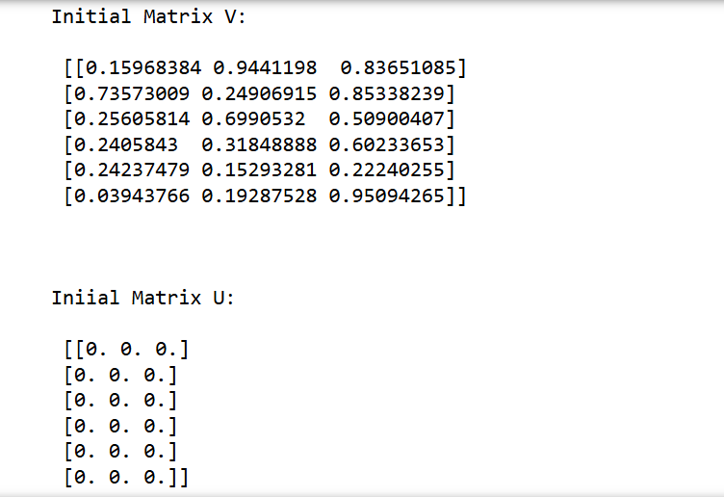

Slide 27
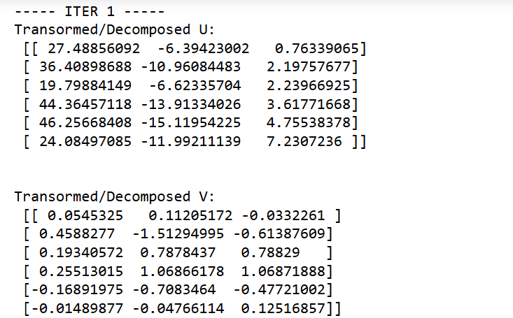

Slide 28
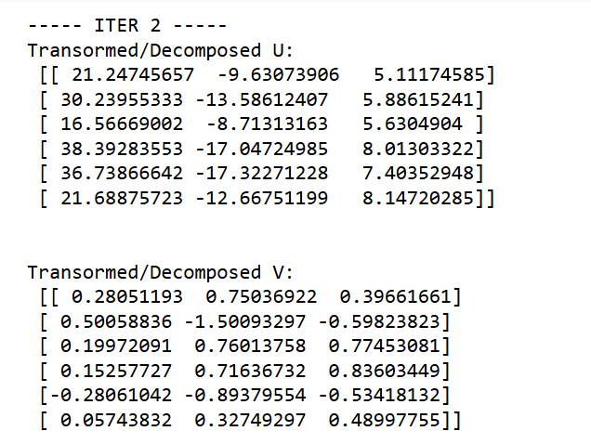

Slide 29
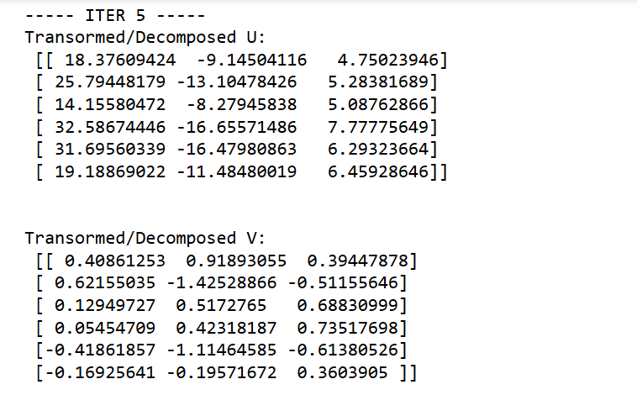

Slide 30
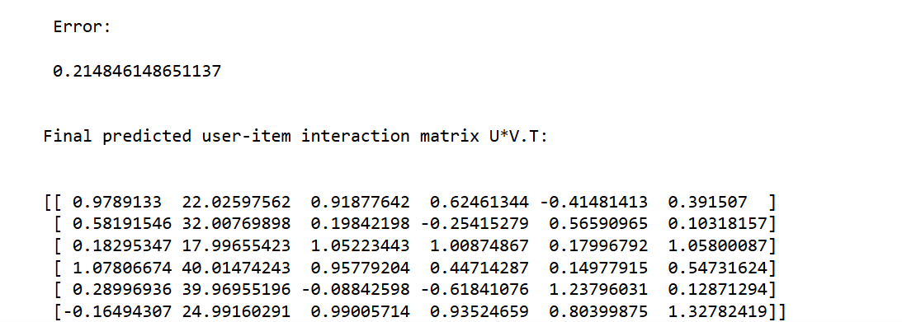

Slide 31
Exercise:
Modify the sample code to work with the GetGlue (Any Realtime) dataset.

Slide 32
End of Module 5

