Slide 1
Module5
Data Science and Visualization

Slide 2
Syllabus: A Deep Dive into Matplotlib
Introduction,Overview of Plots in Matplotlib,
Pyplot Basics: Creating Figures, Closing Figures, Format Strings, Plotting, Plotting Using pandas DataFrames, Displaying Figures, Saving Figures;
Basic Text and Legend Functions: Labels, Titles, Text, Annotations, Legends;
Basic Plots: Bar Chart, Pie Chart, Stacked Bar Chart, Stacked Area Chart, Histogram, Box Plot, Scatter Plot, Bubble Plot;
Layouts: Subplots, Tight Layout, Radar Charts, GridSpec;
Images: Basic Image Operations, Writing Mathematical Expressions

Slide 3
5.1 Introduction
Matplotlib is probably the most popular plotting library for Python, used for data science and machine learning visualizations all around the world.
John Hunter , an American neurobiologist developed Matplotlib in 2003.
Matplotlib is derived version of MATLAB.

Slide 4
Overview of Plots in Matplotlib
Plots in Matplotlib have a hierarchical structure that nests Python objects to create a tree-like structure.
Each plot is encapsulated in a Figure object.
This Figure is the top-level container of the visualization.
It can have multiple axes, which are basically individual plots inside this top-level container.

Slide 5
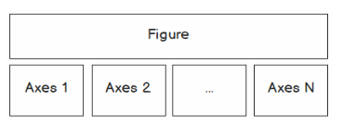
A Figure contains at least one axes object
The two main components of a plot are as follows:
Figure: The Figure is an outermost container that allows you to draw multiple plots within it. It not only holds the Axes object but also has the ability to configure the Title.
Axes: The axes are an actual plot, or subplot, depending on whether you want to plot single or multiple visualizations. Its sub-objects include the x-axis, y-axis, spines, and legends

Slide 6
Anatomy of a Matplotlib Figure
Spines: Lines connecting the axis tick marks
Title: Text label of the whole Figure object
Legend: Describes the content of the plot
Grid: Vertical and horizontal lines used as an extension of the tick marks
X/Y axis label: Text labels for the X and Y axes below the spines

Slide 7
Anatomy of a Matplotlib Figure
Minor tick: Small value indicators between the major tick marks
Minor tick label: Text label that will be displayed at the minor ticks
Major tick: Major value indicators on the spines
Major tick label: Text label that will be displayed at the major ticks
Line: Plotting type that connects data points with a line
Markers: Plotting type that plots every data point with a defined marker

Slide 8
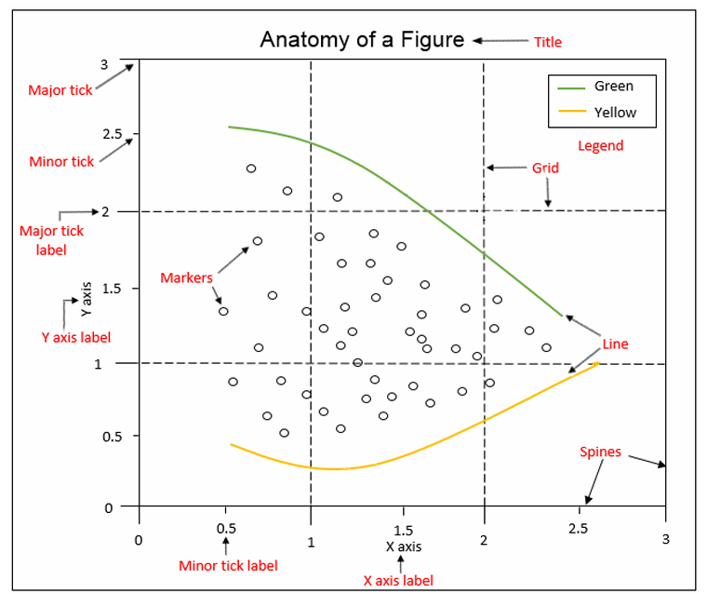

Slide 9
5.2. Pyplot Basics
Pyplot is a Matplotlib's submodule, which provides MATLAB-like plotting
Pyplot offers a simple interface for creating visualizations without manually configuring the Figure and Axes, which are automatically set up.
Use the alias plt to reference the imported submodule for convenience.
import matplotlib.pyplot as plt

Slide 10
Common operations that are performed using pyplot.

Slide 11
Creating Figures
Use plt.figure() to create a new Figure.
By default, the Figure has a width of 6.4 inches and a height of 4.8 inches with a dpi (dots per inch) of 100
To change the default values of the Figure, we can use the parameters figsize and dpi.

Slide 12
Code Snippet to change width,height and dpi
#To change the width and the height
plt.figure(figsize=(10, 5))
#To change the dpi
plt.figure(dpi=300)

Slide 13
Closing Figures
Figures that are no longer used should be closed by explicitly calling plt.close(), which also cleans up memory efficiently.
If nothing is specified, the plt.close() command will close the current Figure.
To find the number of a Figure object, we can make use of the number attribute, as follows: plt.gcf().number
plt.close('all') command is used to close all active Figures

Slide 14
Example: The following example shows how a Figure can be created and closed
#Create Figure with Figure number 10
  plt.figure(num=10)
#Close Figure with Figure number 10
  plt.close(10)

Slide 15
Format Strings
Format strings are a handy way to quickly customize colors, marker types, and line styles
A format string is specified as [color][marker][line], where each item is optional.
If the color argument is the only argument of the format string, you can use matplotlib.colors.
Matplotlib recognizes the following formats, among others:
  RGB or RGBA float tuples (for example, (0.2, 0.4, 0.3) or (0.2, 0.4, 0.3, 0.5))
  RGB or RGBA hex strings (for example, '#0F0F0F' or '#0F0F0F0F')

Slide 16
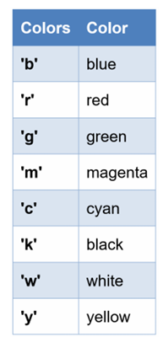
Example: Color specified in string format

Slide 17
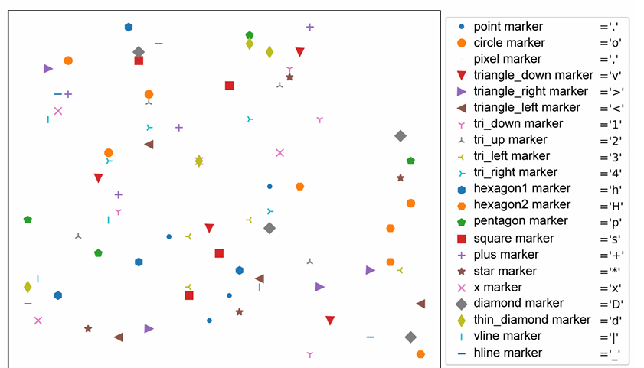
Markers in format strings

Slide 18
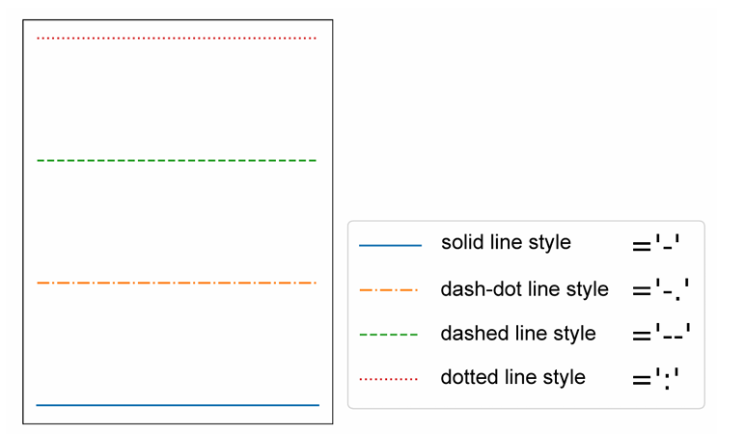
Line styles

Slide 19
Plotting
With plt.plot([x], y, [fmt]), you can plot data points as lines and/or markers.
The function returns a list of Line2D objects representing the plotted data.
By default, if you do not provide a format string (fmt), the data points will be connected with straight, solid lines.

Slide 20
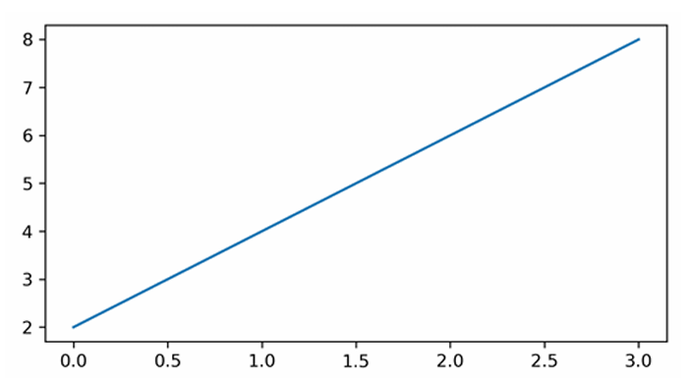
Plotting
plt.plot([0, 1, 2, 3], [2, 4, 6, 8]) produces a plot, as shown in the following diagram.
Since x is optional and the default values are [0, …, N-1], plt.plot([2, 4, 6, 8]) results in the same plot

Slide 21
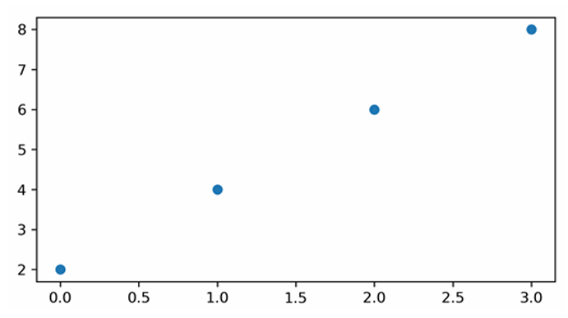
Plotting
If you want to plot markers instead of lines, you can just specify a format string with any marker type.
For example,
plt.plot([0, 1, 2, 3], [2, 4, 6, 8], 'o') displays data points as circles, as shown in the following diagram:

Slide 22
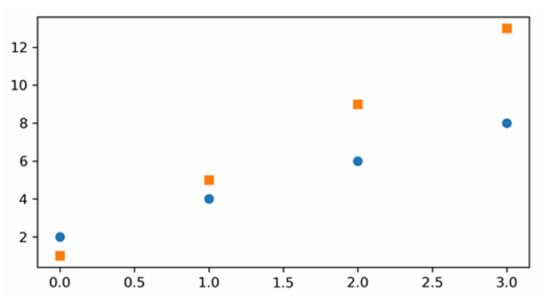
Plotting
To plot multiple data pairs, the syntax plt.plot([x], y, [fmt], [x], y2, [fmt2], …) can be used.
plt.plot([2, 4, 6, 8], 'o', [1, 5, 9, 13], 's') results in the following diagram.

Slide 23
Plotting
Any Line2D properties can be used instead of format strings to further customize the plot.
plt.plot([2, 4, 6, 8], color='blue', marker='o', linestyle='dashed', \ linewidth=2, markersize=12)

Slide 24
Plotting Using pandas DataFrames
It is pretty straightforward to use pandas.DataFrame as a data source.
Instead of providing x and y values, you can provide the pandas.DataFrame in the data parameter and give keys for x and y, as follows:
import pandas as pd
df = pd.read_csv('../../Datasets/example.csv‘)
plt.plot('x_key', 'y_key', data=df)

Slide 25
Ticks
Tick locations and labels can be set manually if Matplotlib's default isn't sufficient.
plt.xticks(ticks, [labels], [**kwargs]) sets the current tick locations and labels of the x-axis.
Parameters:
ticks: List of tick locations; if an empty list is passed, ticks will be disabled.
labels (optional): You can optionally pass a list of labels for the specified locations.
**kwargs (optional): matplotlib.text.Text() properties can be used to customize the appearance of the tick labels.
A quite useful property is rotation; this allows you to rotate the tick labels to use space more efficiently.

Slide 26
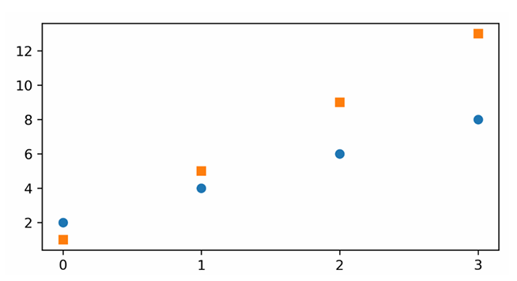
Example:
import numpy as np
plt.figure(figsize=(6, 3))
plt.plot([2, 4, 6, 8], 'o', [1, 5, 9, 13], 's')
plt.xticks(ticks=np.arange(4))

Slide 27
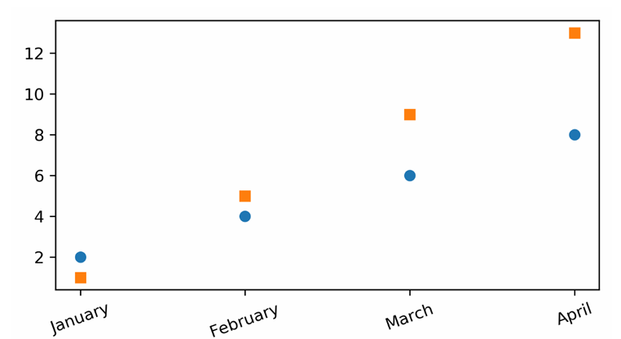
It's also possible to specify tick labels, as follows:
plt.figure(figsize=(6, 3))
plt.plot([2, 4, 6, 8], 'o', [1, 5, 9, 13], 's')
plt.xticks(ticks=np.arange(4), \ labels=['January', 'February', 'March', 'April'], \ rotation=20)

Slide 28
Displaying Figures
plt.show() is used to display a Figure or multiple Figures.
To display Figures within a Jupyter Notebook, simply set the %matplotlib inline command at the beginning of the code

Slide 29
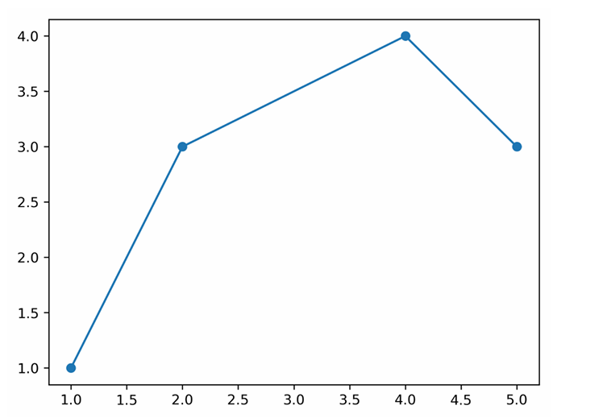
Saving Figures
The plt.savefig(fname) saves the current Figure
Example :
plt.figure()
plt.plot([1, 2, 4, 5], [1, 3, 4, 3], '-o')
#bbox_inches='tight' removes the outer white margins plt.savefig('lineplot.png', dpi=300, bbox_inches='tight')

Slide 30
Syllabus: A Deep Dive into Matplotlib
Introduction,Overview of Plots in Matplotlib,
Pyplot Basics: Creating Figures, Closing Figures, Format Strings, Plotting, Plotting Using pandas DataFrames, Displaying Figures, Saving Figures;
Basic Text and Legend Functions: Labels, Titles, Text, Annotations, Legends;
Basic Plots: Bar Chart, Pie Chart, Stacked Bar Chart, Stacked Area Chart, Histogram, Box Plot, Scatter Plot, Bubble Plot;
Layouts: Subplots, Tight Layout, Radar Charts, GridSpec;
Images: Basic Image Operations, Writing Mathematical Expressions

Slide 31
Basic Text and Legend Functions
All of the functions we discuss in this topic, create and return a matplotlib.text.Text() instance.
Note :
https://github.com/PacktWorkshops/The-Data-Visualization-Workshop/

Slide 32
Labels
Matplotlib provides a few label functions that we can use for setting labels to the x- and y-axes.
The plt.xlabel() and plt.ylabel() functions are used to set the label for the current axes.
The set_xlabel() and set_ylabel() functions are used to set the label for specified axes.
ax.set_xlabel('X Label')
ax.set_ylabel('Y Label')

Slide 33
Titles
A title describes a particular chart/graph. The titles are placed above the axes in the center, left edge, or right edge.
There are two options for titles – you can either set the Figure title or the title of an Axes.
The suptitle() function sets the title for the current and specified Figure.
The title() function helps in setting the title for the current and specified axes.

Slide 34
Example:
fig = plt.figure()
fig.suptitle('Suptitle', fontsize=10, fontweight='bold')
This creates a bold Figure title with a text subtitle and a font size of 10:
plt.title('Title', fontsize=16)
The plt.title function will add a title to the Figure with text as Title and font size of 16 in this case.

Slide 35
Text
There are two options for text – you can either add text to a Figure or text to an Axes.
The figtext(x, y, text) and text(x, y, text) functions add text at locations x or y for a Figure.
Example:
ax.text(4, 6, 'Text in Data Coords', bbox={'facecolor': 'yellow', 'alpha':0.5, 'pad':10})
This creates a yellow text box with the text Text in Data Coords.

Slide 36
Annotations
In annotations, there are two locations to consider:
the annotated location, xy, and
the location of the annotation, text xytext.
It is useful to specify the parameter arrowprops, which results in an arrow pointing to the annotated location.

Slide 37
Example:
ax.annotate('Example of Annotate', xy=(4,2), xytext=(8,4), arrowprops=dict(facecolor='green', shrink=0.05))
This creates a green arrow pointing to the data coordinates (4, 2) with the text Example of Annotate at data coordinates (8, 4):

Slide 38
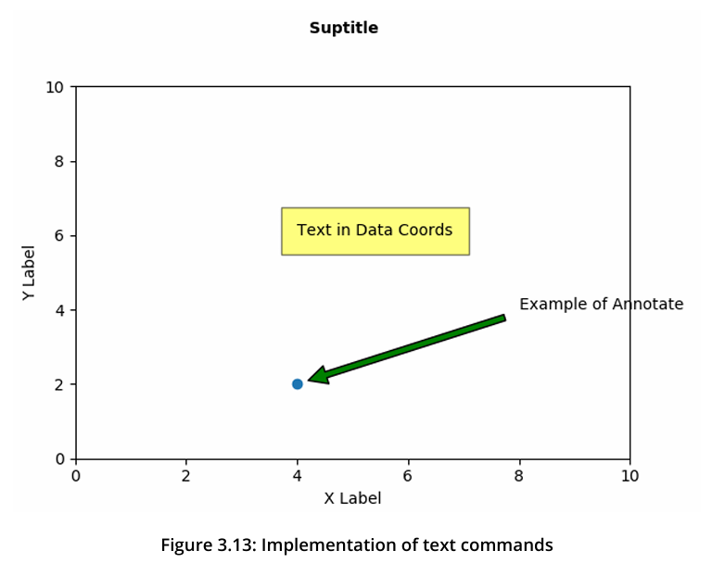

Slide 39
Legends
Legend describes the content of the plot. To add a legend to your Axes, we have to specify the label parameter at the time of plot creation.
Calling plt.legend() for the current Axes or Axes.legend() for a specific Axes will add the legend.
The loc parameter specifies the location of the legend.

Slide 40
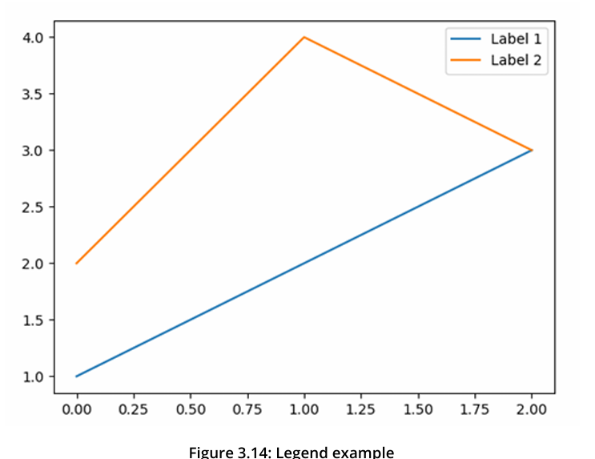
Example:
plt.plot([1, 2, 3], label='Label 1')
plt.plot([2, 4, 3], label='Label 2')
plt.legend()

