Slide 1
Module 3

Slide 2
Module 3 Syllabus
Extracting Meaning from Data:
  Feature Generation and Feature Selection ,
  Motivating application: user (customer) retention.
  Feature Generation (brainstorming, role of domain expertise, and place for imagination), Feature Selection algorithms.
  Filters; Wrappers; Decision Trees; Random Forests.
Recommendation Systems:
  Building a User-Facing Data Product,
  Algorithmic ingredients of a Recommendation Engine,
  Dimensionality Reduction, Singular Value Decomposition,
  Principal Component Analysis,
  Exercise: build your own recommendation system.

Slide 3
Kaggle Data Science Competition https://www.kaggle.com/competitions
What is Kaggle?
  Kaggle is a platform for data science competitions.
  Hosts challenges for data scientists and machine learning practitioners globally.
  Provides a community for collaboration and learning.
Purpose of Competitions:
  Solve real-world data problems.
  Advance data science and machine learning fields.
  Provide learning and networking opportunities.

Slide 4
Structure and Types of Kaggle Competitions
Competition Structure:
  Problem Statement: Detailed description of the challenge.
  Datasets: Training set (with targets) and test set (without targets).
  Evaluation Metric: Criteria for judging model performance (e.g., accuracy, MSE).
  Submissions: Multiple model submissions allowed.
  Leaderboard: Ranks participants based on their scores.
Types of Competitions:
  Featured Competitions: Sponsored by companies, with cash prizes.
  Research Competitions: Focused on academic research.
  Community Competitions: Created by the Kaggle community for learning.

Slide 5
Benefits of Participating in Kaggle Competitions
1. Skill Development:
  Hands-on experience with real-world data problems.
  Learn data cleaning, feature engineering, and model evaluation.
2. Networking:
  Connect with a global community of data scientists.
  Collaborate and share insights on Kaggle forums.
3. Exposure:
  Gain visibility in the data science community.
  Attract job offers and consulting opportunities.
4. Crowdsourcing Solutions:
  Companies can crowdsource innovative solutions.
  Access diverse talent and ideas.

Slide 6
Example Competition: Titanic: Machine Learning from Disaster
One of the most famous and beginner-friendly competitions on Kaggle is the "Titanic: Machine Learning from Disaster" competition. In this competition, participants are challenged to build a predictive model that determines whether a passenger on the Titanic survived or perished based on features such as age, gender, and class.
Training Data: Includes information about each passenger and whether they survived.
Test Data: Includes similar information but without the survival outcome, which participants must predict.
Evaluation Metric: Accuracy, which is the percentage of correct predictions out of the total predictions made.
This competition serves as an excellent starting point for those new to data science, allowing them to learn about data cleaning, feature engineering, and model evaluation in a hands-on way.

Slide 7
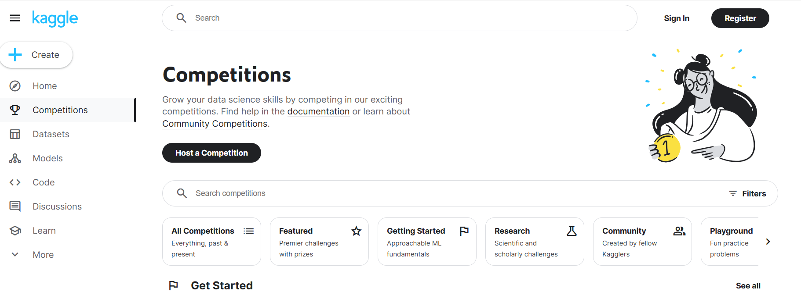

Slide 8
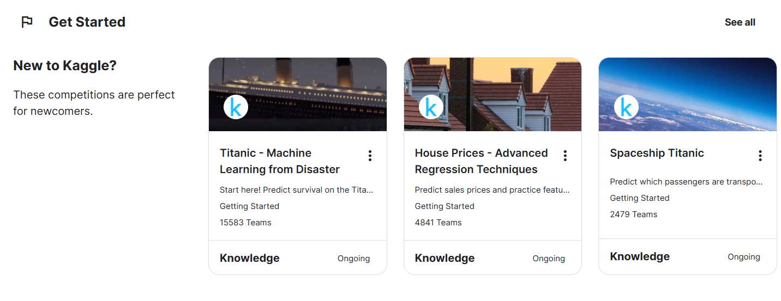

Slide 9
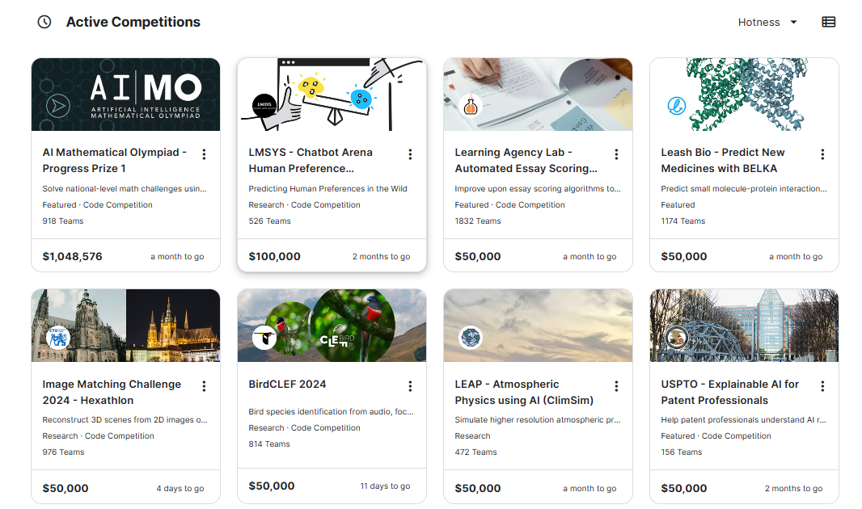

Slide 10
Titanic - Machine Learning from Disaster | Kaggle
https://www.kaggle.com/competitions/titanic

Slide 11

PhD, Biomedical Engineering - Rutgers University
BA, Physics - Cornell University
William Cukierski is a prominent figure in the data science community, known for his significant contributions at Kaggle.
Kaggle is a platform renowned for its data science competitions, where data scientists and machine learning practitioners come together to solve complex data problems.
Cukierski has played a pivotal role in shaping Kaggle’s approach to crowdsourcing solutions for data science challenges

Slide 12
Background and Role:
Cukierski holds a Ph.D. in biomedical engineering and has extensive experience in machine learning and data science.
At Kaggle, he has been instrumental in designing and managing competitions that help companies leverage the collective intelligence of the global data science community to tackle their toughest data challenges.

Slide 13
Contributions:
His work involves ensuring that data problems are well-posed and that the competition structure allows for iterative improvement and innovation.
Through these competitions, Cukierski has helped foster a collaborative environment where data scientists can test their skills, share insights, and contribute to solving real-world problems.

Slide 14

David Huffaker:
David Huffaker is a distinguished researcher and data scientist at Google, specializing in social research and data analysis.
Google, as a tech giant, relies heavily on data-driven insights to refine its products and services, and Huffaker’s work is central to these efforts.

Slide 15
Background and Role:
Huffaker has a background in communication and technology, with a focus on understanding user behavior and social interactions through data.
At Google, he combines qualitative and quantitative research methods to extract meaningful insights from data, helping to inform product development and user experience strategies.

Slide 16
Contributions:
Huffaker is known for his hybrid approach to data analysis, which integrates large-scale data analytics with qualitative insights.
This approach provides a more comprehensive understanding of user behavior, enabling Google to create products that better meet user needs and expectations.
He also emphasizes the importance of ethical considerations and privacy in data handling, ensuring that user data is used responsibly and transparently.

Slide 17
Extracting Meaning from Data
Extracting meaning from data involves interpreting raw data to gain insights, identify patterns, and make informed decisions.
This process is fundamental in data science and can be achieved through various methodologies, including statistical analysis, machine learning, and data visualization.

Slide 18
Insights
Insights are deep understandings derived from analyzing data, which can lead to actionable conclusions. These insights often reveal underlying trends, behaviors, or issues that were not immediately apparent.

Slide 19
Example 1: Customer Behavior in Retail
Data: Sales transactions, customer demographics, and purchase history.
Insight: Analysis reveals that customers aged 25-34 are significantly more likely to purchase eco-friendly products compared to other age groups.
Action: The retailer can increase marketing efforts and product offerings targeted at this demographic to boost sales of eco-friendly products.

Slide 20
Example 2: Website Performance
Data: Web traffic, user engagement metrics, and conversion rates.
Insight: A high bounce rate on a specific landing page suggests that visitors are not finding what they expect.
Action: Revise the content and layout of the landing page to better align with user expectations and improve engagement.

Slide 21
Patterns
Patterns are recurring themes or structures in data that can be identified through statistical analysis or data mining techniques.
Recognizing patterns can help in predicting future events or behaviors.

Slide 22
Example 1: Seasonal Sales Patterns
Data: Monthly sales data over several years.
Pattern: There is a consistent spike in sales every December, followed by a dip in January.
Action: Prepare for increased inventory and marketing campaigns in November and December to capitalize on the holiday season, and plan promotions or discounts to boost sales in January.

Slide 23
Example 2: Customer Churn in Subscription Services
Data: User activity logs, subscription renewal rates, and customer service interactions.
Pattern: Customers who have not used the service in the last two weeks and have contacted customer service with complaints are more likely to churn.
Action: Implement a proactive outreach program to re-engage these at-risk customers and address their issues before they decide to cancel their subscriptions.

Slide 24
Combining Insights and Patterns
Combining insights and patterns can provide a more comprehensive understanding of data, leading to more effective strategies and decisions.

Slide 25
Example: Health Care Analytics
Data: Patient records, treatment outcomes, and demographic information.
Insight: Patients with chronic conditions who engage in regular follow-up visits have better health outcomes.
Pattern: A pattern is observed that patients tend to miss follow-up visits during certain times of the year (e.g., holiday seasons).
Action: Develop a targeted communication and support program to remind patients of follow-up visits, especially during the identified periods when they are more likely to miss appointments.

Slide 26
How do companies extract meaning from the data they have?
Feature Extraction and Feature Selection
Decision Trees
Bagging and Random Forests
Combining Qualitative and Quantitative Research
User Retention Analysis

Slide 27
1. Feature Extraction and Feature Selection:
Feature Extraction: This involves transforming raw data into a more usable format.
For example, instead of feeding raw data directly into an algorithm, which could lead to the "garbage in, garbage out" problem, companies carefully curate the data. This process ensures that the data is clean and relevant
Feature Selection: This process involves choosing a subset of the data to use as predictors or variables in models and algorithms. It helps in constructing a meaningful dataset by eliminating redundant or less informative variables.
For instance, transforming a continuous variable into a binary variable can be a form of feature selection that simplifies the model without losing essential information

Slide 28
2.Decision Trees:
Companies use decision trees to identify patterns and make predictions based on the data.
For example, a decision tree might reveal that the likelihood of a user returning to an app next month is higher if they play a certain number of times in the current month.
This insight can help companies strategize user retention efforts.

Slide 29
3.Bagging and Random Forests
Bagging, or bootstrap aggregating, helps in reducing variance in predictions by averaging the results of multiple models.
Random forests, which are an extension of bagging, further enhance this by incorporating multiple decision trees to improve predictive accuracy and handle idiosyncratic noise in the data

Slide 30
4.Combining Qualitative and Quantitative Research:
A hybrid approach that combines both qualitative insights and quantitative data helps in deriving more nuanced understandings.
For instance, qualitative research might identify user behavior patterns on a small scale, which can then be validated and expanded using large-scale quantitative data.
This approach ensures that the insights are both statistically significant and contextually rich​.

Slide 31
5.User Retention Analysis
By building models that predict user behavior, such as whether a user will continue using an app, companies can tailor their strategies to enhance user retention.
For example, a model might suggest that showing ads within the first five minutes decreases retention rates, guiding companies to adjust their advertising strategies accordingly​.

Slide 32
Perspectives of William Cukierski from Kaggle and David Huffaker from Google
From the perspectives of William Cukierski from Kaggle and David Huffaker from Google, companies extract meaning from the data they have through distinct methodologies and approaches

Slide 33
William Cukierski's Perspective (Kaggle)
William Cukierski emphasizes the importance of feature extraction and feature selection in data science. He outlines the following processes:
Feature Extraction: Transforming raw data into a curated format to avoid the "garbage in, garbage out" problem. This process ensures that the data fed into algorithms is clean and relevant.
Feature Selection: Constructing a subset of data or functions of data to be predictors or variables for models and algorithms. This helps in reducing redundancy and focusing on the most informative variables.
Kaggle Competitions: Kaggle hosts competitions that crowdsource solutions from data scientists worldwide. Participants are given training sets and test sets where they apply their models to make predictions. The competitions foster a "leapfrogging" effect, encouraging iterative improvement and innovation in model building.
Crowdsourcing: Leveraging the collective intelligence of the global data science community to solve complex data problems for businesses. This approach allows companies to tap into a diverse pool of talent and ideas, leading to more robust and creative solutions.

Slide 34
David Huffaker's Perspective (Google)
David Huffaker from Google takes a hybrid approach to social research, combining qualitative insights with quantitative data. His key points include:
Descriptive to Predictive Analysis: Moving from simply describing data to predicting future trends and behaviors. This involves building models that can forecast outcomes based on historical data.
Combining Qualitative and Quantitative Research: Integrating qualitative research, such as user interviews and ethnographic studies, with large-scale quantitative data analysis. This hybrid approach provides a more comprehensive understanding of user behavior and social trends.
User Retention Models: Developing models that predict user retention based on various factors, such as user activity and engagement patterns. These models help in strategizing to improve user retention and satisfaction​
Ethical Considerations: Addressing privacy concerns and ensuring ethical use of data. Huffaker emphasizes the importance of transparency and user control over their data to build trust and mitigate privacy risks.

Slide 35
Kaggle Model
Competition
  Leapfrogging (Economic/Technological/Innovation) Visualization
  Score Tracking
  Submission Timeline
  Team Identification
  Encouraging Partition
Kaggle Customers

Slide 36
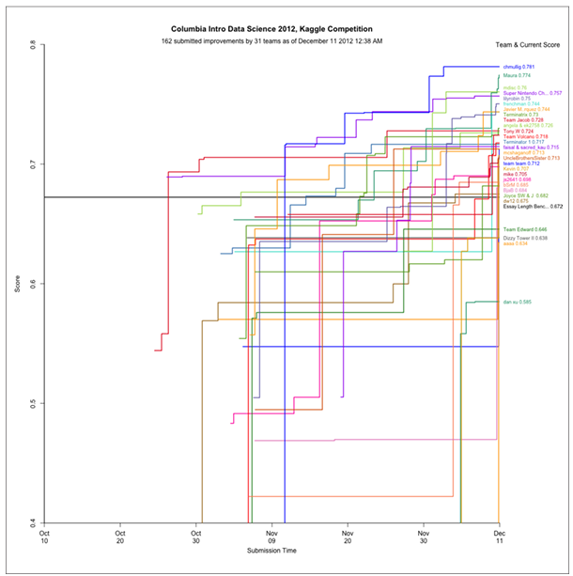

Slide 37
Ethical concerns of Kaggle Model
Existing employees might be displaced if external solutions outperform internal models.
Competitors might feel exploited as they work for minimal rewards, mainly benefiting for-profit companies.
Kaggle charges hosting fees and offers prizes
Data scientists can choose to participate or not.

Slide 38
Kaggle’s Essay Scoring Competition
The competition involved five essay sets, with essays averaging 150 to 550 words.
Written by students in grades 7 to 10, all essays were double-scored by human graders.
The dataset tested the scoring engine's capabilities with the following columns:
  id: Unique identifier for each essay set
  1-5: Essay set identifier
  essay: ASCII text of the student's response
  rater1: Grade from the first rater
  rater2: Grade from the second rater
  grade: Resolved score between the two raters

Slide 39
Crowd Sourcing
Crowdsourcing is the process of obtaining work, information, or opinions from a large group of people, typically via the Internet, social media, or smartphone apps.
It involves collecting services, ideas, or content through the contributions of a dispersed group of participants, which can range from volunteers to paid contributors.
Two types of Crowdsourcing :
  Distributive Crowdsourcing:
  Singular, Focused Crowdsourcing:

Slide 40
1.Distributive Crowdsourcing
Example: Wikipedia.
Involves large-scale, simplistic contributions.
Open to anyone to contribute with volunteer-based regulation and quality control.

Slide 41
2. Singular, Focused Crowdsourcing:
Examples: Kaggle, DARPA, InnoCentive.
Involves solving complex problems by skilled individuals.
Offers cash prizes and community recognition.

Slide 42
Domain Expertise Versus Machine Learning Algorithms
Both are needed to solve data science problems:
Information Quality
Algorithmic Advantage
Role of Experts
Black Box Approach

Slide 43
What are Features in Data Set?
Features in a dataset are individual measurable properties or characteristics of a phenomenon being observed.
Each feature corresponds to a column in a data set, where each row represents an observation or record
In the context of machine learning and data science, features are used as input variables to models.
They represent the data points that help in predicting outcomes or understanding patterns within the dataset.
Examples: Common examples include variables like height, weight, temperature, and volume

Slide 44
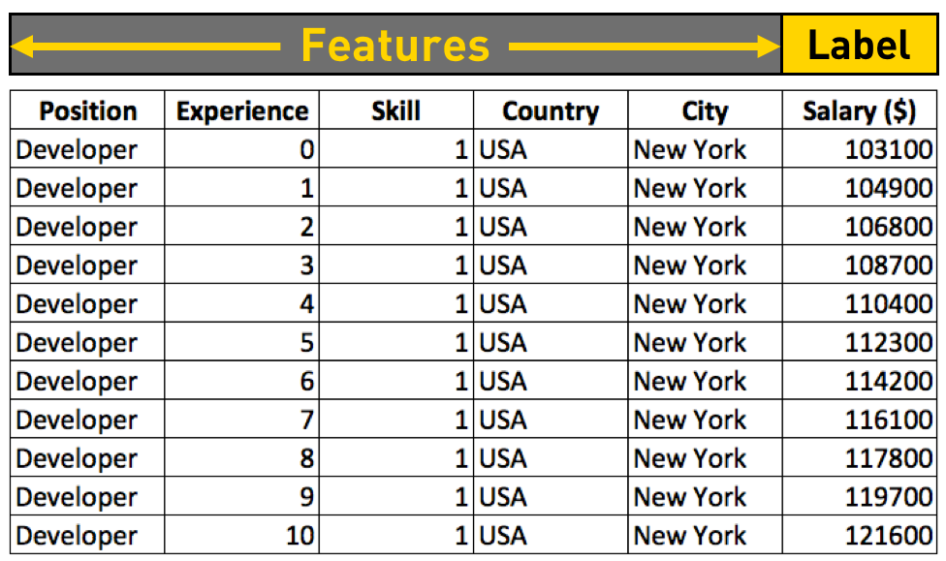

Slide 45
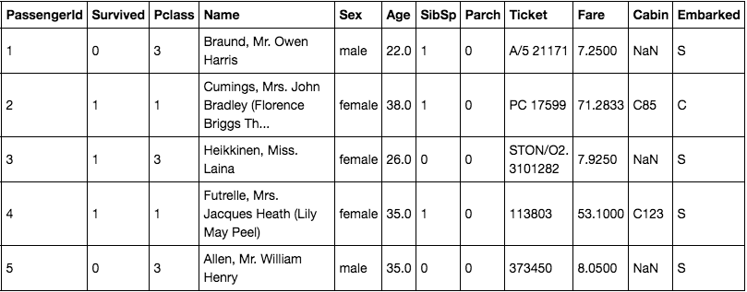
Sample Titanic-dataset

Slide 46
The attributes have the following meaning:
Survived - that's the target, 0 means the passenger did not survive, while 1 means he/she survived.
Pclass - passenger class.
Name, Sex, Age - self-explanatory
SibSp - how many siblings & spouses of the passenger aboard the Titanic.
Parch - how many children & parents of the passenger aboard the Titanic.
Ticket - ticket id
Fare - the price paid (in pounds)
Cabin - passenger's cabin number
Embarked - where the passenger embarked the Titanic

Slide 47
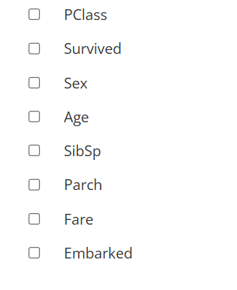
You can ignore name, id and ticket# columns because these are just identifiers and don't offer value as a feature.

Slide 48
Definition of Features
A feature is an attribute or variable that provides meaningful information about the data.
For instance, in a data set about passengers on the Titanic, features might include
  Name: The passenger's name.
  Age: The passenger's age in years.
  Sex: The passenger's gender (e.g., Male, Female).
  Fare: The amount of money paid for the ticket

Slide 49
Types of Features
Features can be
Numerical (e.g., Age, Fare),
Categorical (e.g., Sex, Class),
Ordinal (e.g., Customer satisfaction levels), or
Binary (e.g., Yes/No responses)

Slide 50
Importance of Features in Data Sets
Identifying and understanding the right features in a data set is crucial for effective data analysis and achieving accurate results in predictive modeling.

Slide 51
Feature Selection
Feature selection is a crucial step in the process of building effective predictive models in data science and machine learning.
It involves identifying and selecting a subset of relevant features (or variables) from the total available data to be used in model building.

Slide 52
Why Feature Selection is Important
Reducing Overfitting: By removing irrelevant or redundant features, the model becomes less complex and generalizes better to new data.
Improving Performance: Fewer features mean less computational power is required, leading to faster model training and prediction.
Enhanced Interpretability: Models with fewer features are easier to understand and interpret.

Slide 53
Techniques for Feature Selection
Filters
Wrappers
Embedded
Hybrid

Slide 54
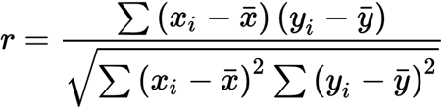
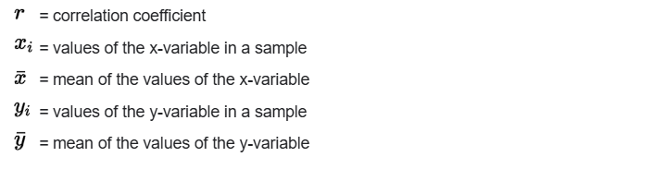
1. Filter Methods
These methods evaluate the relevance of each feature independently of the learning algorithm.
Example: Using the Pearson correlation coefficient to remove features that have low correlation with the target variable

Slide 55
2. Wrapper Methods
These methods use a predictive model to evaluate combinations of features and select the best subset.
Example: Recursive Feature Elimination (RFE), which recursively removes the least important features based on the model's performance

Slide 56
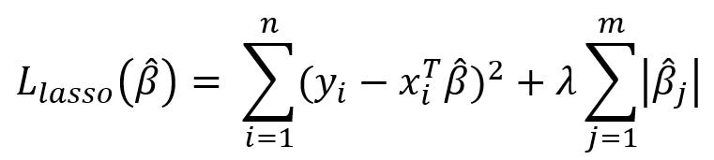
3. Embedded Methods
These methods perform feature selection during the model training process.
Example: LASSO (Least Absolute Shrinkage and Selection Operator) regression, which adds a penalty equal to the absolute value of the magnitude of coefficients, effectively shrinking some coefficients to zero and selecting features.

Slide 57
4. Hybrid Methods
These methods combine both filter and wrapper methods to leverage the advantages of both.
Example: Using a filter method to initially reduce the number of features, followed by a wrapper method to fine-tune the selection

Slide 58
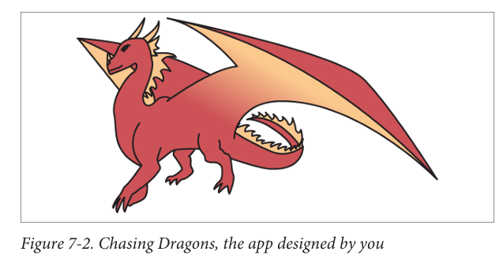
Examples of Feature Selection in Practice: Chasing Dragons App
Imagine you have developed an app called "Chasing Dragons," where users pay a monthly subscription fee.
Your goal is to predict whether a new user will return after the first month based on their initial month’s behavior.
This prediction can help in user retention strategies.

Slide 59
Here’s how you might approach feature selection for this problem
Data Collection: Record every user action with timestamps during their first 30 days.
Feature Generation: Brainstorm possible features that might influence user retention.

Slide 60
Example Features:
Number of days the user visited in the first month.
Time until the second visit.
Points scored each day (30 separate features).
Total points in the first month.
Whether the user filled out their profile (binary feature).
User demographics such as age and gender.
Device characteristics like screen size.
Use your imagination and come up with as many features as possible. Notice there are redundancies and correlations between these features; that’s OK.

Slide 61

Approach
One can use logistic regression for predicting if a user will return to play Chasing Dragons next month.
You could choose a different timeframe, like a week or two months; the exact period doesn't matter right now.
The goal is to get a working model first, then refine it.
Your logistic regression model should look like this:

Slide 62
Feature Selection Methods:
Filters: Use statistical methods to assess the relevance of each feature independently of the model. For example, you might use correlation coefficients to identify highly correlated features.
Wrappers: Evaluate subsets of features by training models and selecting the subset that performs best according to a chosen metric (e.g., accuracy, AUC).
Embedded Methods: Perform feature selection as part of the model training process. For example, regularization methods like Lasso (L1 regularization) can shrink some feature coefficients to zero, effectively performing feature selection.

Slide 63
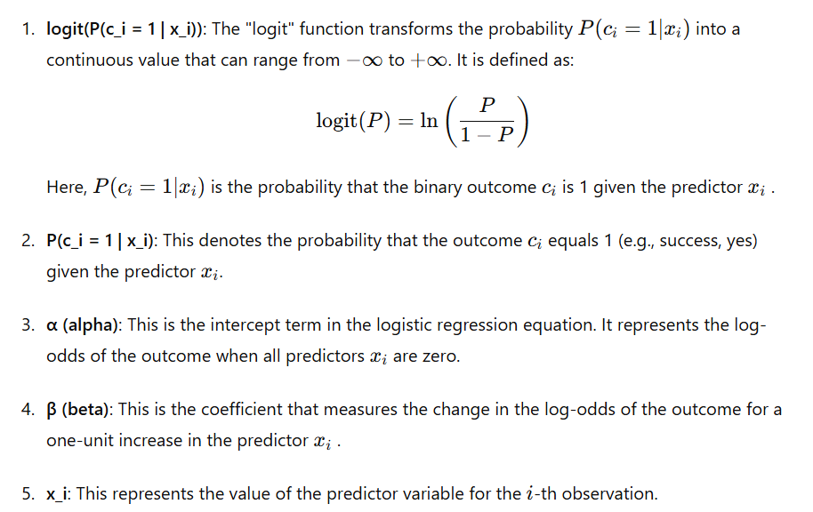

Slide 64
Selecting an algorithm
Let's talk about stepwise regression, a technique used to pick features for a model. It adds or removes features based on certain rules. There are three main methods:
Forward Selection: Start with no features and add them one by one.
Backward Elimination: Start with all features and remove them one by one.
Combined Approach: Use a mix of adding and removing features.

Slide 65
Selection Criterion
As a data scientist, you have several ways to choose the best model. Here are a few common criteria:
R-squared : Measures how well the model explains the variability of the data. The higher the R-squared, the better.
P-values : Used in regression to determine the significance of each coefficient. A low p-value indicates that the coefficient is likely not zero, meaning it's significant.
AIC (Akaike Information Criterion): Calculated as 2k−2ln⁡(L), where k is the number of parameters and L is the likelihood. Lower AIC values indicate a better model.

Slide 66
Selection Criterion
BIC (Bayesian Information Criterion)
Calculated as kln⁡(n)−2ln⁡(L), where k is the number of parameters, n is the number of observations, and L is the likelihood. Lower BIC values indicate a better model.
Entropy : Measures the randomness or unpredictability in the data. Lower entropy values generally indicate a better model.

Slide 67
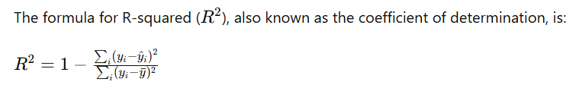
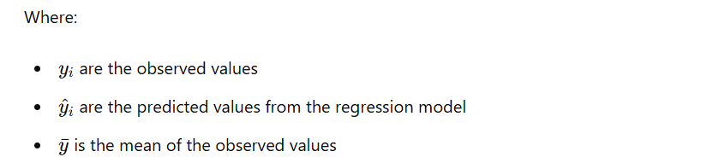
R- Square Formula

Slide 68
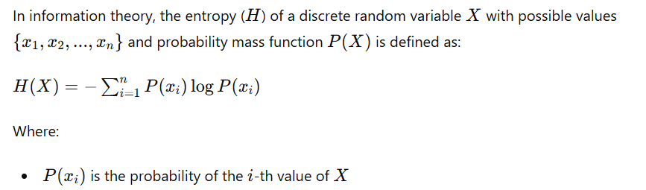
Entropy Formula

Slide 69
Embedded Methods: Decision Trees
A decision tree is a machine learning algorithm used for predictive modeling and decision-making.
It represents a series of decisions or conditions in a tree-like structure,
where each internal node represents a feature or attribute,
each branch represents a decision rule, and
each leaf node represents a prediction or decision outcome

Slide 70
The main components of a decision tree are
Root Node: The topmost node in the tree, representing the initial decision or condition.
Internal Nodes: Nodes that represent features or attributes used for splitting the data.
Branches: Edges connecting nodes, representing the possible outcomes or values of the parent node.
Leaf Nodes: Terminal nodes that represent the final prediction or decision outcome.

Slide 71
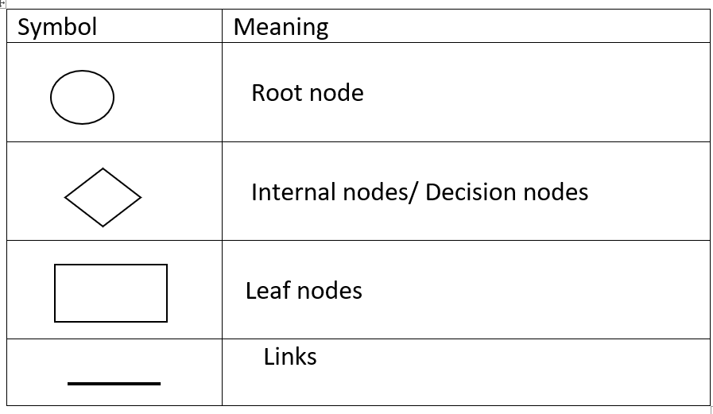
Decision Tree Symbols

Slide 72
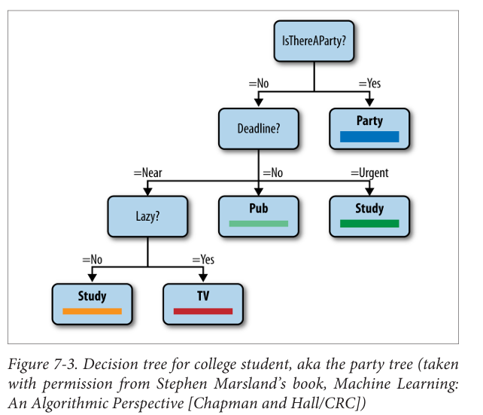
Example1

Slide 73
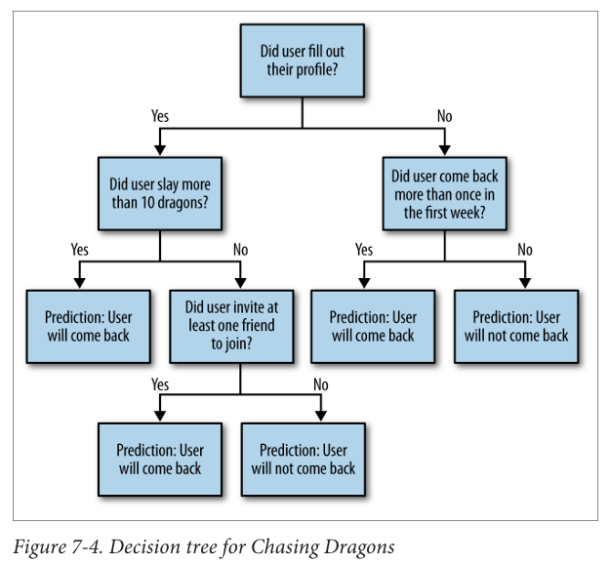
Example2

Slide 74

Entropy
Entropy is a concept borrowed from information theory, which measures the amount of uncertainty or disorder in a system.
In the context of decision trees and machine learning, entropy helps quantify how mixed or impure a set of data is.
For a dataset DDD with k classes, the entropy H(D) is calculated as:
  H(D) is the entropy of the dataset D.
  k is the number of different classes in the dataset.
  pi is the proportion/ probabilty of instances in the dataset that belong to class i.

Slide 75
Entropy
Mathematically, entropy H(X) for a random variable X with two possible outcomes (e.g., X=0 or X=1) is defined as:
H(X) = −p(X=1)*log₂​p(X=1) − p(X=0)*log₂​p(X=0)
Where:
  p(X=1) is the probability of X being 1.
  p(X=0) is the probability of X being 0.

Slide 76
Key properties of entropy:
Entropy is zero when an outcome is certain. For example, if p(X=1)=1 or p(X=0)=1, the entropy is 0, indicating no uncertainty.
Entropy is maximized when the outcomes are equally likely. When p(X=1)=p(X=0)=0.5, the entropy is at its maximum, which is 1 bit. This represents maximum uncertainty or disorder.

Slide 77
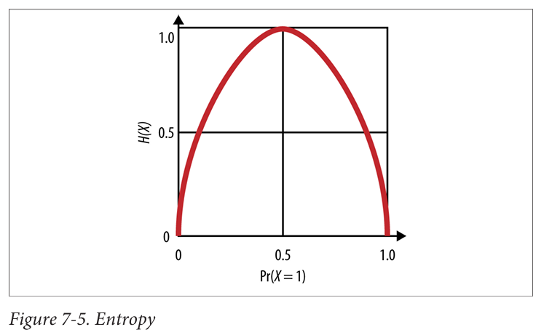
Key properties of entropy:

Slide 78
Information Gain
Information Gain (IG) is used to determine which attribute in a dataset provides the most information about the target variable. It helps in building decision trees by indicating which feature to split on.
Information Gain for a given attribute a, denoted as IG(X,a), is calculated as:
IG(X,a)=H(X)−H(X∣a)
Where:
H(X) is the entropy of the target variable X.
H(X∣a) is the conditional entropy of X given the attribute a.

Slide 79
To compute H(X∣a):
Calculate the conditional entropy for each possible value a_{i}​ of attribute a:
H(X∣a=a_{i})=−p(X=1∣a=a_{i})log₂p(X=1∣a=a_{i})−p(X=0∣a=a_{i})log₂p(X=0∣a=a_{i})
Aggregate these conditional entropies weighted by the probability of each a_{i}​:
H(X∣a)=∑_{ai}p(a=a_{i})⋅H(X∣a=a_{i})

Slide 80
General Algorithm for Decision Trees
Start: Begin with the entire dataset.
Calculate Entropy: Compute the entropy for the target attribute.
Compute Information Gain: For each attribute, compute the information gain.
Select Attribute: Choose the attribute with the highest information gain and place it at the root of the tree
Split Data: Divide the dataset based on the chosen attribute.
Recurse: Repeat the steps 4 and 5 for each subset until we end up with leaf nodes in all branches of tree
Stop: Stop when all instances in a subset belong to the same class or when there are no more attributes to split/entropy becomes zero.
Prune: Optionally, prune the tree to prevent overfitting.

Slide 81
Decision Tree Induction Algorithms
There are many decision tree algorithms such as ID3, C4.5, CART, CHAID, QUEST, GUIDE, CRUISE and CTREE that are used for classification in real time environment . The most commonly used decision tree algorithms are ID3 (Iterative Dichotomizer 3)
ID3 (Iterative Dichotomizer 3): Developed by J R Quinlan in 1986, Makes use of Information Gain as a splitting criteria, univariate decision trees which consider only one feature /attribute to split at each decision node.
C4.5 : Advanced form of ID3 Developed by J R Quinlan in 1993, Makes use for Gain Ratio as the splitting criterion, it is also univariate decision trees.
CART (Classification and regression Trees):Used for Classifying both categorical and continuous valued target variables. It uses GINI Index to construct a decision tree, and is a multivariate decision trees which consider a conjunction of univariate splits.

Slide 82
ID3 Algorithm
Compute Entropy_Info for the whole training data set based on the target attribute
Compute Entropy_Info and Information_Gain for each of the attribute in the training data set
Choose the attribute for which entropy is minimum and therefore the gain is maximum as the best split attribute.
The best split attribute is placed as the root node
The root node is branched into subtrees with each subtree as an outcome of the test condition of the root node attribute. Accordingly, the training data set is also split into subsets
Recursively apply the same operation for the subset of the training dataset with the remaining attributes until a leaf node is derived or no more training instances are available in the subset.
Note : We Stop branching a node if entropy is 0. The best attribute at every iteration is the attribute with the highest information gain.

Slide 83
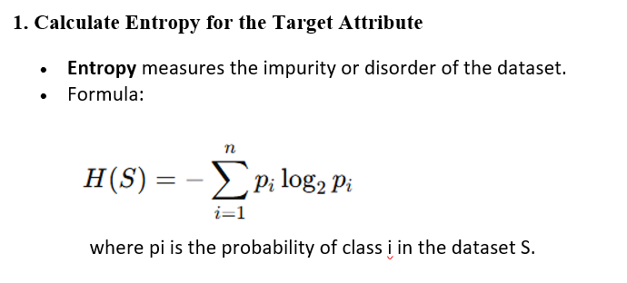
Decision Tree Algorithm (ID3) – Step1

Slide 84
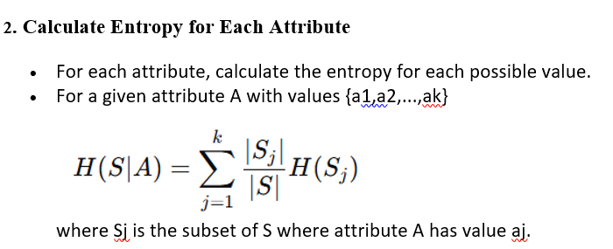
Decision Tree Algorithm (ID3) – Step2

Slide 85
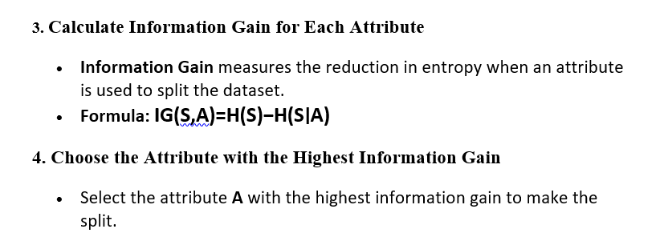
Decision Tree Algorithm (ID3) – Step3,Step4

Slide 86
Decision Tree Algorithm (ID3) – Step5,Step6
5. Split the Dataset
Divide the dataset S into subsets Sj​ based on the chosen attribute A's values {a1,a2,...,ak}.
6. Repeat for Each Subset
For each subset Sj, repeat the process:
  If Sj​ is pure (all instances belong to the same class), make it a leaf node.
  If Sj​ is empty, assign the majority class of S.
  Otherwise, remove the chosen attribute from the list of attributes and go back to Step 1 with Sj​.

Slide 87
Decision Tree Algorithm (ID3) – Step7
To avoid overfitting, you can prune the tree by removing branches that have little importance. This is usually done by setting a maximum depth or by using cross-validation.

Slide 88
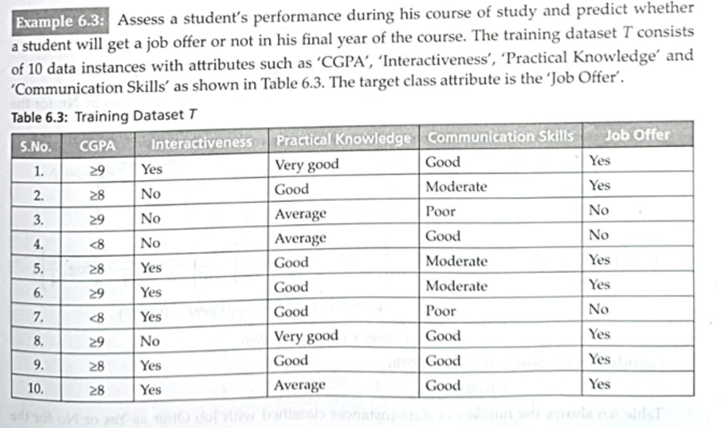

Slide 89
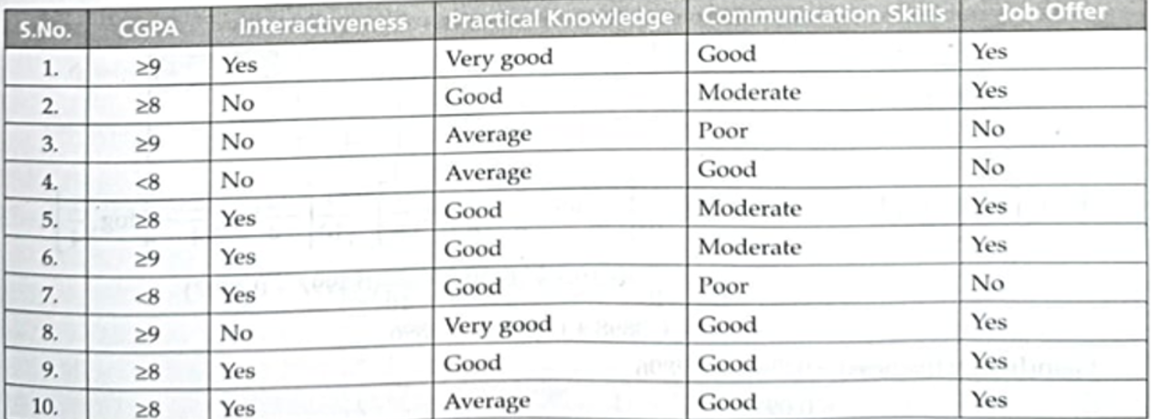
Summary of the Example
Step1: Entropy_Info(Target_attribute = JoBOffer) =
  Entropy_Info(T) = Entropy_Info(7,3) = 0.8807
Step2:
Iteration1:
  Gain(CGPA) = Entropy_Info(T) - Entropy_Info(T,CGPA)
  = 0.8807 – 0.3243 = 0.5564
  Gain(Interactiveness) = Entropy_Info(T) - Entropy_Info(T, Interactiveness)
  = 0.8807 – 0.7896 = 0.0911
  Gain (Practical Knowledge) = Entropy_Info(T) - Entropy_Info(T, Practical Knowledge)
  =0.8807 – 0.6361 = 0.2446
  Gain( Communication skills) = Entropy_Info(T) - Entropy_Info(T, Communication Skills)
  = 0.8807 – 0.36096 = 0.51974

Slide 90
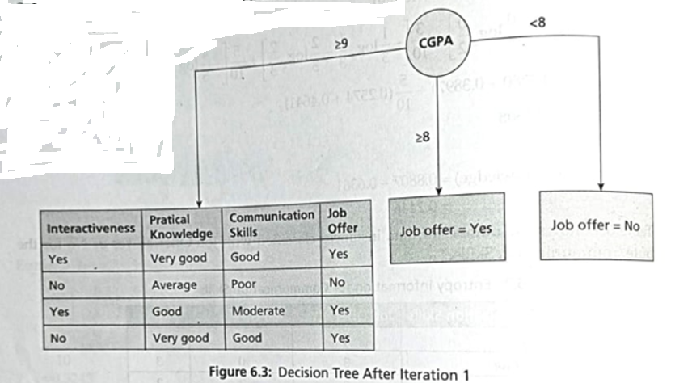
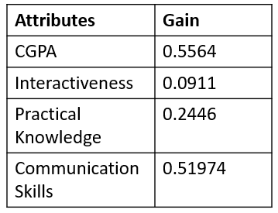
Step3:Choose the best attribute i.e. CGPA and draw the decision tree as follows:

Slide 91
Now, Continue the same process for the subset of data instances branched with CGPA ≥ 9

Slide 92
Iteration2:
Entropy_Info(Target_attribute = JoBOffer) = Entropy_Info(T)
= Entropy_Info(3,1) = 0.8108
  Gain(Interactiveness) = Entropy_Info(T) - Entropy_Info(T, Interactiveness)
  = 0.8108 – 0.4997 = 0.3111
  Gain (Practical Knowledge) = Entropy_Info(T) - Entropy_Info(T, Practical Knowledge)
  = 0.8108 – 0 = 0.8108
  Gain( Communication skills) = Entropy_Info(T) - Entropy_Info(T, Communication Skills)
  = 0.8108 – 0 = 0.8108
Attributes | Gain
Interactiveness | 0.3111
Practical Knowledge | 0.8108
Communication Skills | 0.8108

Slide 93
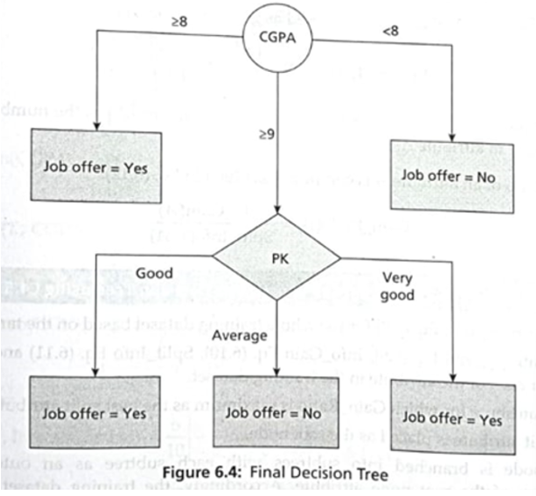
Here both the attributes “ Practical Knowledge” and “ Communication Skills” have the same Gain. So we can either construct the decision tree using “ Practical Knowledge” or “Communication Skills” . The final decision tree is shown in figure below:
Attributes | Gain
Interactiveness | 0.3111
Practical Knowledge | 0.8108
Communication Skills | 0.8108

Slide 94
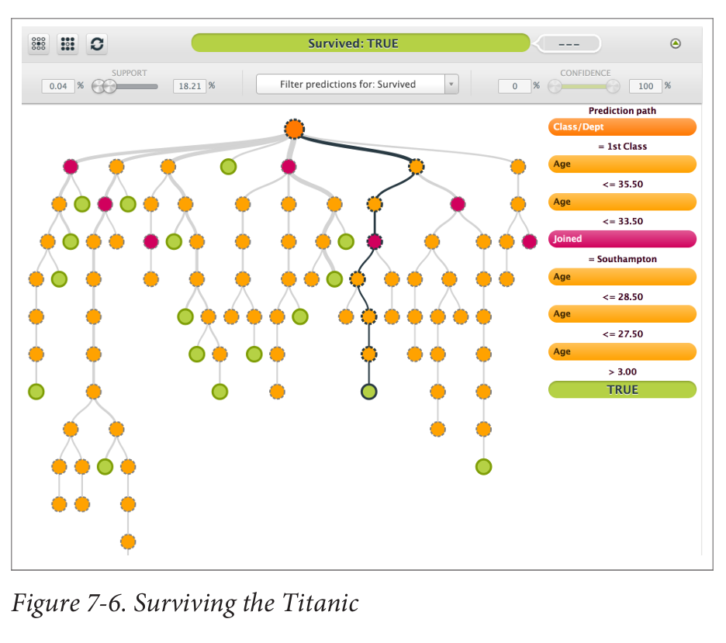

Slide 95
Handling Continuous Variables in Decision Trees
Using Packages that Implement Decision Trees
Building a Decision Tree Algorithm Yourself

Slide 96
R Packages
Rpart: Provides functions for recursive partitioning for classification, regression, and survival trees.
Party: Implements recursive partitioning algorithms, including conditional inference trees and random forests.
randomForest: Offers functions to create and analyze random forest ensembles for classification and regression.
Caret: A comprehensive package for building predictive models, featuring functions for data splitting, pre-processing, and model tuning.
Tree: Provides methods for creating and analyzing classification and regression trees

Slide 97
Python Packages
scikit-learn: A versatile machine learning library that offers tools for data mining, data analysis, and building predictive models.
XGBoost: An optimized gradient boosting library designed for speed and performance in machine learning tasks.
LightGBM: A highly efficient gradient boosting framework that uses tree-based learning algorithms for fast and accurate predictions.
CatBoost: A gradient boosting library that handles categorical features natively, improving accuracy and training speed.
Statsmodels: Provides classes and functions for the estimation of many different statistical models, as well as for conducting statistical tests and data exploration.

Slide 98
Building a Decision Tree Algorithm Yourself
Determine the Optimal Threshold
Binary Partitioning
Calculating Information Gain
Other Ways
Threshold as a Submodel
Creating Bins( instead of Threshold)

Slide 99
Random Forest
Random Forest is an ensemble learning method primarily used for classification and regression tasks.
It combines multiple decision trees to produce a more accurate and stable prediction. The key concept behind random forests is to create a 'forest' of decision trees, where each tree is trained on a random subset of the data and features.
The final prediction is made by aggregating the predictions from all individual trees.
Random forests improve decision trees by averaging multiple trees trained on different parts of your data, making your model more accurate and robust, but harder to interpret.
You just need to decide on the number of trees and the number of features to use at each split.

Slide 100
Bagging in Random Forest
Random forests are an advanced version of decision trees, using a method called bagging (or bootstrap aggregating) to improve accuracy and robustness at the expense of interpretability
Key Points:
Bagging: This technique creates multiple subsets of your data by sampling with replacement. Each subset is used to train a different tree. This helps to reduce variance and avoid overfitting.
Hyperparameters: Random forests are simple to set up with two main hyperparameters:
  Number of trees (N): How many trees to include in the forest.
  Number of features (F): How many features to randomly select at each split in a tree.
  Tree-specific parameters (e.g., max tree depth, min samples per leaf) to optimize performance.

Slide 101
Bootstrapping in Random Forest:
A bootstrap sample involves randomly selecting data points with replacement, often using 80% of the dataset.
This introduces a third hyperparameter, the sample size, but it's usually kept constant.

Slide 102
Random Forest Algorithm
Input:
  Training Dataset: A dataset with NNN samples and MMM features.
  Number of Trees (T): Number of decision trees to include in the forest.
  Number of Features (F): Number of features to consider for splitting at each node.
For each Tree t in T:
  Bootstrap Sampling
  Feature Selection
  Tree Construction
Ensemble Learning : Aggregate Predictions:
Output:
  Random Forest Model: A collection of T decision trees trained on different bootstrap samples and subsets of features.

Slide 103
User Retention: Interpretability Versus Predictive Power
The balance between interpretability and predictive power is important in user retention using decision trees. The key points includes:
Interpretability vs. Predictive Power
Insightful Interpretation
Causal vs. Correlation Understanding
Feature Selection and Testing
Practical Implementation

Slide 104
David Huffaker: Google’s Hybrid Approach to Social Research
Google's Approach to Research and Development
Moving from Descriptive to Predictive Analysis
Insights from Mixed-Methods Research:
Social Layer Integration Across Google Products:
Privacy Concerns and User Engagement:

Slide 105
1. Google's Approach to Research and Development
Google integrates research with product development, emphasizing iterative work and early deployment of near-production code .
Researchers collaborate closely with product teams to deploy experiments at scale and conduct iterative testing with smaller user groups

Slide 106
2. Moving from Descriptive to Predictive Analysis
David advocates transitioning from descriptive data analysis to experimental designs that establish causal relationships .
Example: Introduction of Google+'s "circle of friends" feature involved mixed-method approaches to understand user motivations for selective sharing.

Slide 107
3. Insights from Mixed-Methods Research:
Google employed both qualitative (interviews, surveys) and quantitative (data analysis from 100,000 users) methods to study user behavior and preferences [8].
Key findings included user preferences for privacy, relevance, and distribution when sharing content.

Slide 108
4. Social Layer Integration Across Google Products:
Google integrates social elements into various products like Search, incorporating social annotations based on user preferences and domain expertise

Slide 109
5. Privacy Concerns and User Engagement:
Privacy concerns significantly impact user engagement, highlighting the importance of clear information and control over shared data .
Users are wary of identity theft, unwanted spam, and privacy breaches affecting both digital and physical realms.

Slide 110
The survey identified major concerns among users, categorized as:
Identity theft
  Financial loss
Digital world
  Access to personal data
  Privacy regarding searched content
  Risk of receiving unwanted spam
  Embarrassment from provocative photos being seen
  Unwanted solicitation
  Unwanted ad targeting
Physical world
  Offline threats or harassment
  Potential harm to family members
  Stalking incidents
  Risks to employment due to online activities

Slide 111
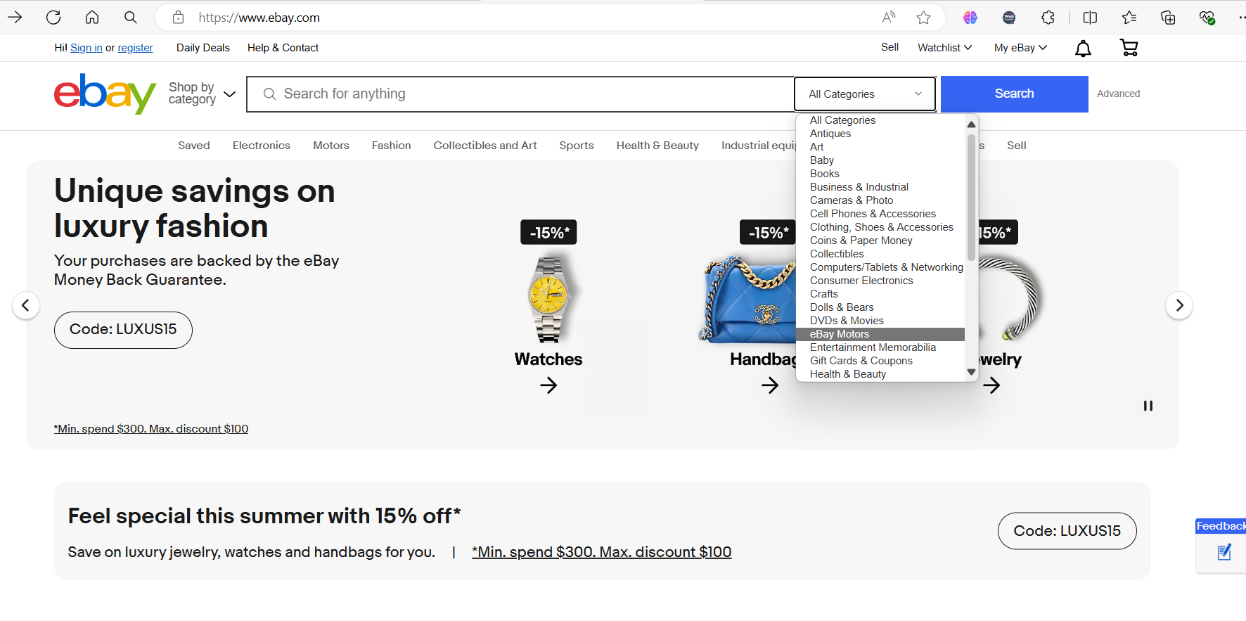

Slide 112
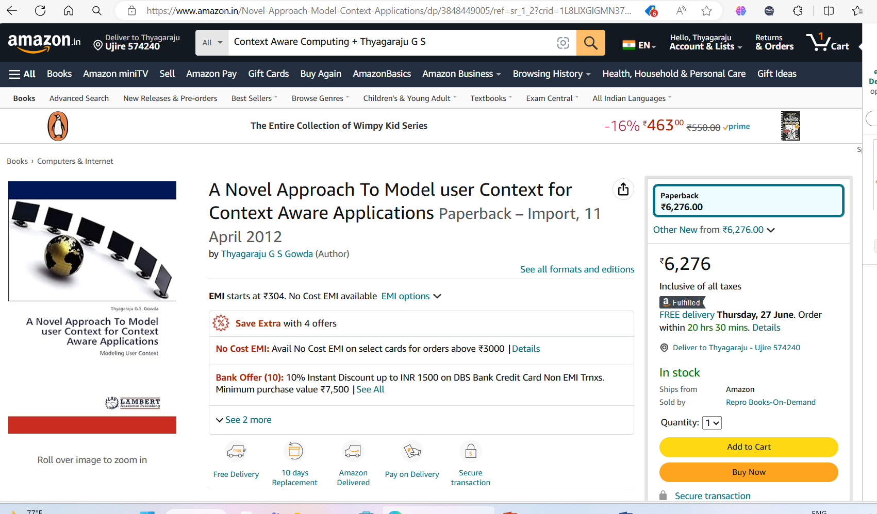

Slide 113
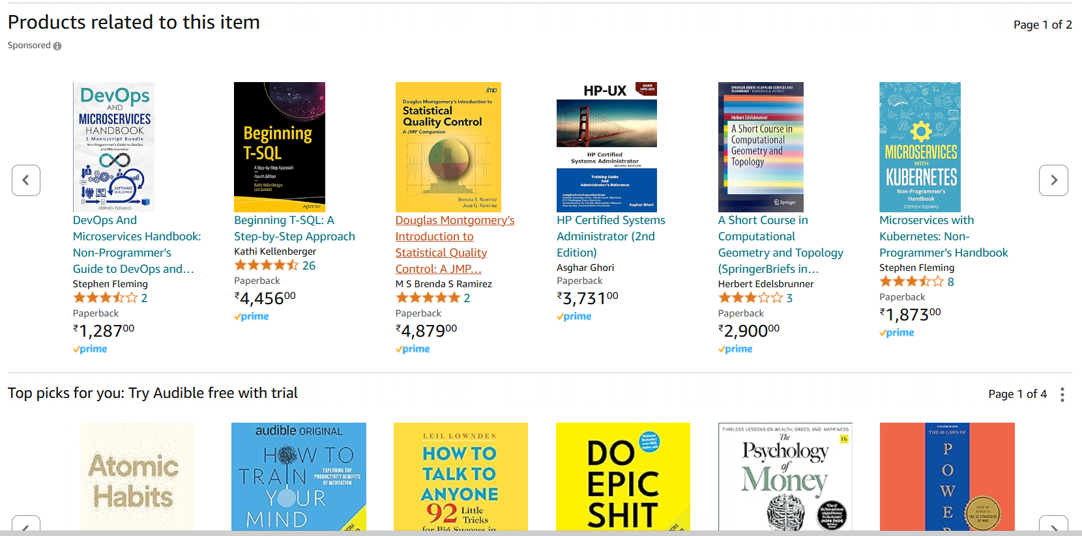

Slide 114


Slide 115
Recommendation Engines: Building a User-Facing Data Product at Scale
Recommendation engines, also known as recommendation systems, are a prime example of data products. Example : Amazon and Netflix.
These systems use data generated by users, such as book purchases or movie ratings, to provide personalized recommendations.
This process involves complex engineering and algorithms, requiring knowledge of linear algebra and coding.
Building such systems highlights the challenges of handling Big Data and implementing scalable solutions.

Slide 116
Matt Gattis, Experience
In this context, Matt Gattis, an MIT graduate and co-founder of Hunch.com, shares his experience in building a recommendation system for the site. Hunch.com.
Initially asked users a series of questions to provide personalized advice on various topics, using machine learning to improve recommendations over time.
They found that answering 20 questions could predict additional user preferences with 80% accuracy, involving traits similar to those assessed by the Myers-Briggs Type Indicator (MBTI).

Slide 117
Matt Gattis, Experience
Hunch later shifted to an API model, gathering data from the web and allowing third parties to use their service to personalize content.
This business model led to eBay acquiring Hunch.

Slide 118
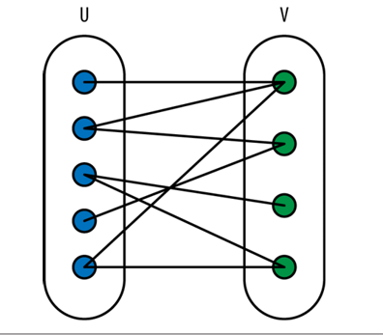
A Real-World Recommendation Engine
Recommendation engines are ubiquitous, suggesting movies, books, and vacations based on users' past preferences.
To set up a recommendation engine, consider you have a set of users (U) and a set of items (V) to recommend. Represent this as a bipartite graph, where each user and item is a node, and edges connect users to items they have expressed opinions about.
These opinions could be positive, negative, or on a continuous scale, and are represented as numeric ratings.

Slide 119
A Real-World Recommendation Engine
Using training data that includes known preferences of some users for some items, the goal is to predict other preferences for these users.
Additional metadata on users (e.g., gender, age) or items (e.g., color) can also be incorporated.
Users can be represented as vectors of features, which might include preferences depending on the context.
All user vectors can be combined into a large user matrix, denoted as U.

Slide 120
Using Nearest Neighbour Algorithm for recommendation
Purpose: To find the item(s) most similar to a given item based on certain features or characteristics.
Steps:
  Data Preparation
  Choose a Distance Metric
  Calculate Distance
  Find Nearest Neighbors
  Recommendation

Slide 121
Example: Let's say you want to recommend movies based on a user's previous movie ratings.

Slide 122
Step 1: Data Preparation
Movie A: [Action, 8.0, 120 min]
Movie B: [Comedy, 6.5, 90 min]
Movie C: [Action, 7.5, 110 min]
Target Movie: [Action, 8.5, 115 min]

Slide 123
Step 2: Choose a Distance Metric
• We'll use Euclidean distance

Slide 124
Step 3: Calculate Distance
Distance(Target, A) = sqrt((8.5 - 8.0)^2 + (115 - 120)^2)
Distance(Target, B) = sqrt((8.5 - 6.5)^2 + (115 - 90)^2)
Distance(Target, C) = sqrt((8.5 - 7.5)^2 + (115 - 110)^2)

Slide 125
Step 4: Find Nearest Neighbors
Calculate the distances:
  Distance(Target, A) ≈ 5.02
  Distance(Target, B) ≈ 25.08
  Distance(Target, C) ≈ 5.10
Sort distances: Movie A, Movie C, Movie B.

Slide 126
Step 5: Recommendation
Nearest neighbors are Movie A and Movie C, as they have the smallest distances to the target movie.
This simplified process shows how the Nearest Neighbor Algorithm can be used to find and recommend items similar to a given target item.

Slide 127
Problems with Nearest Neighbors
Curse of Dimensionality: With too many dimensions (features), the closest neighbors can be very far apart, making them not truly "close."
Overfitting: Relying on the nearest neighbor might result in noise. Using k-nearest neighbors (k-NN) with more neighbors (e.g., k=5) can help but still increases noise.
Correlated Features: Many features are highly correlated, such as age and political views. Counting both can double the influence of a single feature, leading to poor performance. Projecting data onto a smaller dimensional space to account for correlations can help.
Relative Importance of Features: Some features are more informative than others. Weighting features based on their importance (e.g., using covariances) can improve the model.
Sparseness: Sparse vectors or matrices (lots of missing data) make it difficult to measure similarity because there’s little overlap between data points.

Slide 128
Problems with Nearest Neighbors
Measurement Errors: People might lie or inaccurately report preferences, leading to errors in data.
Computational Complexity: Calculating distances for large datasets is computationally expensive.
Sensitivity of Distance Metrics: Euclidean distance can be skewed by the scale of different features. Features like age can outweigh others if not properly scaled. Assuming linear relationships may not always be correct.
Changing Preferences: User preferences change over time, which is not captured by static models. For instance, buying behaviour changes after purchasing a specific item.
Cost to Update: Updating the model as new data comes in is expensive.

Slide 129
Key Issues
The primary problems are overfitting and the curse of dimensionality.
Addressing these involves thinking about more robust methods, potentially drawing from familiar techniques like linear regression.

Slide 130
Beyond Nearest Neighbor: Machine Learning Classification
To improve recommendation systems beyond nearest neighbors, we can use machine learning, specifically linear regression models for each item.

Slide 131
Linear Regression Models for Recommendations
Separate Models for Each Item:
  Build a distinct linear regression model for each item.
  Predict whether a user would like an item based on their attributes (e.g., age, gender).
Incorporate Metadata:
  Treat user attributes (metadata) as features in the model.
  This allows predicting user preferences even when some attributes are missing.

Slide 132
Example:
For a user with three attributes (f_{i1}, f_{i2}, f_{i3}), estimate their preference (p_{i}) for an item using:
p_{i}=β₁f_{i1}+β₂f_{i2}+β₃f_{i3}+ϵ

Slide 133
Advantages:
Feature Weighting: Linear regression inherently solves the feature weighting problem by determining the importance of each feature through its coefficients

Slide 134
Challenges:
One Model per Item:
  Requires as many models as there are items.
  Doesn't leverage information from other items.
Overfitting:
  Large coefficients can indicate overfitting, especially with limited data.
  Overfitting occurs when the model captures noise rather than the underlying pattern.

Slide 135
Addressing Overfitting:
Impose a Bayesian Prior: Add a penalty term to the regression to prevent large coefficients. The penalty term depends on a parameter, λ (lambda).
Choosing λ: Experimentally adjust λ by evaluating model performance on a training set.
Normalization: Normalize variables to ensure that coefficients have reasonable sizes.

Slide 136
Normalization:
Normalize variables to ensure that coefficients have reasonable sizes.
Different normalization methods can be applied if certain variables are expected to have larger coefficients.

Slide 137
The Dimensionality Problem
The dimensionality problem in data analysis refers to dealing with a large number of items or features, often tens of thousands.
To manage this, techniques like Singular Value Decomposition (SVD) and Principal Component Analysis (PCA) are commonly used.

Slide 138
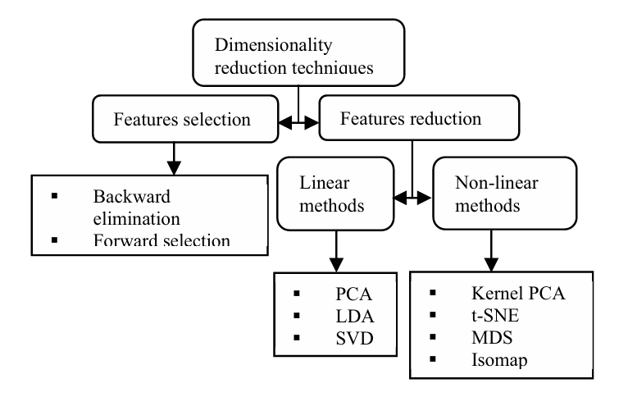
Principal Components Analysis (PCA) , Linear Discriminant Analysis (LDA) , Singular Value Decomposition (SVD), t-Distributed Stochastic Neighbor Embedding (t-SNE),Multidimensionality Scaling(MDS),Isometric Feature Mapping (IsoMap)

Slide 139
Key Terms Used in Singular Value Decomposition(SVD)
Matrix X: The original m×n data matrix that you want to decompose.
Rank (k): The number of linearly independent rows or columns in matrix X.
Orthogonality: Property where vectors are perpendicular to each other, implying their dot product is zero.
Singular Value: The diagonal elements of matrix S, representing the magnitude of each dimension's contribution to the matrix.
Lower Rank Approximation: An approximation of X using fewer dimensions by truncating S and corresponding parts of U and V.
Compression: Reducing the size of data by retaining the most important information and discarding less important details.
Latent Variables (or Latent Features): Hidden features inferred from the data, not directly observable.

Slide 140
Key Terms Used in Singular Value Decomposition(SVD)
U Matrix: An m×k matrix whose columns are orthogonal and represent the left singular vectors.
S Matrix: A k×k diagonal matrix containing singular values, ordered by magnitude.
V Matrix: An n×k matrix whose columns are orthogonal and represent the right singular vectors.
Eigenvalues and Eigenvectors: Eigenvalues are scalars indicating the variance explained by each dimension, and eigenvectors are the directions of these dimensions.
Unitary Matrix: A matrix whose inverse is equal to its transpose.
Dimensionality Reduction: The process of reducing the number of random variables under consideration by obtaining a set of principal variables.
Base Change Operation: Reordering columns based on the magnitude of singular values.

Slide 141
Key Terms Used in Singular Value Decomposition(SVD)
Approximation X: The matrix obtained by multiplying U, S, and V ^{τ} back together, serving as an approximation of the original X.
Prediction: Using the approximated X matrix to predict missing or new values in the dataset.
Frobenius Norm: A measure of matrix error used to quantify the difference between the original matrix and its approximation.
Diagonal Matrix: A matrix in which the entries outside the main diagonal are all zero.
Reconstruction: The process of multiplying U, S, and V^{τ} to get an approximated version of X.
Computational Complexity: The amount of computational resources required to perform SVD, especially significant for large matrices.
SVD-based Recommendations: Using SVD to decompose user-item rating matrices to make personalized recommendations.

Slide 142
Understanding Dimension Reduction and Latent Features
Concept of Latent Features: Latent features are unobserved and not directly measurable.
Dimensionality Reduction: This process simplifies data into fewer dimensions, focusing on essential features.

Slide 143
Algorithmic Approach
Machine Learning Role
Low Dimensional Subspace

Slide 144
Handling Binary Rating Questions
Separate Variables for Each Question
Comparison Questions

Slide 145
SVD: Concept and Mathematical Foundation
Singular Value Decomposition (SVD) is a method to decompose any m×n matrix X of rank k into three specific matrices: X=USV^{τ}
U: An m×k matrix with pairwise orthogonal columns.
S : A k×k diagonal matrix.
V: A k×n matrix with pairwise orthogonal columns.

Slide 146
SVD: Application to Data Sets
X: Represents the original dataset (e.g., users' ratings of items) with m users and n items.
Rank k: Determines the maximum number of latent variables d to consider.
Tuning Parameter d: Similar to k in k-NN, d is chosen based on the dataset and serves as a tuning parameter for the model.

Slide 147
SVD: Interpretation of Matrices
U: Each row corresponds to a user.
V: Each row corresponds to an item.
Singular Values in S: Diagonal values in S indicate the importance of each latent variable, with the largest value representing the most critical latent variable.

Slide 148
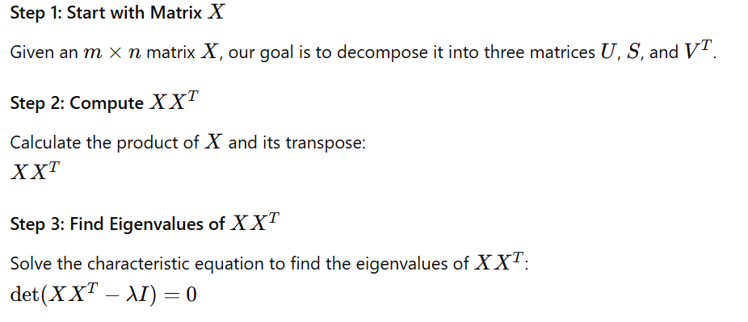
SVD Algorithm

Slide 149
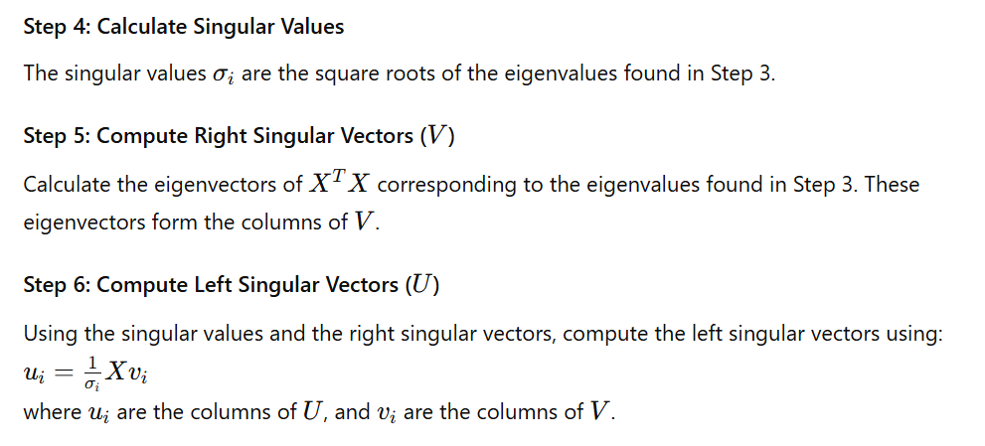
SVD Algorithm

Slide 150
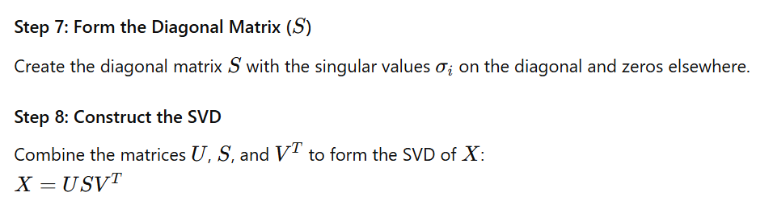
SVD Algorithm

Slide 151
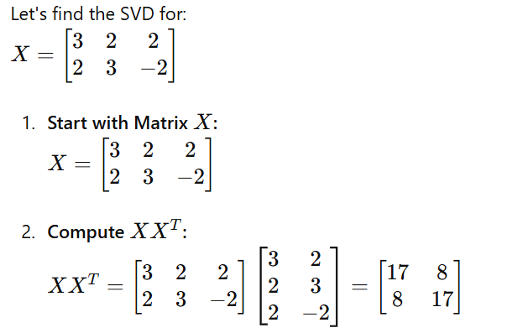
Example: Finding SVD for a Given Matrix

Slide 152
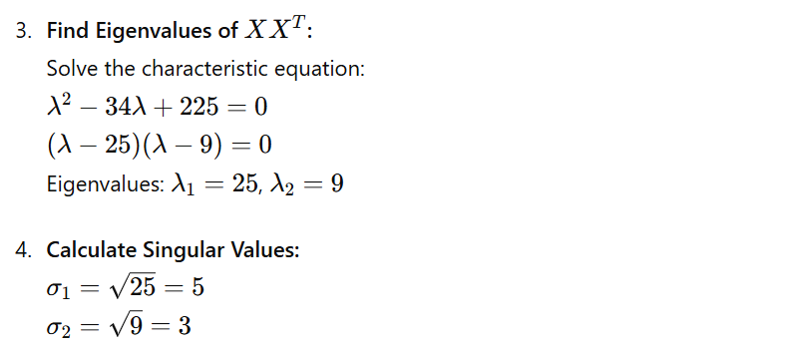

Example: Finding SVD for a Given Matrix

Slide 153
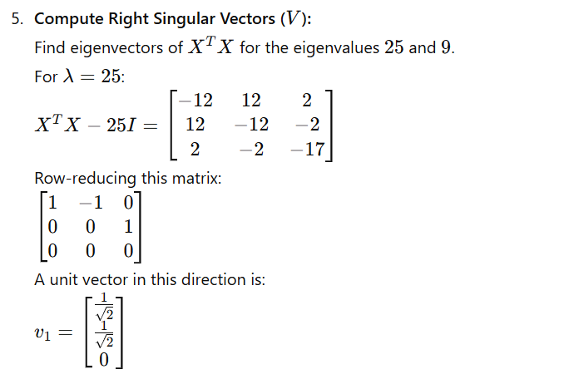
Example: Finding SVD for a Given Matrix

Slide 154
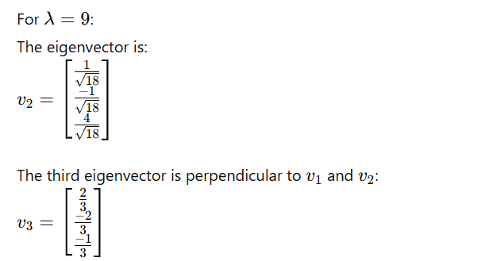
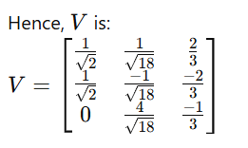
Example: Finding SVD for a Given Matrix

Slide 155
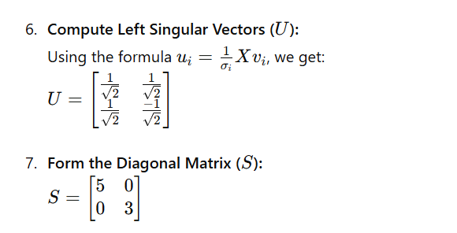
Example: Finding SVD for a Given Matrix

Slide 156
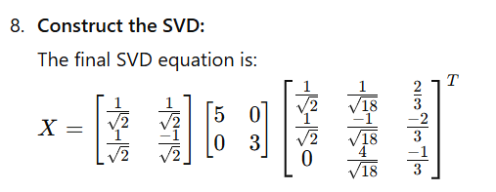
Example: Finding SVD for a Given Matrix

Slide 157
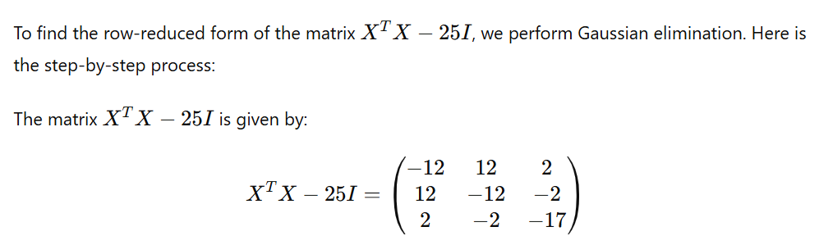
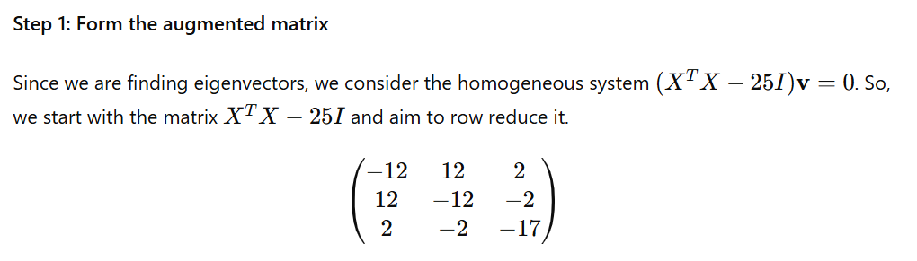
Example: Row Reduced Form

Slide 158
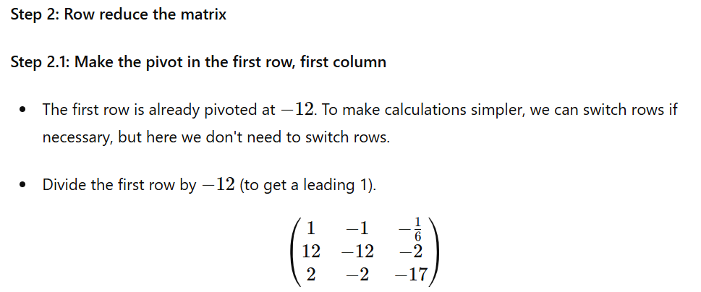

Slide 159
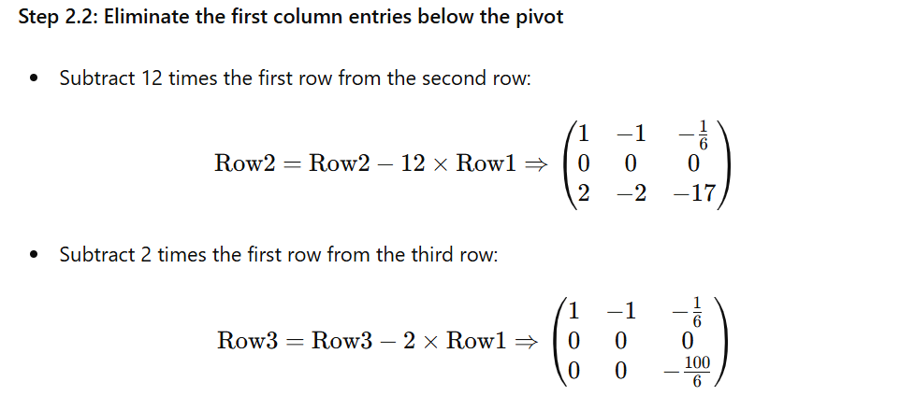

Slide 160
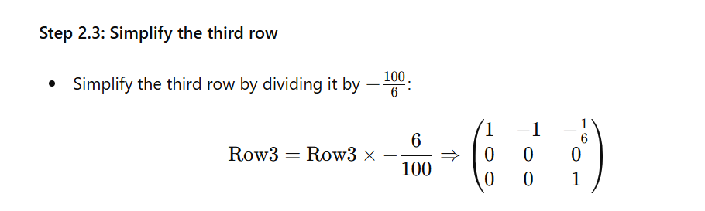

Slide 161
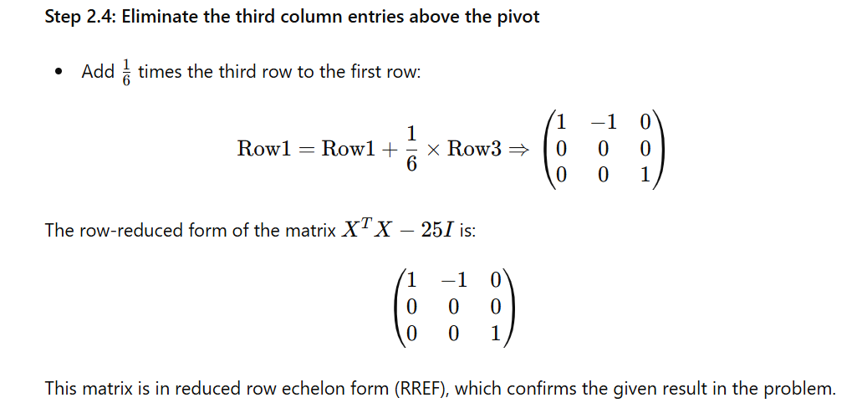

Slide 162
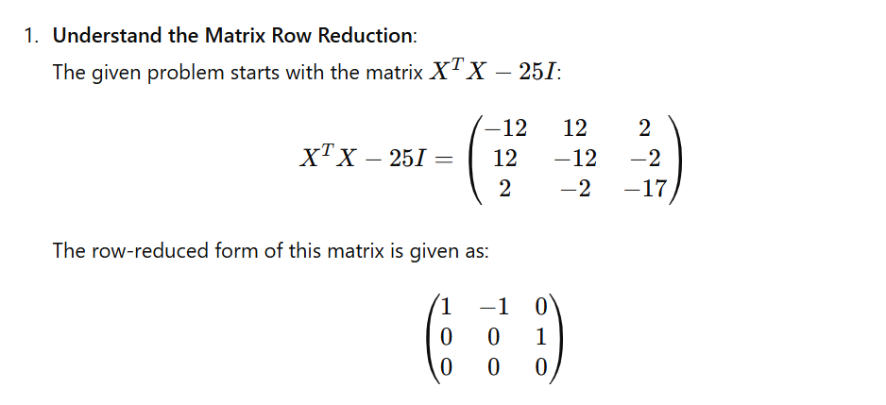
Example Computing v1

Slide 163


Slide 164


Slide 165


Slide 166

Example : Compute u1

Slide 167

Example : Compute u2

Slide 168

Example : Compute u2

Slide 169

Example : Find a vector which is perpendicular to both vector A and B, where A=2i+3j+4k B=i+2j+3k?

Slide 170

Example : Find a vector which is perpendicular to both vector A and B, where A=2i+3j+4k B=i+2j+3k?

Slide 171
Important Properties of SVD
Orthogonality : The columns of matrices U and V are orthogonal.
Lower Rank Approximation: Lower-rank approximation of matrix X is achieved by truncating S to include only the top singular values and the corresponding parts of U and V.
Compression: This truncation process is a form of data compression, retaining the most significant features and discarding the least important ones.
Choosing Latent Variables d : By selecting a smaller number of latent variables d (where d<k), the approximation retains the essential structure of X while reducing its dimensionality.
Interpretation of U and V: The matrices U and V reveal latent features in the data. For example, the most significant latent feature might differentiate between males and females.

Slide 172
Limitations and Challenges
Missing Data: SVD does not inherently solve the issue of missing data.
Computational Complexity: SVD is computationally expensive, making it challenging for large datasets.

Slide 173
Example :Using SVD for Recommendations
Initial Data: Suppose you have a user-item rating matrix X with some missing values.
Fill Missing Values: Replace missing values with the average rating for each item.
Compute SVD: Decompose X into U, S, and V^{T}.
Make Predictions: Multiply U, S, and V^{T} to get an approximation of X, and use this approximated matrix to predict ratings for user-item pairs.

Slide 174
Introduction to Principal Component Analysis (PCA)
Principal Component Analysis (PCA) is a technique used to simplify complex data.
It reduces the number of dimensions (or features) in a dataset while preserving as much important information as possible.
This makes it easier to visualize, analyze, and use the data.

Slide 175
Here's how PCA works in simple terms:
Data Simplification: Imagine you have a dataset with many features (e.g., height, weight, age, income). PCA helps to reduce this to a smaller set of new features that still capture the essential information.
Finding Principal Components: PCA identifies new features called "principal components." These are combinations of the original features that explain the most variance (differences) in the data. The first principal component captures the most variance, the second captures the next most, and so on.
Transformation: The original data is transformed into a new set of uncorrelated features (principal components). These new features are easier to work with because they are not redundant and capture the most important patterns in the data.
Dimensionality Reduction: By selecting a few principal components, you can reduce the number of features while retaining most of the important information. This makes the data simpler and faster to process without losing significant insights.

Slide 176
Why Use PCA?
Simplification: Makes complex data easier to understand and visualize.
Efficiency: Reduces computational resources needed for analysis and modeling.
Noise Reduction: Helps to remove less important information and focus on the most critical aspects of the data.
Uncorrelated Features: Ensures that the new features are not redundant, which can improve the performance of machine learning model
In summary, PCA is a powerful tool for simplifying data by finding and using new features that capture the most important information from the original dataset.

Slide 177

Principal Component Analysis (PCA) for Predicting Preferences
Approximate the original data matrix X through the product X≈U⋅V^{T}.
Minimize the discrepancy between the actual data X and the predicted data U⋅V^{T}, measured by the squared error:

Slide 178
Algorithm Steps:
Initialization
Optimization Problem
Alternating Least Squares (ALS):
  Step 1: Fix V and update U.
  Step 2: Fix U and update V.
Convergence Check

Slide 179
1. Initialization
Define the number of latent features d. Typically, d is around 100.
Initialize matrices U(of size m×d) and V (of size n×d) with random values, where m is the number of users and n is the number of items.

Slide 180

2. Optimization Problem

Slide 181

3.Alternating Least Squares (ALS): Step 1: Fix V and update U.

Slide 182

3.Alternating Least Squares (ALS): Step2: Fix U and update V.

Slide 183
4. Convergence Check
Repeat the ALS steps until the changes in U and V are smaller than a predefined threshold ϵ.
Once the changes are less than ϵ, the algorithm is considered to have "converged."

Slide 184
Python Inbuilt Libraries Used
math
numpy

Slide 185
math
Purpose: Provides mathematical functions.Key
Functions: math.sqrt(x): Returns the square root of x.
Usage in Code: To calculate the root mean squared error (RMSE)
Example1 :
  import math
  result = math.sqrt(16) # result will be 4.0
Example2:
  import math
  # Calculating root mean squared error
  error = math.sqrt(total_error / number_of_elements)

Slide 186
numpy
Purpose: Array and matrix operations, linear algebra. Supports large, multi-dimensional arrays and matrices, along with a collection of mathematical functions to operate on these arrays.
Key Functions:
  numpy.mat(data): Creates a matrix from an array-like object or a string of data.
  numpy.zeros(shape): Returns a new array of given shape and type, filled with zeros.
  numpy.eye(N): Returns a 2-D array with ones on the diagonal and zeros elsewhere.
  numpy.linalg.inv(a): Computes the (multiplicative) inverse of a matrix.
  numpy.vstack(tup): Stacks arrays in sequence vertically (row wise).
Usage in Code: For creating and manipulating matrices and performing linear algebra operations.

Slide 187
Example:
import numpy
# Creating a matrix
V = numpy.mat([[0.15968384, 0.9441198, 0.83651085],
[0.73573009, 0.24906915, 0.85338239],
[0.25605814, 0.6990532, 0.50900407]])
# Creating a zero matrix
U = numpy.mat(numpy.zeros([6, 3]))
# Identity matrix for regularization
L_identity = L * numpy.mat(numpy.eye(3))
# Inverting a matrix
inv_matrix = numpy.linalg.inv(some_matrix)

Slide 188
Building a Recommendation System: Sample Code Explanation
This sample code demonstrates a basic implementation of a collaborative filtering recommendation system using matrix factorization.
The code is written in Python and utilizes the NumPy library for efficient matrix operations.

Slide 189
Key aspects of the code:
Purpose: To illustrate how to build a recommendation system on a small dataset.
Technique: Matrix factorization, which is a common approach in collaborative filtering.
Data representation: User-item interactions are represented as sparse matrices.
Core idea: The algorithm learns latent features for both users and items, which can then be used to predict ratings.
Iterative approach: The code uses an iterative process to refine the user and item feature matrices, gradually improving the prediction accuracy.
Error measurement: After each iteration, the code calculates the Root Mean Square Error (RMSE) to track the model's performance.

Slide 190
Importing Libraries
import math
import numpy

Slide 191
Input Data Structure - User-Item Interactions (pu)
pu: List of tuples representing user-item interactions.
Format: [(user, item, rating), ...]
Explanation: Each tuple (user, item, rating) represents how a user rated an item.
pu = [[(0,0,1),(0,1,22),(0,2,1),(0,3,1),(0,5,0)],
[(1,0,1),(1,1,32),(1,2,0),(1,3,0),(1,4,1),(1,5,0)],
[(2,0,0),(2,1,18),(2,2,1),(2,3,1),(2,4,0),(2,5,1)],
[(3,0,1),(3,1,40),(3,2,1),(3,3,0),(3,4,0),(3,5,1)],
[(4,0,0),(4,1,40),(4,2,0),(4,4,1),(4,5,0)],
[(5,0,0),(5,1,25),(5,2,1),(5,3,1),(5,4,1)]]

Slide 192
Input Data Structure - Item-User Interactions (pv)
pv: List of tuples representing item-user interactions.
Format: [(item, user, rating), ...]
pv = [[(0,0,1),(0,1,1),(0,2,0),(0,3,1),(0,4,0),(0,5,0)],
[(1,0,22),(1,1,32),(1,2,18),(1,3,40),(1,4,40),(1,5,25)],
[(2,0,1),(2,1,0),(2,2,1),(2,3,1),(2,4,0),(2,5,1)],
[(3,0,1),(3,1,0),(3,2,1),(3,3,0),(3,5,1)],
[(4,1,1),(4,2,0),(4,3,0),(4,4,1),(4,5,1)],
[(5,0,0),(5,1,0),(5,2,1),(5,3,1),(5,4,0)]]

Slide 193
Initializing Matrices
V: Initial item feature matrix.
U: Initial user feature matrix.
V = numpy.mat([[0.15968384, 0.9441198 , 0.83651085],
[0.73573009, 0.24906915, 0.85338239],
[0.25605814, 0.6990532 , 0.50900407],
[0.2405843 , 0.31848888, 0.60233653],
[0.24237479, 0.15293281, 0.22240255],
[0.03943766, 0.19287528, 0.95094265]])
print(V)
U = numpy.mat(numpy.zeros([6, 3]))

Slide 194
Regularization Parameter
L: Regularization parameter to prevent overfitting.
L =0.03

Slide 195
ALS Algorithm - Update User Features (U)
for iter in range(5):
print("\n----- ITER %s -----" % (iter + 1))
print("U")
urs = []
for uset in pu:
vo = []
pvo = []
for i, j, p in uset:
vor = []
for k in range(3):
vor.append(V[j, k])
vo.append(vor)
pvo.append(p)
vo = numpy.mat(vo)
ur = numpy.linalg.inv(vo.T * vo + L * numpy.mat(numpy.eye(3))) * vo.T * numpy.mat(pvo).T
urs.append(ur.T)
U = numpy.vstack(urs)
print(U)

Slide 196
ALS Algorithm - Update Item Features (V)
print("V")
vrs = []
for vset in pv:
uo = []
puo = []
for j, i, p in vset:
uor = []
for k in range(3):
uor.append(U[i, k])
uo.append(uor)
puo.append(p)
uo = numpy.mat(uo)
vr = numpy.linalg.inv(uo.T * uo + L * numpy.mat(numpy.eye(3))) * uo.T * numpy.mat(puo).T
vrs.append(vr.T)
V = numpy.vstack(vrs)
print(V)

Slide 197
Calculating Error
err = 0.
n = 0.
for uset in pu:
for i, j, p in uset:
err += (p - (U[i] * V[j].T)[0, 0]) ** 2
n += 1
print(math.sqrt(err / n))

Slide 198
Final Predictions
print(U * V.T)

Slide 199
Adapting to GetGlue (Any Realtime)Dataset
Challenge: Modify the sample code to work with the GetGlue dataset.
Steps:
  Preprocess the GetGlue data into the required format.
  Initialize matrices based on the dimensions of the GetGlue data.
  Adjust hyperparameters as necessary.

Slide 200
End of Module 5

