Slide 1
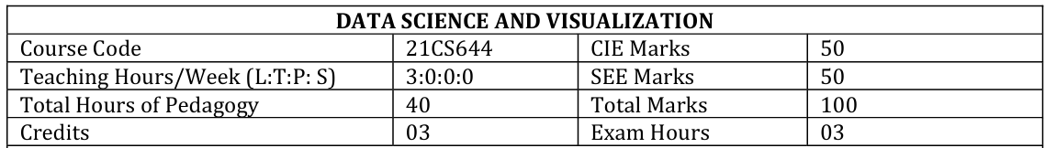

Slide 2
Overfitting
Sometimes the machine learning model performs well with the training data but does not perform well with the test data. It means the model is not able to predict the output when deals with unseen data by introducing noise in the output, and hence the model is called overfitted.

Slide 3
Overfitting
Overfitting in model development refers to the phenomenon where a model learns not only the underlying patterns in the training data but also captures noise, random fluctuations, or outliers that are specific to the training dataset. This results in a model that performs extremely well on the training data but fails to generalize effectively to new, unseen data.
When a model is overfitted, it may exhibit poor performance when applied to new data that was not part of the training dataset.
Overfitted models tend to be too complex, capturing spurious relationships and details that are not reflective of the true underlying patterns in the data.
Overfitting can lead to misleading conclusions and inaccurate predictions when deployed in real-world scenarios.

Slide 4
Strategies to Mitigate Overfitting and Improve Model Generalizability:
Simplify the Model:
Regularization:
Cross-Validation:
Feature Selection
Early Stopping

Slide 5
Regularization
Regularization is one of the most important concepts of machine learning. It is a technique to prevent the model from overfitting by adding extra information to it.

Slide 6
Library Assignment #1 [ on or before 15/5/2024]
Student Details
Name:
USN:
Sem:
Date and Time Of Library Visit:
Reference Details:
Questions:
Explain how Cross validation and regularization are used to avoid overfitting in Data Science With Examples.
Discuss different types of Regularization (like L1/L2/Elastic Net/Dropout ) in Data Science with examples.

Slide 7
Module1 : Introduction to Data Science and Statistical Inference Needed:
Introduction : What is Data Science? Big Data and Data Science hype – and getting past the hype, Why now? Datafication, Current landscape of perspectives, Skill sets.
Needed Statistical Inference: Populations and samples, Statistical modelling, probability distributions, fitting a model.

Slide 8
Data Scientist Profile
The key elements that define the Data Scientist Profile are:
  Computer science skills
  Mathematical skills
  Statistical skills
  Machine learning skills
  Domain expertise (subject matter knowledge)
  Communication and presentation skills
  Data visualization skills

Slide 9
What is Data Science?
Data science is an interdisciplinary field that involves using scientific methods, processes, algorithms, and systems to extract knowledge and insights from structured and unstructured data. It combines techniques and theories from statistics, mathematics, computer science, AI, information science, and domain-specific fields like business or healthcare to analyze complex data sets.
The main goal of data science is to turn raw data into actionable insights, predictions, and recommendations.

Slide 10
Various stages of data processing and analysis
Data Collection: Gathering data from various sources such as databases, APIs, sensors, or web scraping.
Data Cleaning: Preprocessing and preparing the data by handling missing values, removing duplicates, and transforming data into a suitable format for analysis.
Exploratory Data Analysis (EDA): Understanding the data through statistical summaries, visualizations, and identifying patterns or anomalies.
Feature Engineering: Creating new features or variables that can enhance the predictive power of machine learning models.
Machine Learning: Applying statistical models and algorithms to build predictive models and make data-driven decisions. This includes supervised learning (classification, regression), unsupervised learning (clustering, dimensionality reduction), and other techniques.
Data Visualization: Presenting findings and insights through charts, graphs, dashboards, and interactive visualizations.
Deployment and Monitoring: Integrating data science solutions into production systems and continuously monitoring model performance.

Slide 11
Model Questions
What is Data Science? Explain the Venn Diagram of data Science.
Explain in detail about BigData and Data Science Hype. Why Hype? How to get past this hype?
Explain the Data Science Profile. Explain the work of the Data Scientist in academia and industry.
“The Data Scientists play a major role in Academics and industry”. Justify.
Explain the concept of Datafication with example. Why it is required in the current scenario?
Discuss in detail about the current landscape of perspectives and skill sets.

Slide 12
Model Questions
There are varieties of types of data that a Data Scientist has to deal”, explain the statement with examples.
Explain the following concepts involved in building models:
    Statistical modeling.
    Probability distributions
    Fitting and overfitting
What is Statistical Thinking? Discuss in details statistical inferences and also explain about population and Samples
What is Statistical Modelling? How do you build a model?
Explain in detail about probability distribution with examples and fitting a model. Write about over fitting.
Explain the following concepts with examples
    Statistical inference
    Population
    Samples
    Types of Data

Slide 13
End of Module1

Slide 14
Module2: Syllabus
Exploratory Data Analysis and the Data Science Process: Basic tools (plots, graphs and summary statistics) of EDA, Philosophy of EDA, The Data Science Process.
Case Study: Real Direct (online real estate firm).
Three Basic Machine Learning Algorithms: Linear Regression, k-Nearest Neighbors (k- NN), k-means.

Slide 15
“Exploratory data analysis” is an attitude, a state of flexibility, a willingness to look for those things that we believe are not there, as well as those we believe to be there.
— John Tukey

Slide 16
What is Exploratory Data Analysis?
EDA involves using basic tools like plots, graphs, and summary statistics to systematically analyze data.
It includes:
  Plotting distributions (e.g., box plots)
  Examining time series data
  Transforming variables
  Exploring pairwise relationships (scatterplot matrices)
  Computing summary statistics (mean, min, max, quartiles)
  Identifying outliers

Slide 17
Define Exploratory Data Analysis?
Exploratory Data Analysis (EDA) is a data analysis approach focused on summarizing the main characteristics of a dataset using visual methods like plots and graphs and statistical summaries.
Its objectives include
  Gaining insights,
  Understanding data structure,
  Detecting patterns and anomalies, and
  Formulating hypotheses for further analysis.

Slide 18
Plots and Graphs
Plots refer specifically to visual representations of data using graphical elements such as points, lines, bars, or other symbols to display relationships, distributions, or trends within the data.
Examples: Scatter plots, line plots, bar plots, box plots, histograms, pie charts, heatmaps, etc.
Graphs, in a broader sense, can refer to any visual representation of data or mathematical relationships. In some contexts, graphs specifically refer to mathematical structures represented by nodes (vertices) and edges (connections) that illustrate relationships between entities.
Examples: Line graphs, network graphs (nodes and edges), flowcharts, tree diagrams, Venn diagrams, etc.

Slide 19
Statistical Summary
A statistical summary is a concise description or summary of key characteristics or features of a dataset or a sample of data. It provides numerical measures that describe the central tendency, variability, and distribution of the data.
Common statistical summaries include:
  Measures of Central Tendency:
  Measures of Variability
  Summary of Distribution

Slide 20
Measures of Central Tendency:
Mean: Average value of the data points.
Median: Middle value of the dataset when arranged in order.
Mode: Most frequently occurring value(s) in the dataset.

Slide 21
Measures of Variability:
Range: Difference between the maximum and minimum values.
Variance: Average of the squared differences from the mean.
Standard Deviation: Square root of the variance, indicating the spread of data around the mean.

Slide 22
Summary of Distribution:
Quartiles: Values that divide the dataset into four equal parts.
Interquartile Range (IQR): Range of values between the first and third quartiles.
Skewness and Kurtosis: Measures of asymmetry and tail heaviness of the distribution.

Slide 23
Other Summary Statistics:
Sum: Total sum of all data points.
Count: Number of observations in the dataset.
Percentiles: Values below which a certain percentage of data falls.

Slide 24
Mindset of EDA
EDA is more than just tools—it's a mindset.
Focuses on developing a deep relationship with the data.
Goal: Gain intuition and understand the data's shape.
Connect this understanding to the underlying data generation process.

Slide 25
Personal Exploration
EDA is a personal exploration between the analyst and the data.
No need to prove anything to others at this stage.
It's about understanding the data without external validation.

Slide 26
Philosophy of Exploratory Data Analysis
Quote: "Long before worrying about how to convince others, you first have to understand what's happening yourself." - Andrew Gelman
Key Points:
Exploratory Data Analysis (EDA) is crucial for understanding the data before diving into advanced analysis.
EDA helps gain intuition, compare distributions, ensure data sanity, identify missing data, and detect outliers.
In the context of log-generated data, EDA plays a vital role in debugging and ensuring accurate patterns.

Slide 27
The Importance of EDA
EDA differs from data visualization used for communicating findings later in the analysis process.
EDA focuses on personal understanding rather than external communication.
It empowers algorithm development by informing decisions on metrics like "popularity" based on data behavior.
EDA ensures a more robust and informed approach to data analysis.

Slide 28
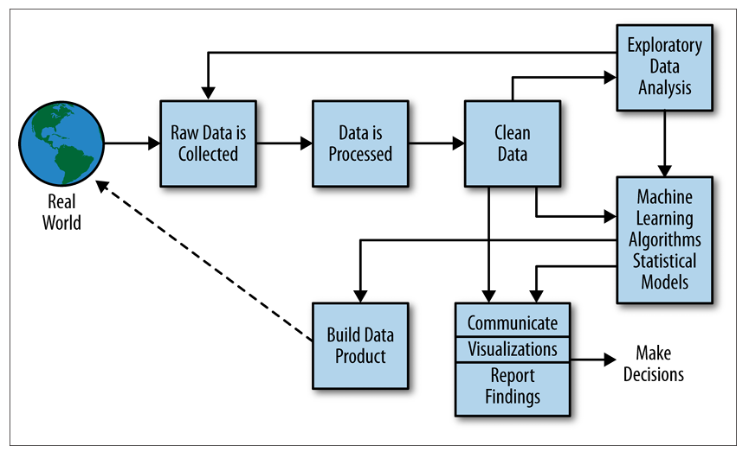
The Data Science Process
Real World
Raw Data is Collected
Data is Processed
Clean Data
Exploratory Data Analysis
Machine Learning Algorithms/Statistical Models
Communicate Visualizations/Report Findings
Build Data Product
Make Decisions

Slide 29
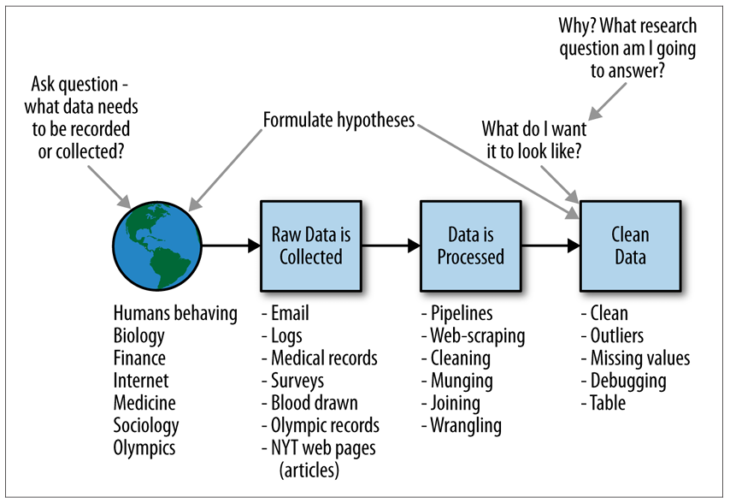
A Data Scientist’s Role in This Process

Slide 30
Connection to the Scientific Method
We can think of the data science process as an extension of or variation of the scientific method:
Ask a question.
Do background research.
Construct a hypothesis.
Test your hypothesis by doing an experiment.
Analyze your data and draw a conclusion.
Communicate your results

Slide 31
Exploratory Data Analysis Example
There are 31 datasets named nyt1.csv, nyt2.csv,…,nyt31.csv, which you can find here:
https://github.com/oreillymedia/doing_data_science

Slide 32
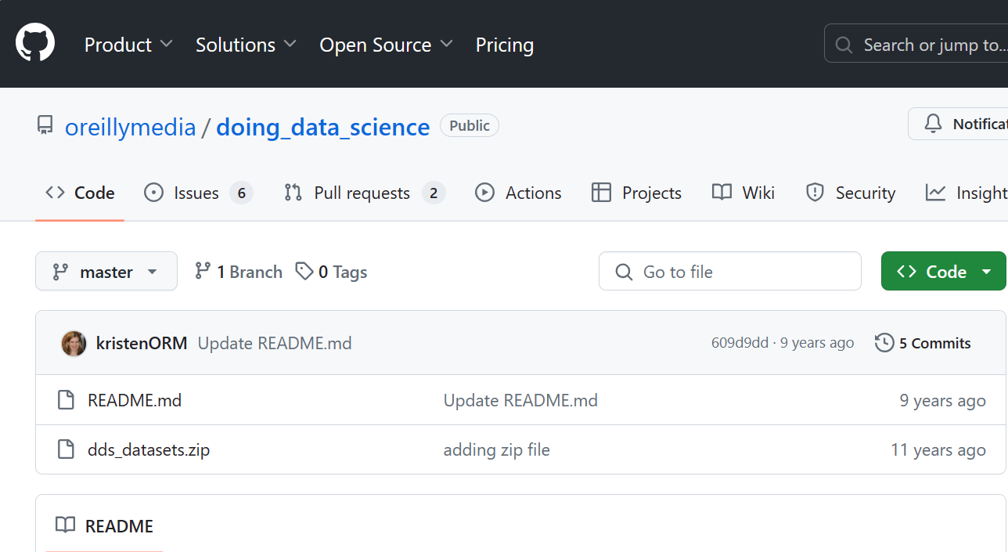

Slide 33
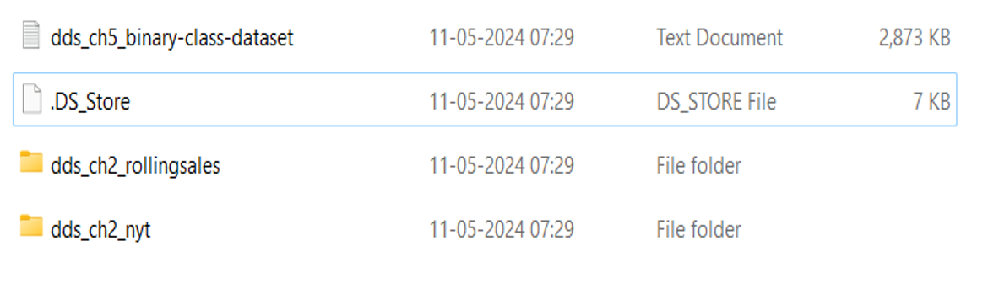

Slide 34
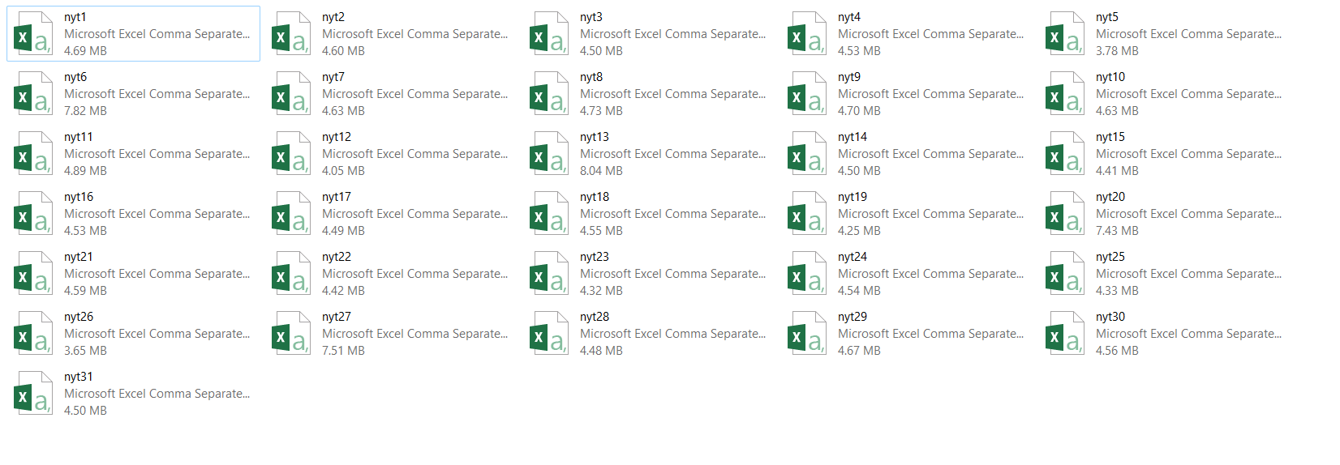
31 CSV Files: nyt1.csv, nyt2.csv,…,nyt31.csv

Slide 35
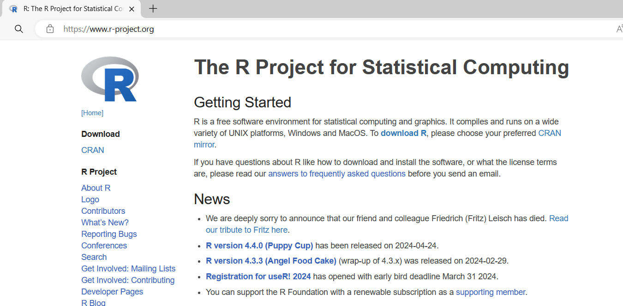
Download and Install R: https://www.r-project.org/

Slide 36
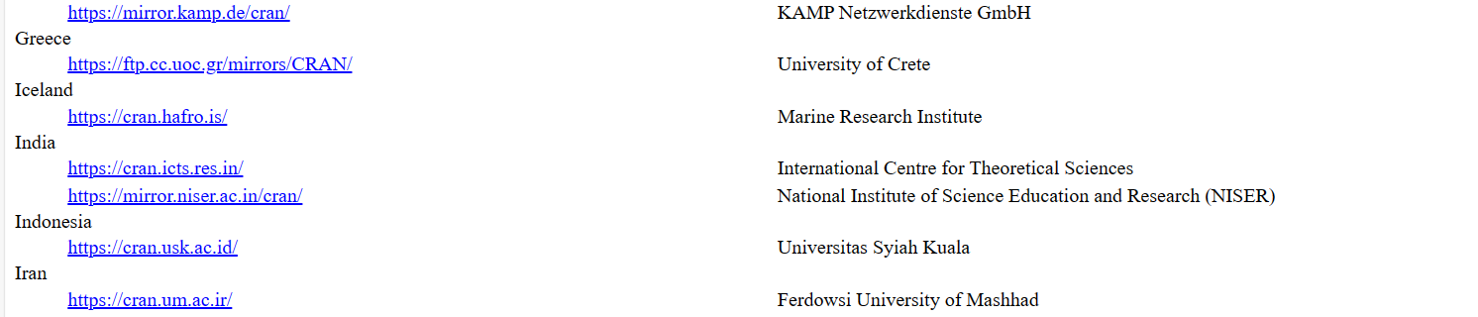

Slide 37
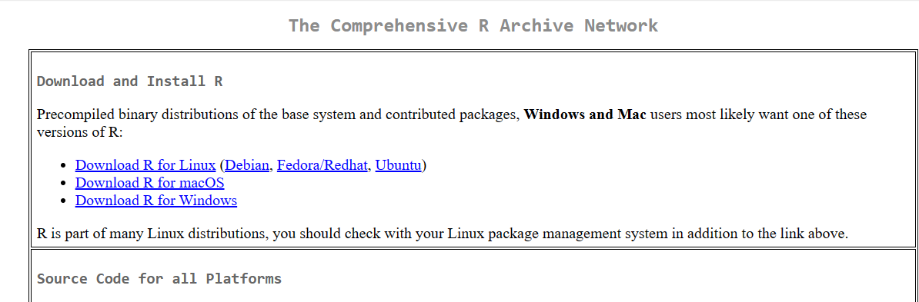

Slide 38
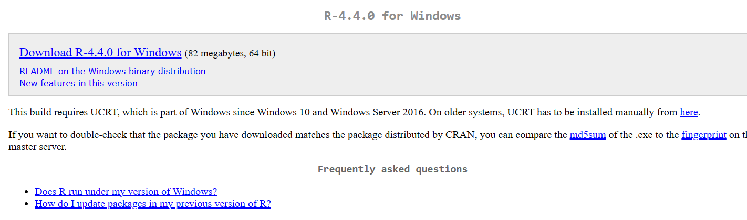

Slide 39
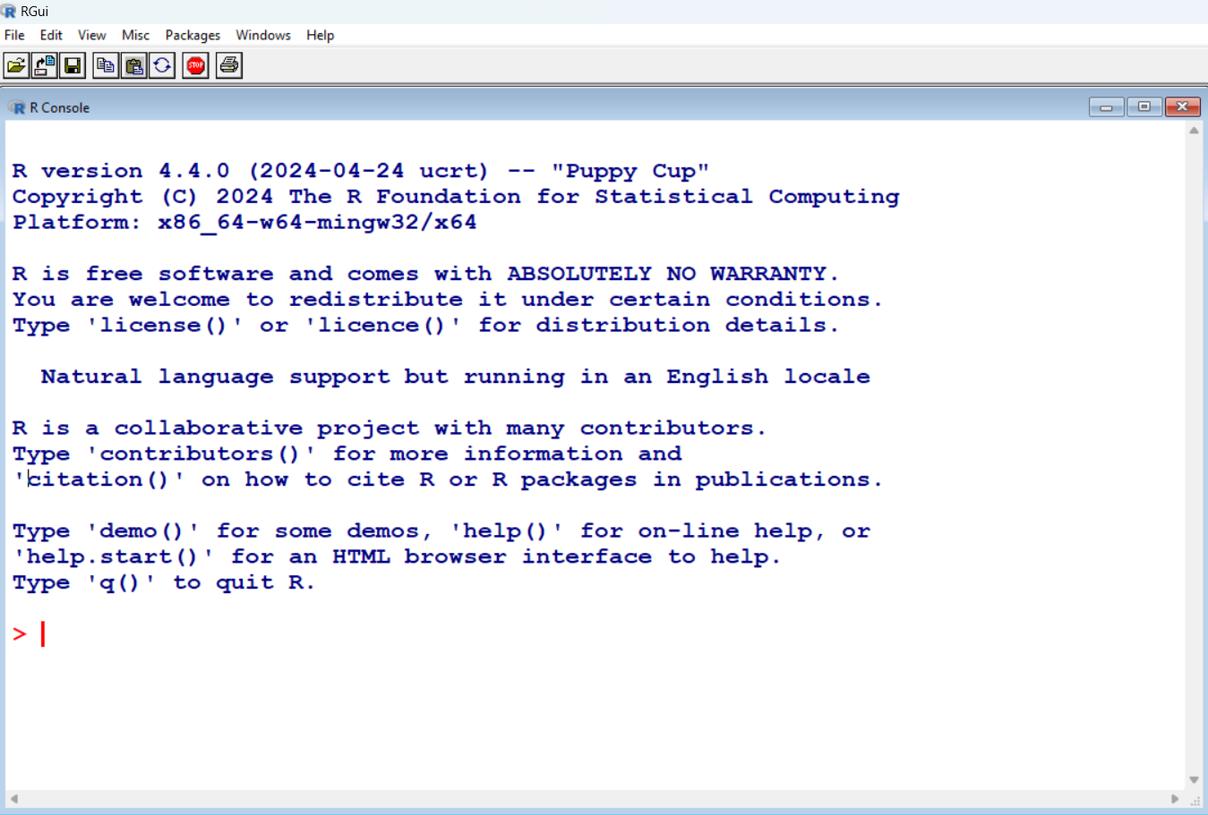

Slide 40
data1 <- read.csv("D://DVSDATA// 31Files// nyt1.csv")

Slide 41
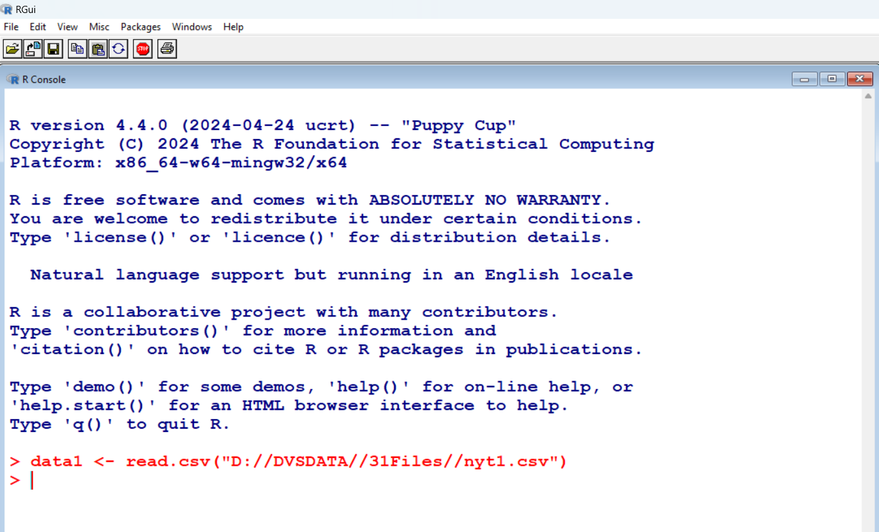

Slide 42
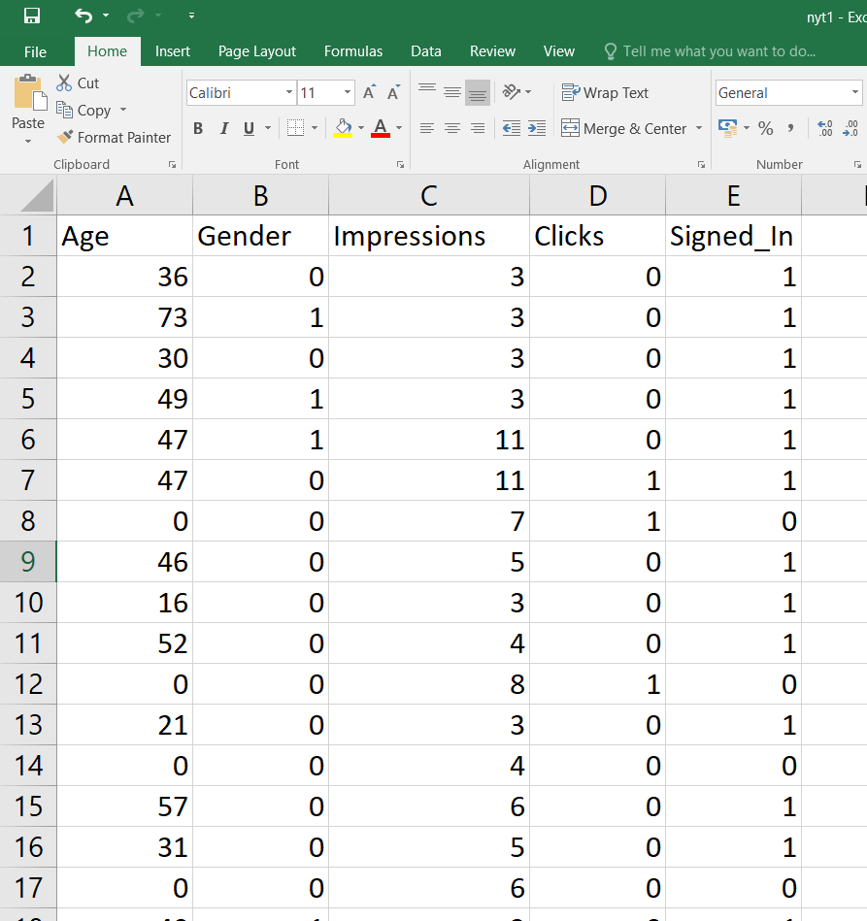

Slide 43
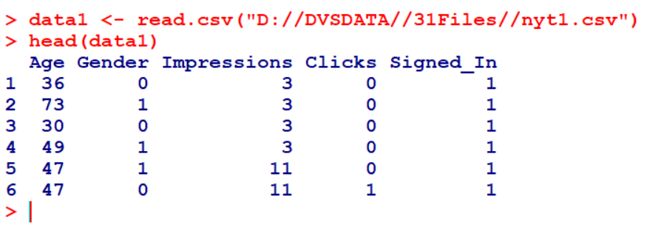

Slide 44
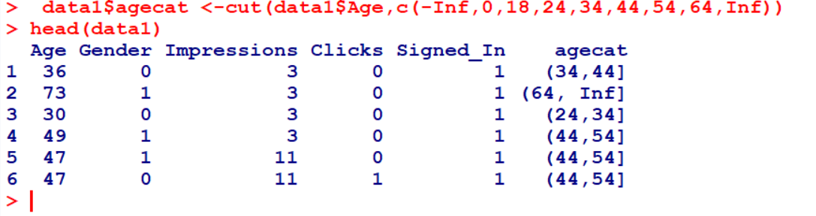

Slide 45
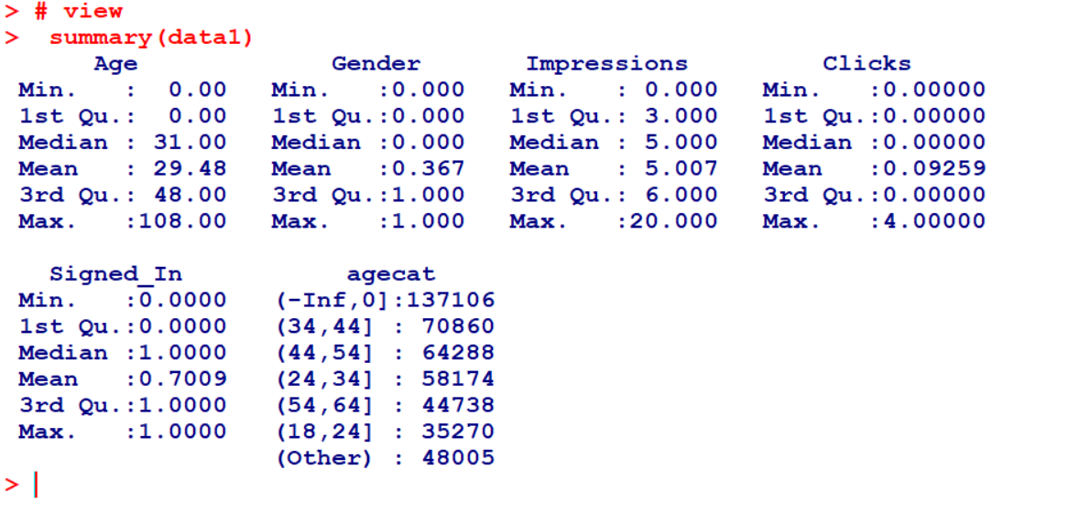

Slide 46
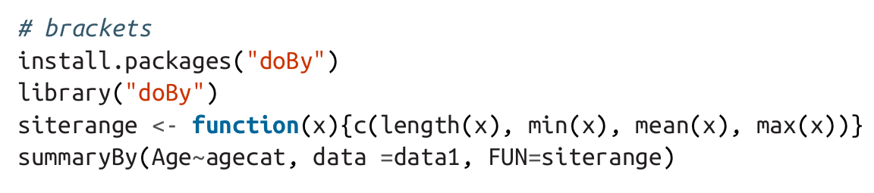

Slide 47
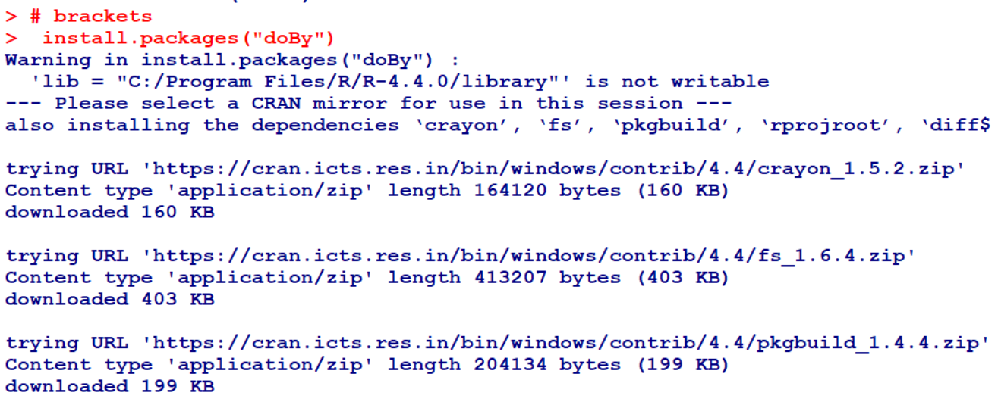

Slide 48
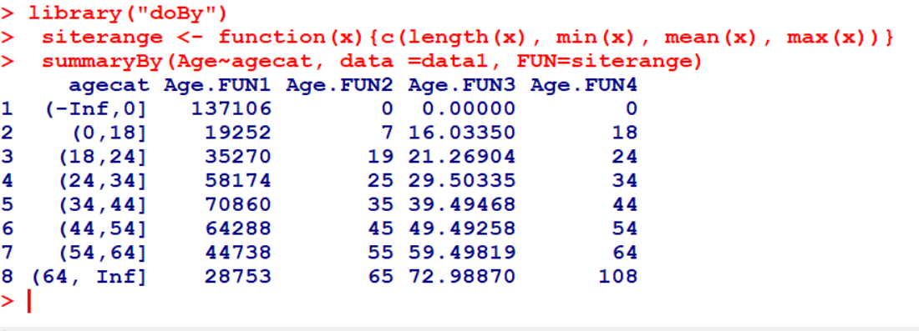

Slide 49
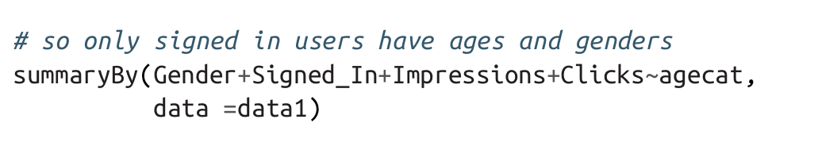
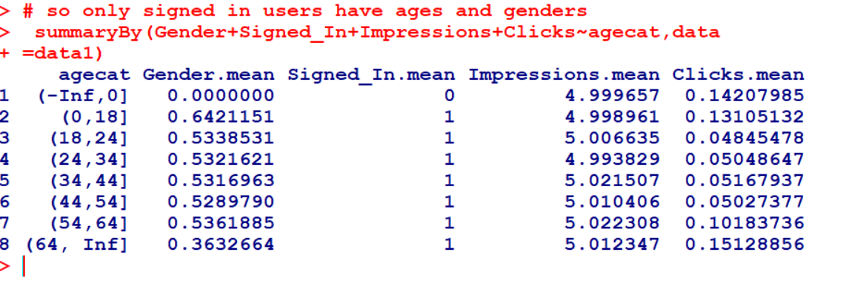

Slide 50
Drawing Plots
Install Package: install.packages("ggplot2")
Load Library: library(ggplot2)
Draw Histogram : ggplot(data1, aes(x=Impressions, fill=agecat)) +geom_histogram(binwidth=1)
Draw Box Plot: ggplot(data1, aes(x=agecat, y=Impressions, fill=agecat))+geom_boxplot()

Slide 51
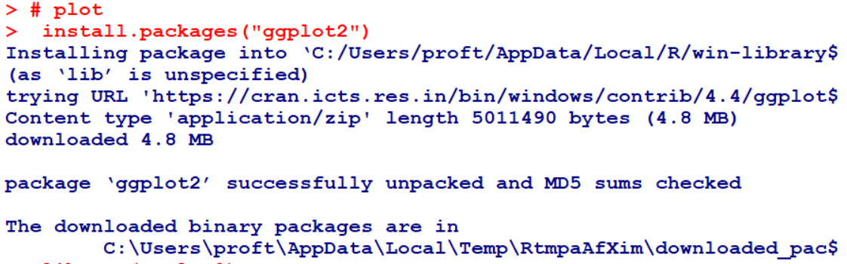
Install Package: install.packages("ggplot2")

Slide 52
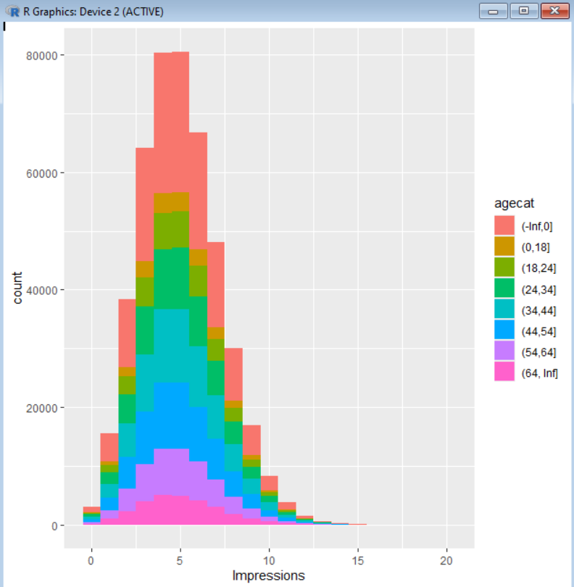
Draw Histogram : ggplot(data1, aes(x=Impressions, fill=agecat)) +geom_histogram(binwidth=1)

Slide 53
Box Blot
A box plot, also known as a box-and-whisker plot, is a graphical representation of a dataset that displays its distribution and central tendency. It is particularly useful for visualizing the spread and skewness of the data, as well as identifying outliers.
Here are the main components of a box plot:
Box: The box itself represents the interquartile range (IQR), which is the range between the first quartile (Q1) and the third quartile (Q3). This range contains the middle 50% of the data.
Median Line: A line inside the box marks the median (Q2) of the dataset.
Whiskers: Lines extending from the box to the smallest and largest values within 1.5 times the IQR from Q1 and Q3, respectively. These lines show the range of the data excluding outliers.
Outliers: Data points that fall outside of the whiskers. They are typically plotted as individual points beyond the whiskers.

Slide 54
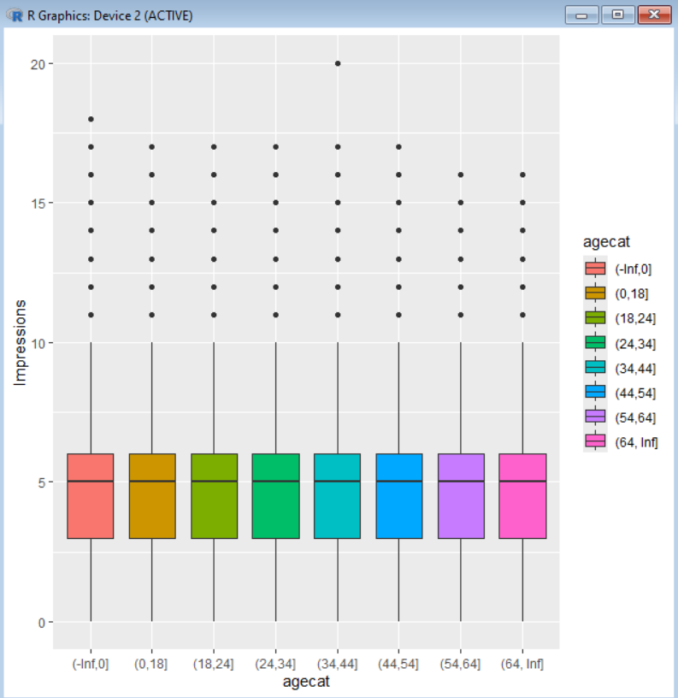
Draw Box Plot: ggplot(data1, aes(x=agecat, y=Impressions, fill=agecat))+geom_boxplot()

Slide 55
Outliers
In data science, outliers are data points that significantly deviate from the rest of the dataset. These anomalies can occur due to variability in the data or errors in the data collection process. Identifying and handling outliers is crucial because they can significantly affect the results of data analysis and statistical modeling.

Slide 56
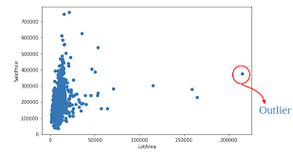

Slide 57
Example of Outliers
Consider a dataset representing the ages of students in a university class:
Ages=[18,19,20,21,22,23,24,25,26,27,40]
In this dataset, most students' ages range from 18 to 27 years. However, there is one student aged 40, which is significantly higher than the rest. This age of 40 is an outlier.

Slide 58
Thought Experiment: How Would You Simulate Chaos?
[Simulating Chaos: Exploring Order from Disorder]
Most data problems start out with a certain amount of dirty data, ill defined questions, and urgency. As data scientists we are, in a sense, attempting to create order from chaos.
Lorenzian Water Wheel: Ferris wheel-like apparatus with rotating water buckets, exhibiting chaotic behavior influenced by molecular interactions.
Digital Chaos Simulations: Binder and Jensen's paper explores chaos using finite-state machines in digital simulations.
Interdisciplinary Program: M.I.T., Harvard, and Tufts collaborated on a chaos simulation involving a humanitarian crisis scenario in Chad-Sudan border region.
Creating Order in Startups: Gascoigne's essay discusses strategies for managing chaos within startup environments to establish order amidst uncertainty and complexity.

Slide 59
Exploring Chaos and Simulation in Data Science
Simulation serves as a vital tool in data science, aiding in understanding model behavior and debugging code
Data scientists navigate organizational chaos, striving to impose order and learn from chaotic experiences.

Slide 60

Case Study: RealDirect

Slide 61
Case Study: RealDirect
CEO : Doug Perlson, Expert in real estate law, startups, and online advertising.
Vision : To leverage comprehensive real estate data to enhance the process of buying and selling homes.
Existing Status : Typically, homeowners sell their properties approximately every seven years with assistance from brokers and relying on current data.
Challenges : The broker system and data quality.

Slide 62
Case Study: RealDirect
RealDirect collects information by assembling a team of licensed real estate agents who collaborate and share knowledge through a seller interface with data-driven tips for selling homes and utilizing interaction data to offer real-time recommendations for next steps.
Brokers are trained to become proficient in using information-gathering tools.
RealDirect is actively developing real-time data feeds, covering crucial aspects such as home search initiation, initial offers, duration between offer and closure, and online search patterns.

Slide 63
How Does RealDirect Make Money?
Offering a subscription to Registered sellers—about $395 a month—to access the selling tools.
Reduced Real Estate Agents commission, from 2.5% or 3%. to 2%.
Website provide statuses for each person on site: active, offer made, offer rejected, showing, in contract, etc. Based on status, different actions are suggested by the software
Important factors that buyers prioritize was included in website, such as proximity to parks, subway stations, and schools, along with comparisons of apartment prices per square foot within the same building or block.

Slide 64
How Does RealDirect Make Money?
Ultimately, access to accurate and timely information benefits both buyers and sellers, assuming transparency and honesty in the transaction process.

Slide 65
Exercise: RealDirect Data Strategy
You have been hired as chief data scientist at realdirect.com, and report directly to the CEO.
The company (hypothetically) does not yet have its data plan in place.
It’s looking to you to come up with a data strategy.
Here are a couple ways you could begin to approach this problem:

Slide 66
Approaches
Explore all Current Details of Existing Website
Get Auxiliary Data
Load, Clean and Conduct Exploratory Data Analysis
Summarize the out come of EDA
Can you think of any other people you should talk to?
Acquire Domain Knowledge
Work on Best Practices for Data Strategy

Slide 67
1. Explore all Current Details of Existing Website
Explore its existing website, thinking about how buyers and sellers would navigate through it, and how the website is structured/ organized.
Try to understand the existing business model, and think about how analysis of RealDirect user-behavior data could be used to inform decision-making and product development.
Come up with a list of research questions you think could be answered by data:
  What data would you advise the engineers log and what would your ideal datasets look like?
  How would data be used for reporting and monitoring product usage?
  How would data be built back into the product/website?

Slide 68
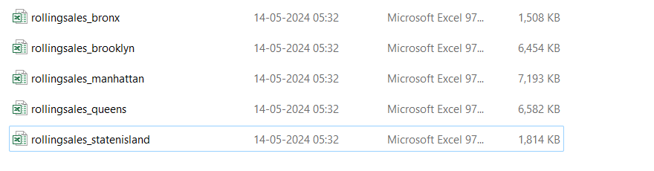
2.Get Auxiliary Data
Because there is no data yet for you to analyze (typical in a start up when its still building its product), you should get some auxiliary data to help gain intuition about this market.
For example, go to https://github.com/oreillymedia/doing_data_science. Click on Rolling Sales Update (after the fifth paragraph). You can use any or all of the datasets here.

Slide 69
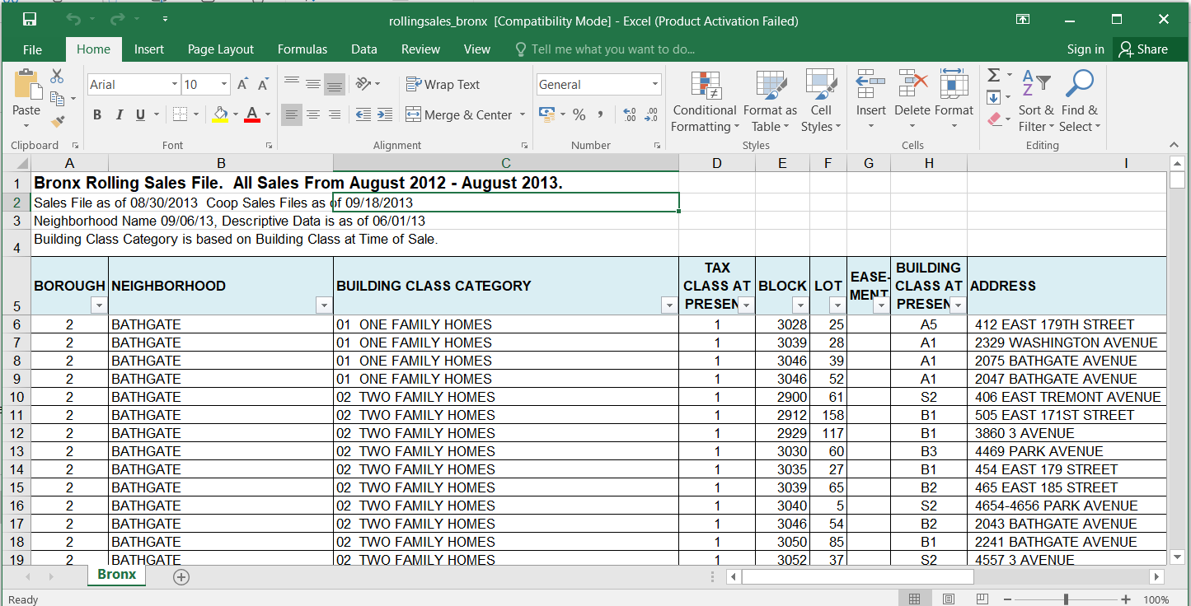

Slide 70
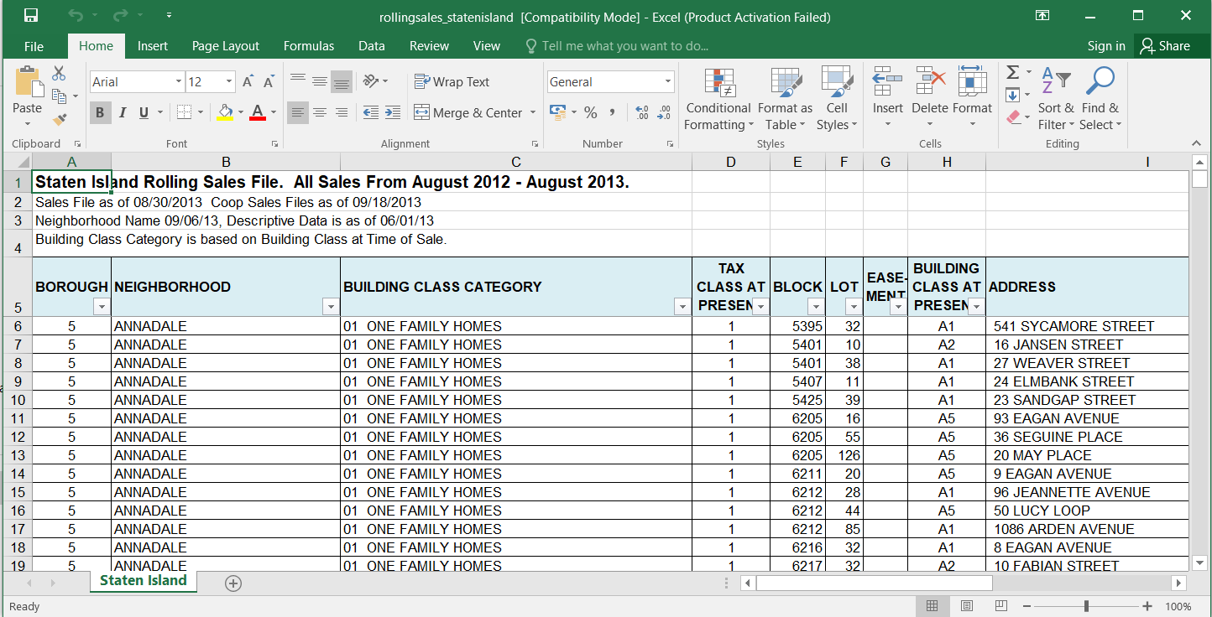

Slide 71
3. Load, Clean and Conduct Exploratory Data Analysis
First challenge: load in and clean up the data.
Next, conduct exploratory data analysis in order to find out where there are outliers or missing values, decide how you will treat them, make sure the dates are formatted correctly, make sure values you think are numerical are being treated as such, etc.
Once the data is in good shape, conduct exploratory data analysis to visualize and make comparisons
(i) across neighborhoods, and
(ii) across time.

Slide 72
3.Summarize the out come of EDA
Summarize your findings in a brief report aimed at the CEO

Slide 73
4. Can you think of any other people you should talk to?
Being the “data scientist” often involves speaking to people who aren’t also data scientists, so it would be ideal to have a set of communication strategies for getting to the information you need about the data.

Slide 74
5. Acquire Domain Knowledge
Most of you are not “domain experts” in real estate or online businesses.
Step out of your comfort zone and figure out how to “collect data”
Master the domain specific vocabulary. Sometimes “domain experts” have their own set of vocabulary.
  Did Doug use vocabulary specific to his domain that you didn’t understand (“comps,” “open houses,” “CPC”)?

Slide 75
6. Work on Best Practices for Data Strategy
Doug mentioned the company didn’t necessarily have a data strategy. There is no industry standard for creating one.
As you work through this assignment, think about whether there is a set of best practices you would recommend with respect to developing a data strategy for an online business, or in your own domain.

Slide 76
Sample R code
Here’s some sample R code that takes the Brooklyn housing data in the preceding exercise, and cleans and explores it a bit.
[ Size of Data Set: Rows: 23374, Columns: 21]
>install.packages("readxl")
>library(readxl)
>bk <- read_excel("D://DVSDATA//rollingsales_brooklyn.xls", sheet = 1)
>head(bk)
>summary(bk)

Slide 77
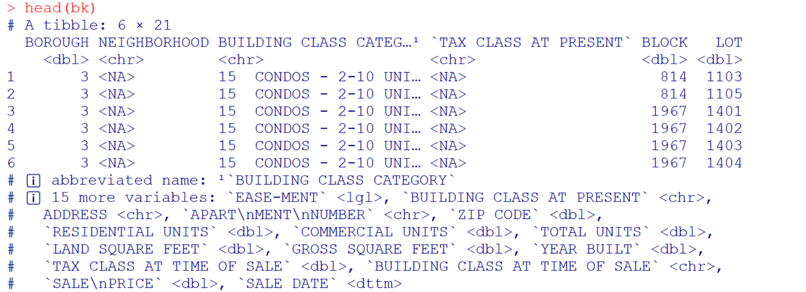
head(bk)

Slide 78
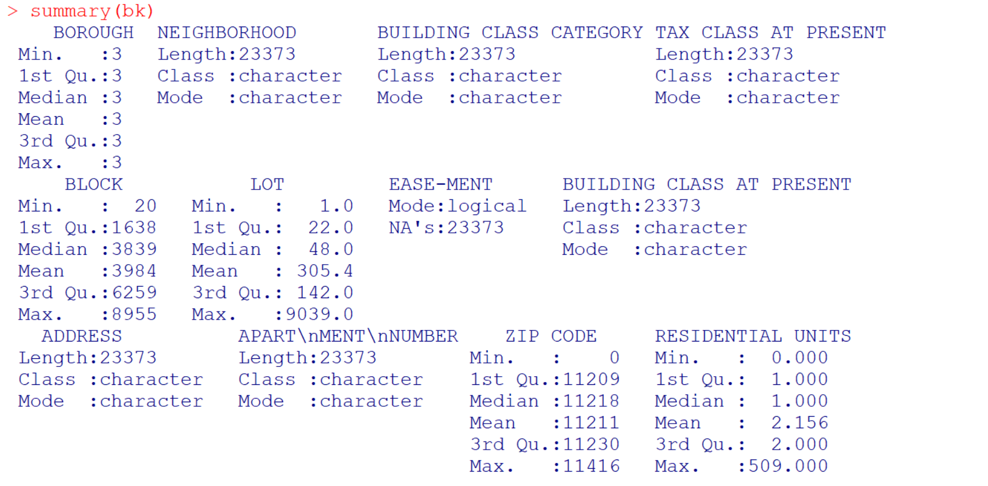
summary (bk)

Slide 79
To print Missing Values
na_count <- sum(is.na(bk$SALEPRICE))
print(na_count)
Output: 0

Slide 80
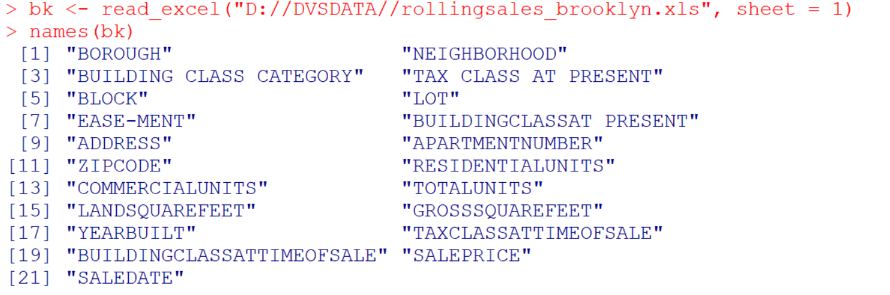
List all column names : names(bk)

Slide 81
clean/format the data with regular expressions
bk$gross.sqft <- as.numeric(gsub("[^[:digit:]]","",bk$GROSSSQUAREFEET))
Access the GROSSSQUAREFEET column:
Use gsub to remove non-digit characters
as.numeric(...) converts the resulting cleaned string, which now contains only digits, to a numeric type.
Assign the numeric value to a new column gross.sqft

Slide 82
Example
Suppose bk$GROSSSQUAREFEET has the following values:
"1,000"
"2,500"
"3,750sqft"
The gsub("[^[:digit:]]","",bk$GROSSSQUAREFEET) operation would transform these values to:
"1000"
"2500"
"3750"

Slide 83
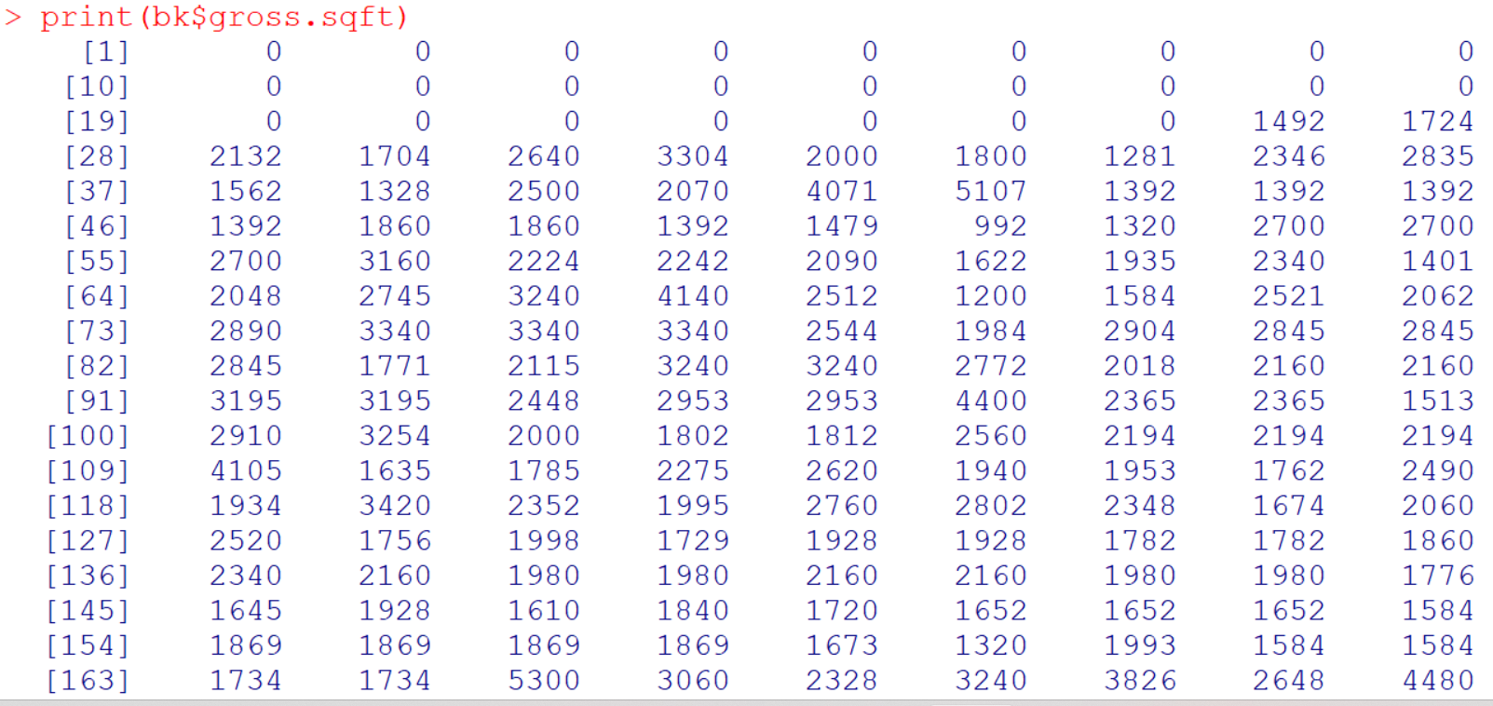

Slide 84
Similarly
bk$land.sqft <- as.numeric(gsub("[^[:digit:]]","",bk$LANDSQUAREFEET))
bk$sale.date <- as.Date(bk$SALEDATE)
bk$year.built <- as.numeric(as.character(bk$YEARBUILT))

Slide 85
Print and Check
print(bk$land.sqft)
print(bk$sale.date)
print(bk$year.built)

Slide 86
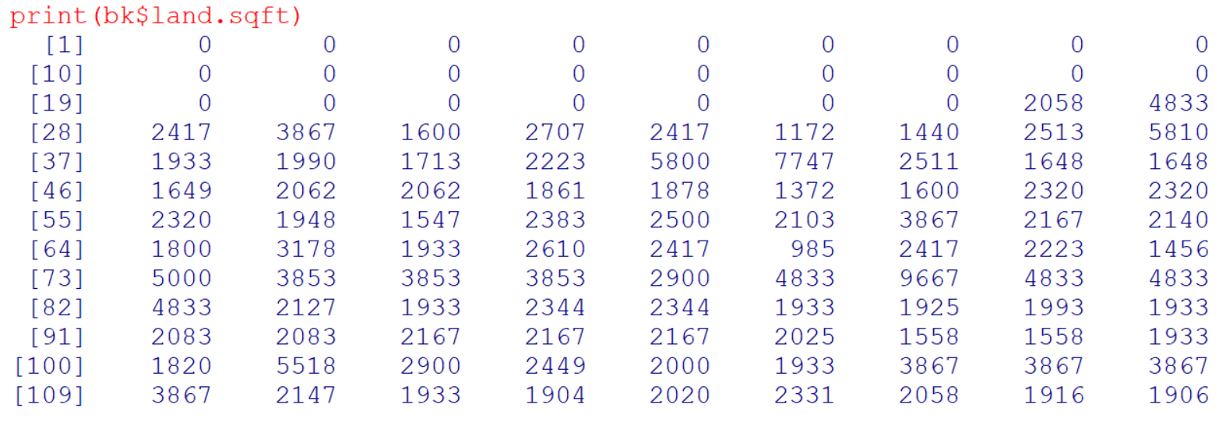

Slide 87
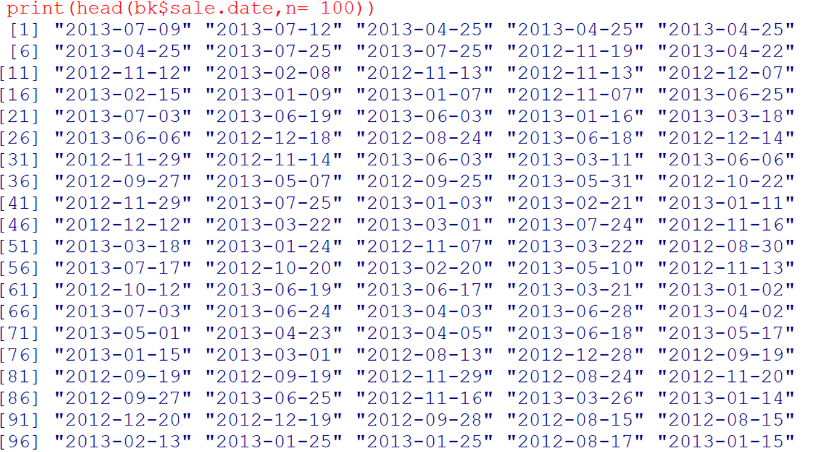

Slide 88
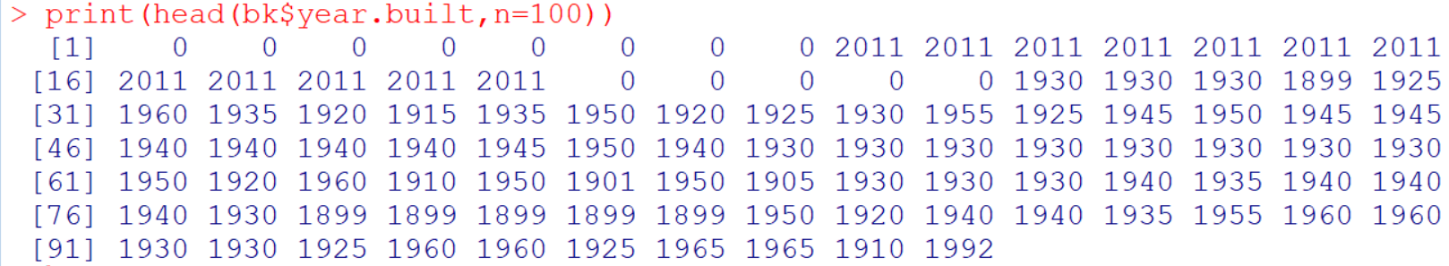

Slide 89
Exploratory Data Analysis

Slide 90
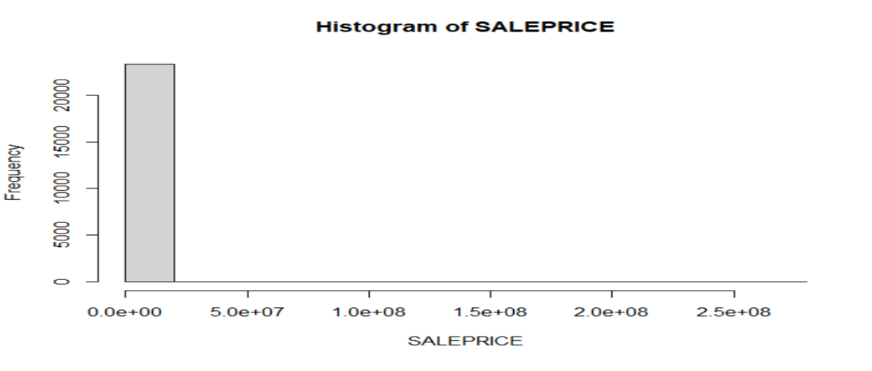
attach(bk) hist(SALEPRICE)

Slide 91
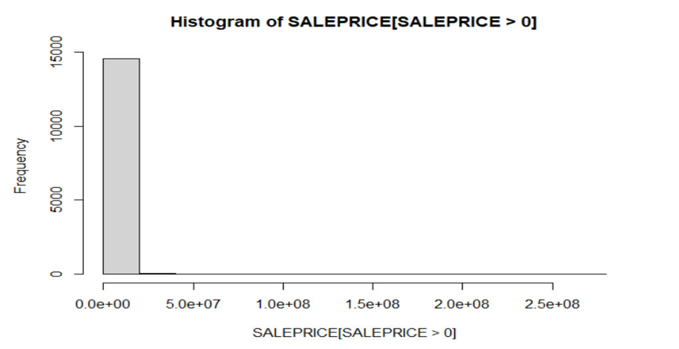
hist(SALEPRICE[SALEPRICE>0])

Slide 92
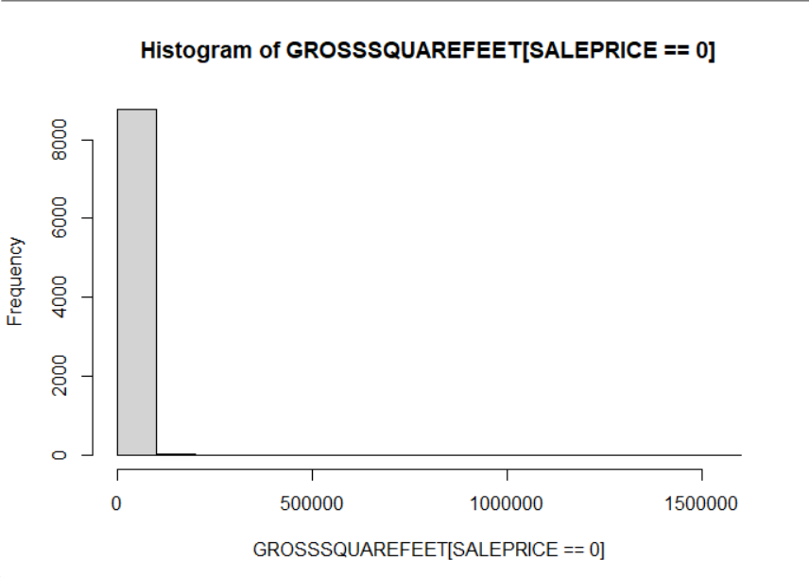
hist(GROSSSQUAREFEET[SALEPRICE==0])

Slide 93
Complete Code
hist(SALEPRICE)
hist(SALEPRICE[SALEPRICE>0])
hist(GROSSSQUAREFEET[SALEPRICE==0])
detach(bk)

Slide 94
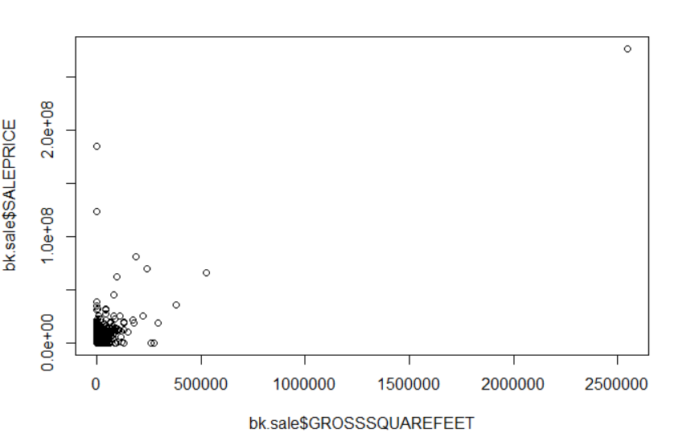
## keep only the actual sales bk.sale <- bk[bk$SALEPRICE!=0,] plot(bk.sale$GROSSSQUAREFEET,bk.sale$SALEPRICE)

Slide 95
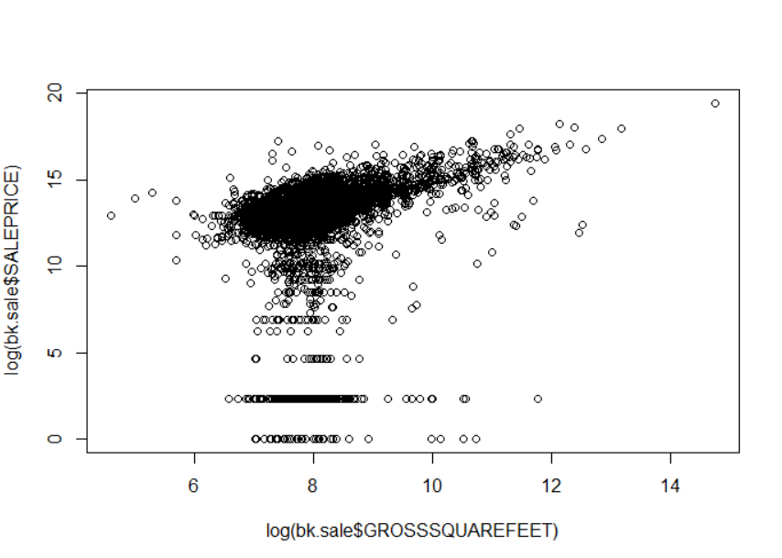
plot(log(bk.sale$GROSSSQUAREFEET),log(bk.sale$SALEPRICE))

Slide 96
Algorithms
An algorithm is a procedure or set of steps or rules to accomplish a task.
Algorithms are one of the fundamental concepts in, or building blocks of, computer science:
  the basis of the design of elegant and efficient code, data preparation and processing, and software engineering.
Some of the basic types of tasks that algorithms can solve are sorting, searching, and graph-based computational problems.
Efficiency is measured in terms of memory and computational time, which matters especially when you’re dealing with massive amounts of data and building consumer facing products.

Slide 97
Characteristics of an Algorithm
(Definiteness) Well-Defined Instructions : Clear and unambiguous steps.
Input: Specific data or parameters provided to the algorithm.
Output : One or more results produced by the algorithm.
Finiteness : Terminates after a finite number of steps.
Effectiveness : Each step can be performed in a finite amount of time using basic computational operations.

Slide 98
Additional Characteristics (Optional)
Deterministic: Most algorithms are deterministic, meaning that given the same input, they will always produce the same output. However, some algorithms can be non-deterministic or probabilistic, incorporating randomness in their steps.
General-purpose: Algorithms can often be designed to solve a broad class of problems, making them versatile and reusable for different applications with similar characteristics.

Slide 99
ML Algorithms
In the context of machine learning, an algorithm is a method or a process used to build models from data.
Key characteristics of algorithms include:
  Procedural: They specify a sequence of steps to achieve a specific outcome.
  General-purpose: They can often be applied to different types of data and problems.
  Deterministic: Given the same input, an algorithm will always produce the same output.
Examples in Machine Learning: Decision Trees, Linear Regression, Support Vector Machines, Gradient Descent, K-Means Clustering.

Slide 100
ML Model
A model is the output or the representation generated after an algorithm processes data.
In machine learning, a model is the mathematical representation of the learned patterns or relationships within the data.
The model is used to make predictions or decisions without being explicitly programmed to perform the task.

Slide 101
Key characteristics of models include:
Predictive: They can make predictions or decisions based on new data.
Learned: They are built using algorithms that learn from historical data.
Specific to Data: Models are specific to the data they are trained on; different datasets typically produce different models.
Examples in Machine Learning: A trained neural network for image recognition, a regression equation from linear regression, a decision tree classifier.

Slide 102
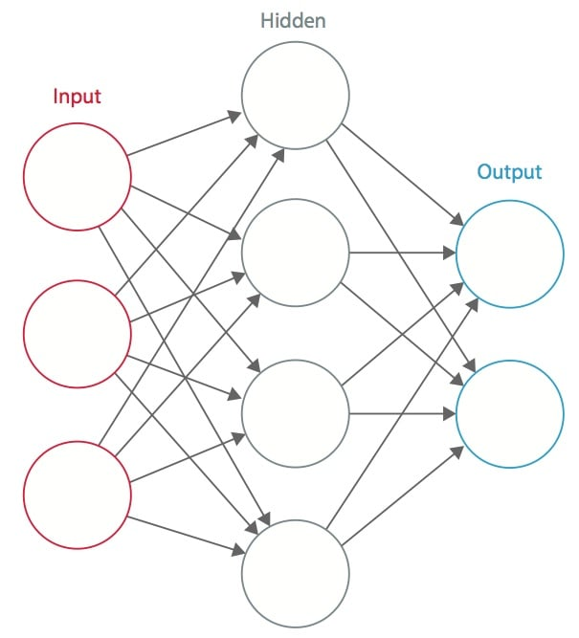
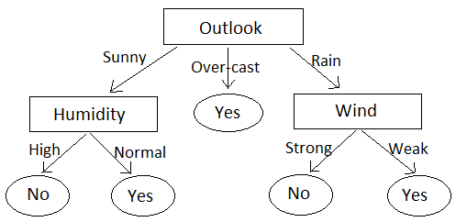
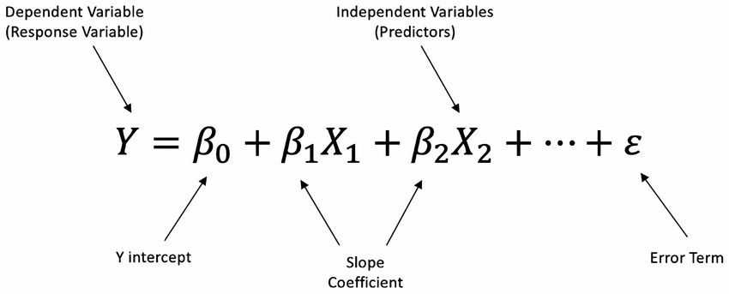
Machine Learning Models Examples
A trained neural network for image recognition,
A regression equation from linear regression,
A decision tree classifier.

Slide 103
Summary
An algorithm is the method or procedure used to learn from data.
A model is the result or the representation produced by running an algorithm on data.
In essence, algorithms are the recipes or instructions, and models are the final dishes prepared following those recipes.

Slide 104
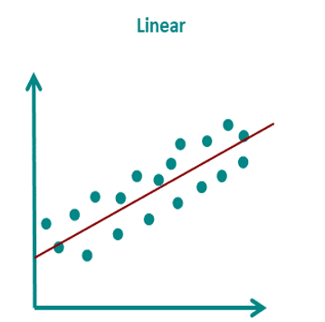
Linear Regression Algorithm:
Collect Data
Create A Formula (y = mx+c or y = m1x1+mx2+--+C)
Find the best fitting Line to a set of data points (Calculate coefficients i.e slope and intercept)
This algorithm defines the steps to fit a line to a set of data points by minimizing the sum of the squared differences between the observed and predicted values.

Slide 105
Linear Regression Model
Linear Regression Model: After running the linear regression algorithm on a specific dataset, you get a model represented by the equation 𝑦=𝑚𝑥+𝑏, where 𝑚 is the slope (coefficient) and 𝑏 is the intercept. This model can then be used to predict 𝑦 for new values of 𝑥.

Slide 106
Example : Linear Regression
Imagine you're a teacher trying to predict how well your students will do on their final exam based on how many hours they study.
You have data from past students showing how many hours they studied and what their scores were.
The linear regression algorithm is like a recipe or set of steps you follow to find a formula that best predicts the exam scores based on study hours.

Slide 107
Steps of the Linear Regression Algorithm
Collect Data: You have a list of study hours and corresponding exam scores for your past students.
Create a Formula: You assume there's a straight-line relationship (linear) between study hours and exam scores. The formula looks like:
  Score=𝛽0 + 𝛽1×Hours => y = c+ m x
  Here, 𝛽0​ is the starting point (intercept), and 𝛽1​ is how much the score increases for each additional hour of study (slope).
Find the Best Line: The algorithm helps you find the best values for 𝛽0​ and 𝛽1​ that make the formula fit your data as closely as possible.
  This is done by minimizing the differences between the actual scores and the scores predicted by your formula.

Slide 108
Linear Regression Model
Once you've used the algorithm to find the best 𝛽0​ and 𝛽1​, you get a specific formula.
Score=𝛽0 + 𝛽1×Hours
This formula is your linear regression model.

Slide 109
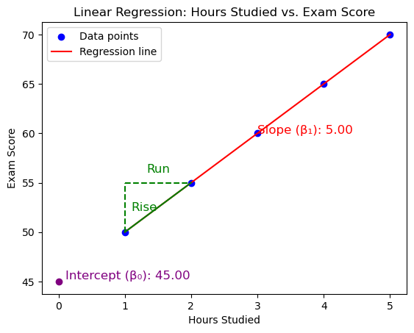
Example: Let's say you collected the following data from past students:
Hours Studied | Exam Score
1 | 50
2 | 55
3 | 60
4 | 65
5 | 70
Model: Score=45+5×Hours

Slide 110
Types/Classes of Data Science Algorithms
Data Engineering Algorithms
  Data munging, preparation, and processing algorithms, such as sorting, MapReduce, or Pregel.
Optimization algorithms
Machine learning algorithms.

Slide 111
Machine Learning Algorithms
Machine learning algorithms are largely used to predict, classify, or cluster.
Overlaps with statistical modeling.
Statistical Modeling: Originates from statistics departments.
Machine Learning Algorithms: Rooted in computer science departments.
Some techniques belong to both fields:
  Example: Linear Regression (found in both machine learning and statistics)

Slide 112
Key Differences and Cultural Approaches
Parameters | Statisticians | Machine Learning Software Engineers
Interpreting Parameters | Real-world interpretations | Focus on predictive power
Confidence Intervals | Use confidence intervals and posterior distributions | Often lack this notion
Explicit Assumptions | Make explicit assumptions about data distributions | Often implicit assumptions
Cultural Approaches | Investigate uncertainty, never 100% confident | Focus on building predictive models, emphasize rapid iteration and fixing issues

Slide 113
Josh Wills' quote
Data scientist (noun):
Person who is better at statistics than any software engineer and better at software engineering than any statistician.

Slide 114
Three Basic Algorithms
Linear Regression
KNN
K Means

Slide 115
1. Linear Regression Algorithm
Collect Data: Gather data for the dependent and independent variables.
Visualize Data: Plot the data to see if there is an apparent linear relationship.
Fit the Model: Use the least squares method to find the best-fitting line.
Evaluate the Model: Check how well the line fits the data using metrics like Mean Squared Error (MSE).
Make Predictions: Use the fitted model to make predictions on new data.

Slide 116
Example1:
Suppose you run a social networking site that charges a monthly subscription fee of $25, and that this is your only source of revenue.
Each month you collect data and count your number of users and total revenue. You’ve done this daily over the course of two years, recording it all in a spreadsheet. You could express this data as a series of points. Here are the first four:
S={(x,y)=(1,25),(10,250),(100,2500),(200,5000)}

Slide 117
Equation to represent the relationship of x and y
x | y
1 | 25
10 | 250
100 | 2500
200 | 5000
𝑦=25𝑥

Slide 118
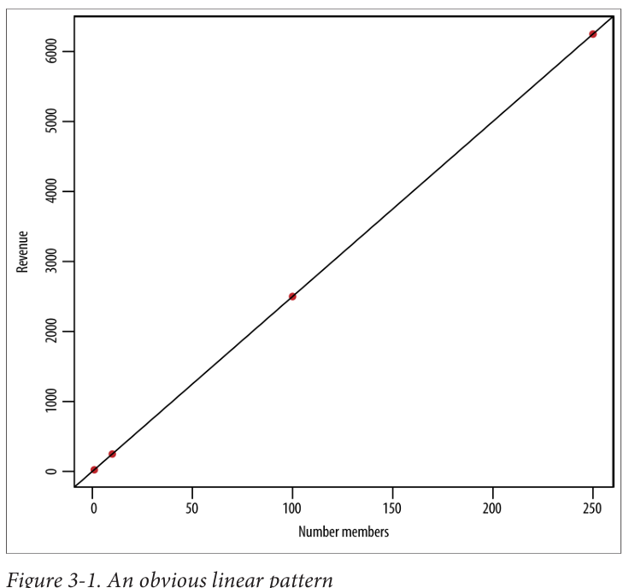
Deduce this mentally and identify the following:
There’s a linear pattern.
The coefficient relating 𝑥 and 𝑦 is 25.
The relationship seems deterministic.

Slide 119
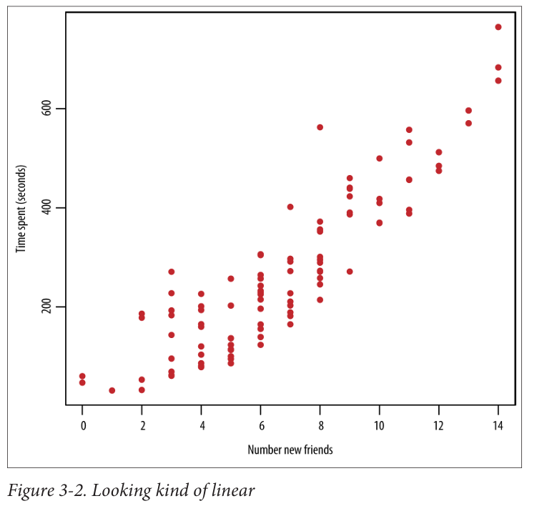
Example2: Sample Data and Plot:
new_friends | time_spent (seconds)
7 | 276
3 | 43
4 | 82
6 | 136
10 | 417
9 | 269

Slide 120
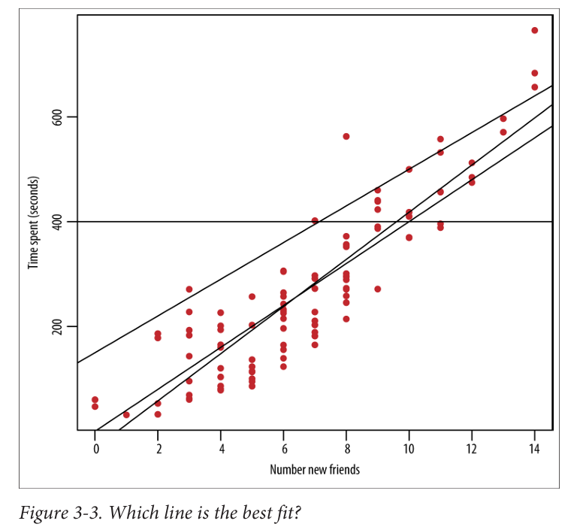

Slide 121
Which Line is the best fit?
Assuming a Linear Relationship:
  Start with the assumption: 𝑦=𝛽0+𝛽1𝑥 ,
  𝛽0​ and 𝛽1​ represent the intercept and slope, respectively
Estimate the parameters (𝛽0​ and 𝛽1​) using observed data pairs:
  (𝑥1,𝑦1),(𝑥2,𝑦2),...,(𝑥𝑛,𝑦𝑛).

Slide 122
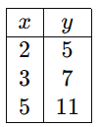
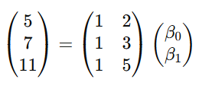
Linear model in matrix notation
Express the linear model in matrix notation: 𝑦=𝑥⋅𝛽.
𝑥 is the matrix of input variables, and 𝛽 is the parameter vector.
In this example:
𝑦1=5, 𝑦2=7, and 𝑦3=11 are the observed values of the dependent variable.
𝑥1=2, 𝑥2=3, and 𝑥3=5 are the values of the independent variable.
𝛽0​ is the intercept and β1​ is the slope of the linear

Slide 123

Fitting the model
By applying least squares estimation, Linear regression seeks to find the line that minimizes the sum of the squares of the vertical distances between the approximated or predicted 𝑦_{𝑖}^ s and the observed 𝑦_{𝑖} s.
To find this line, you define the "residual sum of squares" (RSS), denoted as:
RSS(𝛽) = $\sum_{i}{\left(y_{i}−βx_{i}\right)}$²
  where i ranges over the various data points.

Slide 124


Slide 125

Evaluation metrics
R-squared (𝑅²) : 𝑅² measures the proportion of the variance in the dependent variable that is predictable from the independent variable(s).
𝑅² ranges from 0 to 1. A higher 𝑅² value indicates a better fit of the model to the data.

Slide 126

Evaluation metrics
p-values: The p-value tests the null hypothesis that a coefficient (β) is equal to zero (no effect).
A low p-value (< 0.05) indicates that you can reject the null hypothesis, meaning the coefficient is significantly different from zero.

Slide 127
Example R Code for the Sample Data
new_friends | time_spent (seconds)
7 | 276
3 | 43
4 | 82
6 | 136
10 | 417
9 | 269

Slide 128


Slide 129


Slide 130


Slide 131
2. KNN Algorithm
The K-Nearest Neighbors (KNN) algorithm is a simple, supervised machine learning algorithm that can be used for both classification and regression tasks.
It works based on the principle that similar data points (neighbors) are likely to have similar outcomes.

Slide 132
2. KNN Algorithm
Data Preparation: Collect and prepare the dataset, ensuring it's in a suitable format for analysis.
Choosing K: Select the number of neighbors (K) to consider for making predictions.
Distance Calculation: For a given data point that needs to be classified or predicted, calculate the distance between this point and all other points in the dataset. Common distance metrics include Euclidean, Manhattan, and Minkowski distances.
Identify Neighbors: Identify the K closest data points (neighbors) to the data point in question.
Voting/Prediction:
  Classification: The class with the majority among the K neighbors is assigned to the data point.
  Regression: The average value of the K neighbors is assigned to the data point.

Slide 133
Key Points:
Distance Metrics: Euclidean distance is most common, but other metrics can be used depending on the problem.
Choosing K: The value of K can significantly impact the algorithm's performance. A common approach is to use cross-validation to find the optimal K.
Data Scaling: KNN is sensitive to the scale of the data. It’s important to normalize or standardize the data before applying KNN.

Slide 134
Example Data Set:
X1 | X2 | Label
1 | 2 | A
2 | 3 | A
3 | 3 | B
6 | 5 | B
7 | 8 | B
8 | 8 | A
We want to predict the label of a new point (4, 4) using KNN with K=3.

Slide 135

Step-by-Step Example:
We want to predict the label of a new point (4, 4) using KNN with K=3

Slide 136

Step-by-Step Example:

Slide 137

Implementation in Python:

Slide 138

Implementation in Python:

Slide 139


Implementation in R Program

Slide 140
KNN Applications
Image Classification
Recommendation Systems
Medical Diagnosis
Fraud Detection
Customer Segmentation

Slide 141
Distance/ Similarity Metrics
When working with various types of data, understanding and defining similarity or distance between data points is crucial.
Here we discuss several common similarity and distance metrics, each with its unique definition of "closeness."
These metrics are used in different contexts and types of data to determine how similar or different data points are.

Slide 142

1. Euclidean Distance
Euclidean distance is the straight-line distance between two points in a plane. It is commonly used for real-valued attributes that can be plotted in multidimensional space.

Slide 143

2. Cosine Similarity
Cosine similarity measures the cosine of the angle between two non-zero vectors of an inner product space. It is used to determine how similar two vectors are, yielding a value between -1 (exact opposite) and 1 (exactly the same), with 0 meaning no correlation.

Slide 144

3. Jaccard Distance/Similarity
Jaccard similarity measures the similarity between finite sets. It is defined as the size of the intersection divided by the size of the union of the sets.

Slide 145

4. Mahalanobis Distance
Mahalanobis distance is a measure of the distance between a point and a distribution. It accounts for the correlations of the data set and is scale-invariant.

Slide 146
5. Hamming Distance
Hamming distance measures the number of positions at which the corresponding symbols differ. It is used for strings of the same length.
Example: For strings "olive" and "ocean": The Hamming distance is 4 (differences at positions 2, 3, 4, and 5).

Slide 147

6.Manhattan Distance
Manhattan distance (also known as L1 distance) measures the sum of the absolute differences of their Cartesian coordinates. It is like a taxi driving on a grid of streets.

Slide 148
Custom Distance Metrics
Custom distance metrics are often created to handle specific needs in datasets that contain mixed types of data (e.g., numerical and categorical).

Slide 149
Scenario
You are working with a movie dataset that includes the following attributes for each movie:
  Budget (in millions of dollars) - Numerical
  Number of actors - Numerical
  Genre – Categorical
You need to define a custom distance metric that appropriately handles these mixed data types.

Slide 150
Example Movies
Let's consider two movies:
Movie A:
Budget = $50 million, Number of Actors = 10, Genre = Action
Movie B:
Budget = $80 million, Number of Actors = 12, Genre = Comedy

Slide 151
Step 1: Normalize the Numerical Attributes
Normalization scales the numerical values to a common range, usually [0, 1], to ensure fair contribution to the overall distance.
For simplicity, assume the following normalization (based on min-max normalization):
Budget: min = $0 million, max = $100 million
Number of Actors: min = 0, max = 20

Slide 152
Normalized values:
Movie A:
Normalized Budget = (50 - 0) / (100 - 0) = 0.5
Normalized Number of Actors = (10 - 0) / (20 - 0) = 0.5
Movie B:
Normalized Budget = (80 - 0) / (100 - 0) = 0.8
Normalized Number of Actors = (12 - 0) / (20 - 0) = 0.6

Slide 153
Step 2: Calculate Normalized Euclidean Distance for Numerical Attributes

Slide 154
Step 3: Calculate Categorical Distance for Genre
Since the genres are different (Action vs. Comedy), assign a distance of 10:
𝑑_{cat} = 10

Slide 155
Step 4: Combine the Distances
Combine the distances from numerical and categorical attributes. Since the categorical distance is significantly larger, it will dominate unless we scale it appropriately.
For the purpose of this example, assume we directly add them:
d_{total​=dnum​+dcat​} = 0.316+10 = 10.316

Slide 156

Custom Distance Metric Formula

Slide 157
Training and Test Sets
When you are working with a machine learning algorithm, the general process involves two main phases: training and testing.
Here's a simple explanation of each phase:

Slide 158
Training Phase
Purpose: To create and train a model using known data.
Process:
  You use a portion of your data, called the training set, where the outcomes (or labels) are already known.
  The model learns from this data. For example, in a dataset of people with their ages, incomes, and credit scores labeled as "high" or "low," the model learns the patterns and relationships between these attributes.
  In the k-NN (k-Nearest Neighbors) algorithm, the training phase involves simply reading in the data with the known labels (e.g., "high" or "low" credit).

Slide 159
Testing Phase
Purpose: To evaluate how well the trained model performs on new, unseen data.
Process:
  You use a different portion of your data, called the test set, which was not used during training.
  In the test set, you pretend that you don't know the outcomes (or labels). The model makes predictions based on what it learned during training.
  You then compare the model's predictions to the actual known outcomes in the test set to see how accurate the model is.

Slide 160
Example with Steps
Consider you have a dataset with 1,000 rows, each containing information about age, income, and credit score (either "high" or "low").
Here's how you could split this data into training and test sets and use them:

Slide 161
1. Load the Data:
> head(data)
age income credit
1 69 79 low
2 66 17 low
3 49 26 low
4 49 71 low
5 58 57 high
6 44 79 high

Slide 162
2. Define the Number of Rows and Sampling Rate:
n.points <- 1000 # Total number of rows in the dataset
sampling.rate <- 0.8 # 80% for training, 20% for testing

Slide 163
3. Calculate the Number of Test Set Labels:
num.test.set.labels <- n.points * (1 - sampling.rate) # 20% of the data

Slide 164
4. Randomly Sample Training Set Rows:
training <- sample(1:n.points, sampling.rate * n.points, replace=FALSE)

Slide 165
5. Create Training Set:
train <- subset(data[training, ], select = c(age, income))
cl <- data$credit[training] # Labels for the training set

Slide 166
6. Define Test Set Rows and Create Test Set:
testing <- setdiff(1:n.points, training)
test <- subset(data[testing, ], select = c(age, income))
true.labels <- data$credit[testing] # True labels for the test set

Slide 167
How It Works
Training Set: 80% of the data (randomly selected) used to train the model. This set includes the "credit" labels.
Test Set: The remaining 20% of the data used to test the model. This set does not provide the "credit" labels to the model during testing but keeps them for evaluating the model's performance.
By comparing the model's predictions on the test set with the true labels (which are known but not used during prediction), you can assess how well your model is likely to perform on new, unseen data.

Slide 168
Picking an Evaluation Metric:
Customizing Evaluation Metrics
Sensitivity and Specificity
  Sensitivity (True Positive Rate)
  Specificity (True Negative Rate)
Precision and Recall
  Precision
  Recall
Accuracy and Misclassification Rate

Slide 169


Slide 170


Slide 171


Slide 172
Summary of the Metrics
Sensitivity (Recall): Focuses on correctly identifying positive cases.
Specificity: Focuses on correctly identifying negative cases.
Precision: Focuses on the accuracy of positive predictions.
Recall: Focuses on the ability to find all relevant positive cases.
Accuracy: Overall correctness of the model.
Misclassification Rate: Overall incorrectness of the model.

Slide 173
Modeling Assumptions in k-NN Algorithm
Feature Space and Distance: The data exists in a feature space where a notion of "distance" between data points is meaningful.
Labeled Training Data: The training data has labels or classifications for two or more classes.
Choosing the Number of Neighbors (k): The choice of k can significantly impact the performance of the model.
Association Between Features and Labels: There is an implicit assumption that the observed features and the labels are somehow related.

Slide 174
3.K Means Algorithm
The K-Means algorithm is a popular clustering technique used to partition a dataset into K clusters.
The goal is to minimize the variance within each cluster, thereby ensuring that data points within a cluster are as similar as possible.

Slide 175
Steps of K-Means Algorithm
Initialize Centroids:
  Randomly select 𝐾 initial centroids from the dataset. These centroids will represent the initial cluster centers.
Assign Data Points to Clusters:
  For each data point, calculate the Euclidean distance to each centroid.
  Assign each data point to the cluster with the nearest centroid.
Update Centroids:
  For each cluster, calculate the new centroid by taking the mean of all data points assigned to that cluster.
Repeat:
  Repeat steps 2 and 3 until the centroids no longer change significantly, or for a fixed number of iterations.
Convergence:
  The algorithm converges when the assignments of data points to clusters no longer change.

Slide 176
Example Dataset
Let's consider a simple 2D dataset for illustration:
Data Point | X | Y
A | 1 | 2
B | 1 | 4
C | 3 | 4
D | 5 | 2
E | 5 | 4

Slide 177
Step1: Initialize Centroids
  Suppose we choose K=2 (we want to partition the data into 2 clusters).
  Randomly select two initial centroids. For simplicity, let's choose points A (1, 2) and D (5, 2).

Slide 178
Step2: Assign Data Points to Clusters
  Calculate distances and assign points to the nearest centroid.
Data Point | Distance to (1, 2) | Distance to (5, 2) | Assigned Cluster
A (1, 2) | 0 | 4 | 1
B (1, 4) | 2 | 4.47 | 1
C (3, 4) | 2.83 | 3.61 | 1
D (5, 2) | 4 | 0 | 2
E (5, 4) | 4.47 | 2 | 2

Slide 179
3. Update Centroids: Calculate the new centroids for each cluster.
Cluster 1: (A, B, C)
  New Centroid = ((1+1+3)/3, (2+4+4)/3) = (1.67, 3.33)
Cluster 2: (D, E)
  New Centroid = ((5+5)/2, (2+4)/2) = (5, 3)

Slide 180
Step 4: Repeat
Reassign data points to the new centroids and update centroids again if necessary.
Data Point | Distance to (1.67, 3.33) | Distance to (5, 3) | Assigned Cluster
A (1, 2) | 1.86 | 4.12 | 1
B (1, 4) | 1.05 | 4.12 | 1
C (3, 4) | 1.67 | 2.24 | 1
D (5, 2) | 3.61 | 1 | 2
E (5, 4) | 3.81 | 1 | 2
New centroids remain the same as above: Cluster 1 (1.67, 3.33), Cluster 2 (5, 3)

Slide 181
Step5: Convergence
The algorithm converges when the centroids no longer change.
In this example, the clusters have stabilized after the second iteration.

Slide 182

Step6: Visual Representation
The final clusters can be visualized as follows:
Cluster 1: Points A (1, 2), B (1, 4), C (3, 4) with centroid (1.67, 3.33)
Cluster 2: Points D (5, 2), E (5, 4) with centroid (5, 3)

Slide 183
k-means has some known issues
Choosing k is more an art than a science, although there are bounds: 1≤k≤n, where n is number of data points.
There are convergence issues—the solution can fail to exist, if the algorithm falls into a loop, for example, and keeps going back and forth between two possible solutions, or in other words, there isn’t a single unique solution.
Interpretability can be a problem—sometimes the answer isn’t at all useful. Indeed that’s often the biggest problem.

Slide 184
Exercise: Basic Machine Learning Algorithms
Consider the NYC (Manhattan) Housing dataset and perform the following using R program:
Analyze sales using regression with any predictors you feel are relevant. Justify why regression was appropriate to use.
Visualize the coefficients and fitted model.
Predict the neighborhood using a k-NN classifier. Be sure to with hold a subset of the data for testing. Find the variables and the k that give you the lowest prediction error.
Report and visualize your findings.
Describe any decisions that could be made or actions that could be taken from this analysis.

Slide 185
End of Module2

