Slide 1
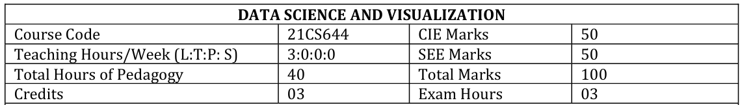

Slide 2
Course Learning Objectives
CLO 1. To introduce data collection and pre-processing techniques for data science
CLO 2. Explore analytical methods for solving real life problems through data exploration techniques
CLO 3. Illustrate different types of data and its visualization
CLO 4. Find different data visualization techniques and tools
CLO 5. Design and map element of visualization well to perceive information

Slide 3
Syllabus
Module1: Introduction to Data Science
Module2:Exploratory Data Analysis and the Data Science Process
Module3:Feature Generation and Feature Selection Extracting Meaning from Data
Module4: Data Visualization and Data Exploration
Module5: A Deep Dive into Matplotlib Introduction

Slide 4
Syllabus
Module1: Introduction to Data Science Introduction: What is Data Science? Big Data and Data Science hype – and getting past the hype, Why now? – Datafication, Current landscape of perspectives, Skill sets. Needed Statistical Inference: Populations and samples, Statistical modelling, probability distributions, fitting a model.
Module2:Exploratory Data Analysis and the Data Science Process: Basic tools (plots, graphs and summary statistics) of EDA, Philosophy of EDA, The Data Science Process, Case Study: Real Direct (online real estate firm). Three Basic Machine Learning Algorithms: Linear Regression, k-Nearest Neighbours (k- NN), k-means.
Module3:Feature Generation and Feature Selection Extracting Meaning from Data: Motivating application: user (customer) retention. Feature Generation (brainstorming, role of domain expertise, and place for imagination), Feature Selection algorithms. Filters; Wrappers; Decision Trees; Random Forests. Recommendation Systems: Building a User-Facing Data Product, Algorithmic ingredients of a Recommendation Engine, Dimensionality Reduction, Singular Value Decomposition, Principal Component Analysis, Exercise: build your own recommendation system.

Slide 5
Syllabus
Module4: Data Visualization and Data Exploration Introduction: Data Visualization, Importance of Data Visualization, Data Wrangling, Tools and Libraries for Visualization Comparison Plots: Line Chart, Bar Chart and Radar Chart; Relation Plots: Scatter Plot, Bubble Plot , Correlogram and Heatmap; Composition Plots: Pie Chart, Stacked Bar Chart, Stacked Area Chart, Venn Diagram; Distribution Plots: Histogram, Density Plot, Box Plot, Violin Plot; Geo Plots: Dot Map, Choropleth Map, Connection Map; What Makes a Good Visualization?
Module5: A Deep Dive into Matplotlib Introduction, Overview of Plots in Matplotlib, Pyplot Basics: Creating Figures, Closing Figures, Format Strings, Plotting, Plotting Using pandas DataFrames, Displaying Figures, Saving Figures; Basic Text and Legend Functions: Labels, Titles, Text, Annotations, Legends; Basic Plots:Bar Chart, Pie Chart, Stacked Bar Chart, Stacked Area Chart, Histogram, Box Plot, Scatter Plot, Bubble Plot; Layouts: Subplots, Tight Layout, Radar Charts, GridSpec; Images: Basic Image Operations, Writing Mathematical Expressions

Slide 6
Course Outcomes
At the end of the course the student will be able to:
CO 1. Understand the data in different forms
CO 2. Apply different techniques to Explore Data Analysis and the Data Science Process
CO 3. Analyze feature selection algorithms & design a recommender system.
CO 4. Evaluate data visualization tools and libraries and plot graphs.
CO 5. Develop different charts and include mathematical expressions.

Slide 7
Assessment Details (both CIE and SEE)
The weightage of Continuous Internal Evaluation (CIE) is 50% and for Semester End Exam (SEE) is 50%.
The minimum passing mark for the CIE is 40% of the maximum marks (20 marks).
The minimum passing mark is 35% (18 Marks out of 50) in the semester-end examination (SEE), and a
Minimum of 40% (40 marks out of 100) in the sum total of the CIE (Continuous Internal Evaluation) and SEE (Semester End Examination) taken together .

Slide 8
Continuous Internal Evaluation:
Three Unit Tests each of 20 Marks (duration 01 hour)
  1. First test at the end of 5th week of the semester
  2. Second test at the end of the 10th week of the semester
  3. Third test at the end of the 15th week of the semester
Two assignments each of 10 Marks
  4. First assignment at the end of 4th week of the semester
  5. Second assignment at the end of 9th week of the semester
6. At the end of the 13th week of the semester Group discussion/Seminar/quiz any one of three suitably planned to attain the COs and POs for 20 Marks (duration 01 hours)
The sum of three tests, two assignments, and quiz/seminar/group discussion will be out of 100 marks and will be scaled down to 50 marks

Slide 9
Semester End Examination:
Theory SEE will be conducted by University as per the scheduled timetable, with common question papers for the subject (duration 03 hours) Max Marks: 100
  1. The question paper will have ten questions. Each question is set for 20 marks. Marks scored shall be proportionally reduced to 50 marks
  2. There will be 2 questions from each module. Each of the two questions under a module (with a maximum of 3 sub-questions), should have a mix of topics under that module.
  The students have to answer 5 full questions, selecting one full question from each module.

Slide 10

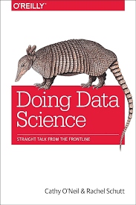

Textbooks
1. Doing Data Science, Cathy O’Neil and Rachel Schutt, O'Reilly Media, Publisher, 2013

Slide 11
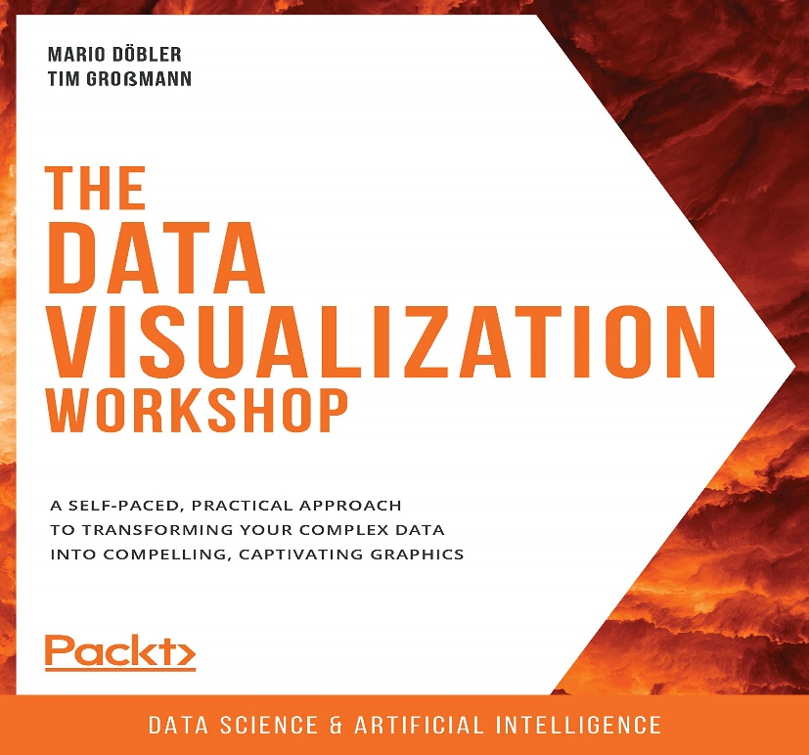


Textbooks
2. Data Visualization workshop, Tim Grobmann and Mario Dobler, Packt Publishing, ISBN 9781800568112

Slide 12
Reference:
1. Mining of Massive Datasets, Anand Rajaraman and Jeffrey D. Ullman, Cambridge University Press, 2010
2. Data Science from Scratch, Joel Grus, Shroff Publisher /O’Reilly Publisher Media
3. A handbook for data driven design by Andy krik

Slide 13
Weblinks and Video Lectures (e-Resources):
1. https://nptel.ac.in/courses/106/105/106105077/
2. https://www.oreilly.com/library/view/doing-data-science/9781449363871/toc01.html
3. http://book.visualisingdata.com/
4. https://matplotlib.org/
5. https://docs.python.org/3/tutorial/
6. https://www.tableau.com/

Slide 14
Module1 : Introduction to Data Science and Statistical Inference Needed:
Introduction : What is Data Science? Big Data and Data Science hype – and getting past the hype, Why now? Datafication, Current landscape of perspectives, Skill sets.
Needed Statistical Inference: Populations and samples, Statistical modelling, probability distributions, fitting a model.

Slide 15
Background of Book
Cathy and Rachel were unsure and puzzled about all the excitement around data science and Big Data in the media.
They discussed their confusion over breakfast, wondering if this new trend might be important and match their skills.
Instead of ignoring it, they decided to learn more.
Eventually, Rachel started teaching a data science course at Columbia University, Cathy wrote about it on her blog, and now you're reading a book based on their experiences.

Slide 16
Big Data and Data Science Hype:
Here are five reasons why Big Data and Data Science have caused a lot of excitement:
Confusing Terminology
Lack of Recognition for Previous Work
Exaggerated Hype
Confusion with Statistics
Debates about Science vs. Craft

Slide 17
Getting Past the Hype
Rachel studied statistics in school and then started working at Google. Initially didn't believe about data science hype, Rachel found her job at Google revealed its validity.
School laid a foundation, but coding, data visualization, and domain knowledge were crucial for her role, highlighting a significant gap between academia and industry.
This made her curious about a new field called data science. Data science combines statistics and computer science to solve real-world problems using data.
Rachel investigated this field by talking to people at Google, start-ups, and universities. She even taught a course on data science to understand it better.

Slide 18
Getting Past the Hype (Continued--)
From those meetings she started to form a clearer picture of the new thing that’s emerging. She ultimately decided to continue the investigation by giving a course at Columbia called “Introduction to Data Science,” which Cathy covered on her blog.
The author believes data science is a real, new field that brings together different subjects and has a new way of working with data
Now, Rachel and Cathy want to share their knowledge about data science with many more people through this book.

Slide 19
Why now the Data Science is Emerging?
The two key factors that explains the significance of the current time period for the emergence of data science are:
Availability of massive amounts of data:
  Our online activities like shopping, communicating, reading news, listening to music, searching for information, and expressing opinions are being tracked and generating a lot of data.
  Additionally, there is increasing "datafication" of our offline behaviors as well, mirroring the online data collection.
  Data is being collected across various sectors like finance, healthcare, pharmaceuticals, bioinformatics, social welfare, government, education, retail, and many others.
Abundance of inexpensive computing power:
  Along with the availability of massive amounts of data, there is also an abundance of inexpensive computing power to process and analyze this data.

Slide 20
Datafication and its Implications
Datafication is defined as the process of taking all aspects of life and turning them into data. It involves quantifying and recording various activities and behaviors, both online and offline, for later examination and analysis.
Examples of datafication include:
  "Liking" something on social media platforms
  Google's augmented reality glasses recording what people look at
  Twitter capturing people's thoughts
  LinkedIn capturing professional networks

Slide 21
Datafication and its Implications (Continued)
Spectrum of intentionality in datafication:
People intentionally participate in some forms of datafication, like social media interactions.
People unintentionally or passively get datafied through activities like browsing the web (via cookies) or walking in public spaces (via sensors and cameras).
"Once we datafy things, we can transform their purpose and turn the information into new forms of value."
Here "we" likely refers to modelers and entrepreneurs who monetize the data for purposes like targeted advertising and increased efficiency through automation.
It also raises the concern that if "we" is meant to refer to people in general, this perspective of datafication creating value primarily for commercial interests goes against the broader interests of society.

Slide 22
What is Data Science? The Current Landscape (with a Little History)/Different Perspectives
What data science is and whether it is distinct from statistics/machine learning.

Slide 23
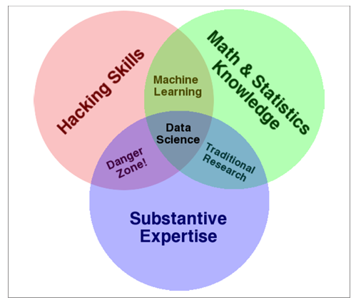
What is Data Science? The Current Landscape (with a Little History)/Different Perspectives
The perspective from the Quora discussion and blog posts that view data science as encompassing skills like statistics, data munging (parsing/formatting data), coding, visualization, etc. Suggesting it is a broad set of skills and techniques.
Driscoll then refers to Drew Conway’s Venn diagram of data science from 2010, shown in Figure below:

Slide 24
What is Data Science? The Current Landscape (with a Little History)/Different Perspectives
One view, argued by statistician Cosma Shalizi, is that data science is just statistics rebranded, and any good statistics department already does what data science claims to do.

Slide 25
What is Data Science? The Current Landscape (with a Little History)/Different Perspectives
The perspective that "data scientist" emerged as a new job title in 2008 at companies like LinkedIn and Facebook to describe a hybrid skillset combining statistics, computer science, curiosity and persistence for working on data problems
William Cleveland's 2001 position paper viewing "data science" as an action plan to expand the field of statistics, suggesting data science existed conceptually before the job title.i.e in the high-tech industry.

Slide 26
The Role of the Social Scientist in Data Science
Providing expertise in understanding and analyzing human/user behavior data, which was particularly relevant for early data science roles at social network companies like LinkedIn and Facebook.
Contributing the "substantive expertise" component required for data science problems that involve social phenomena, as represented in Drew Conway's data science Venn diagram.[Fig1]

Slide 27
The Role of the Social Scientist in Data Science
Asking good investigative questions and having strong inquiry skills, which are valuable qualities for a data scientist.
Bringing a combination of quantitative, programming, and social science skills, which can make them well-suited for data science roles focused on social science-related problems.
Potentially being a part of the emerging field of "computational social sciences," which is described as a subset of data science focused on social phenomena.

Slide 29
Course Learning Objectives
CLO 1. To introduce data collection and pre-processing techniques for data science
CLO 2. Explore analytical methods for solving real life problems through data exploration techniques
CLO 3. Illustrate different types of data and its visualization
CLO 4. Find different data visualization techniques and tools
CLO 5. Design and map element of visualization well to perceive information

Slide 30
Syllabus
Module1:
  Introduction to Data Science and
  Statistical Inference
Module2:
  Exploratory Data Analysis and
  The Data Science Process
Module3:
  Feature Generation and Feature Selection
  Extracting Meaning from Data
Module4:
  Introduction to Data Visualization and Data Exploration
  Different types of Plots
Module5: A Deep Dive into Matplotlib Introduction

Slide 31
Module1 : Introduction to Data Science and Statistical Inference Needed:
Introduction : What is Data Science? Big Data and Data Science hype – and getting past the hype, Why now? Datafication, Current landscape of perspectives, Skill sets.
Needed Statistical Inference: Populations and samples, Statistical modelling, probability distributions, fitting a model.

Slide 32
Data Scientist Jobs [ During 2010 – 2014]
The specific mention of 465 job openings for data scientists in New York City alone at the time the content was written. This number is described as "a lot", highlighting the significant demand for data science roles in just one major city.
The observation that most job descriptions for data scientists require expertise in multiple areas such as computer science, statistics, communication, data visualization, and extensive domain expertise. This implies a high demand for professionals with a diverse and multidisciplinary skillset

Slide 33
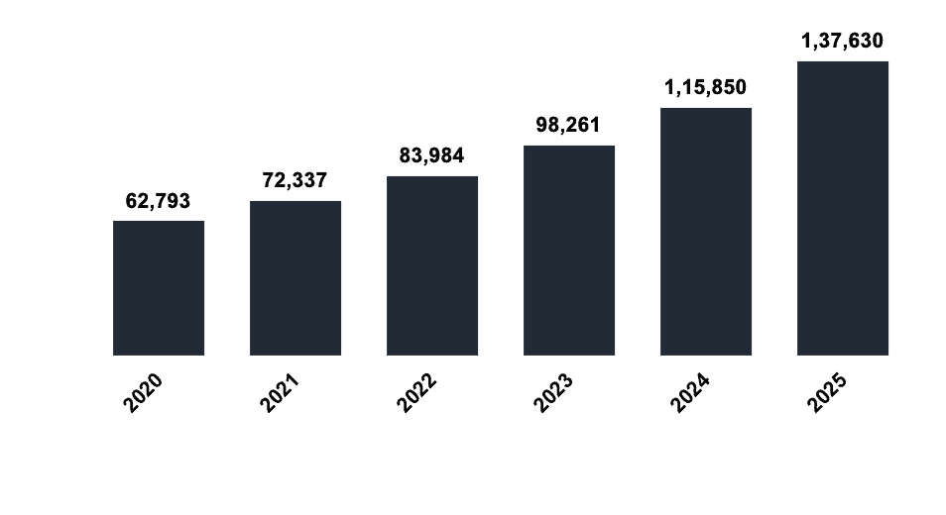
Data Science Jobs in India

Slide 34
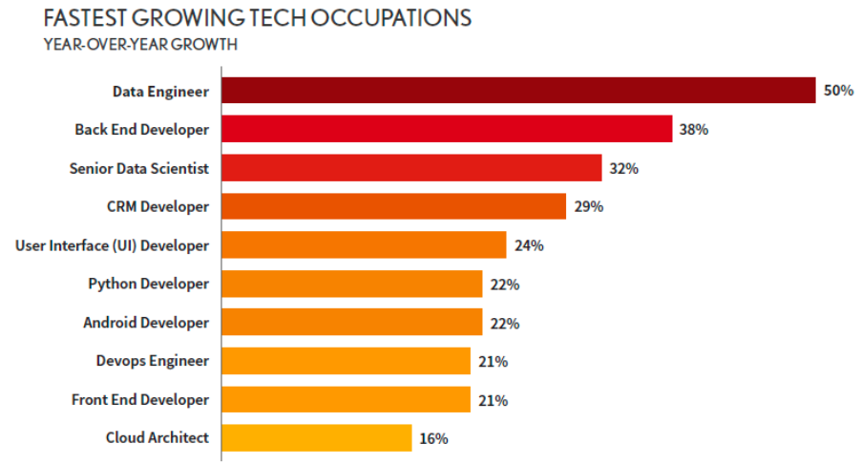

Slide 35
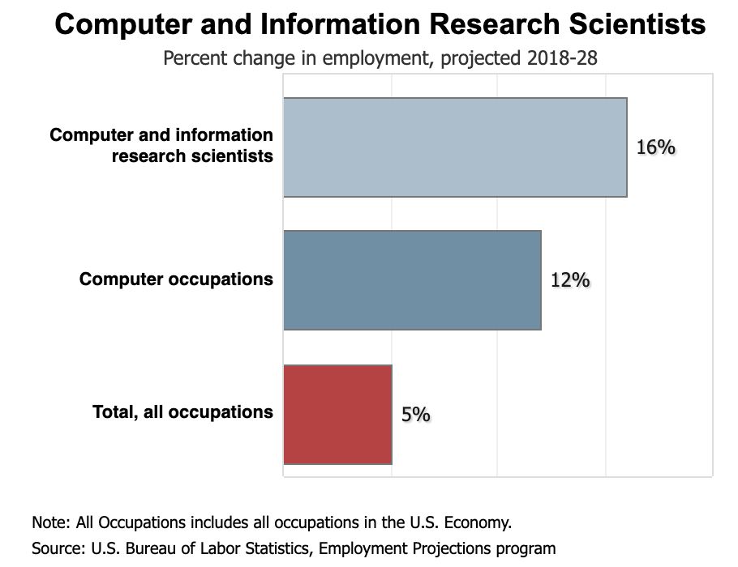

Slide 36
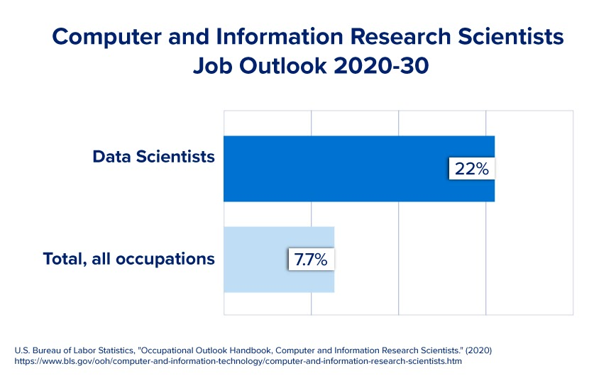

Slide 37
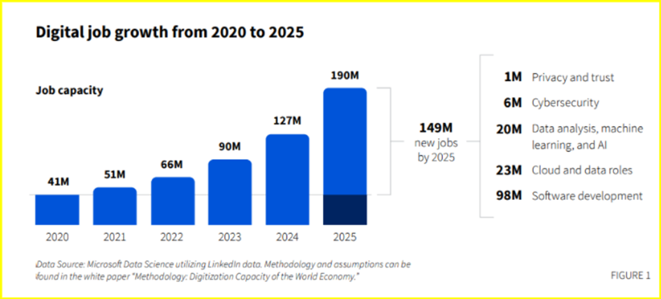

Slide 38
Data Scientist Profile
The key elements that define the Data Scientist Profile are:
  Computer science skills
  Mathematical skills
  Statistical skills
  Machine learning skills
  Domain expertise (subject matter knowledge)
  Communication and presentation skills
  Data visualization skills

Slide 39
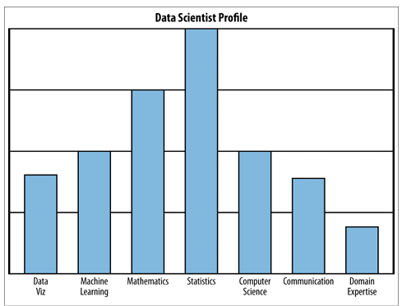
Data Scientist Profile
Fig:
Rachel’s data science profile, which she created to illustrate trying to visualize oneself as a data scientist;
she wanted students and guest lecturers to “riff” on this—to add buckets or remove skills, use a different scale or visualization method, and think about the drawbacks of self-reporting

Slide 40
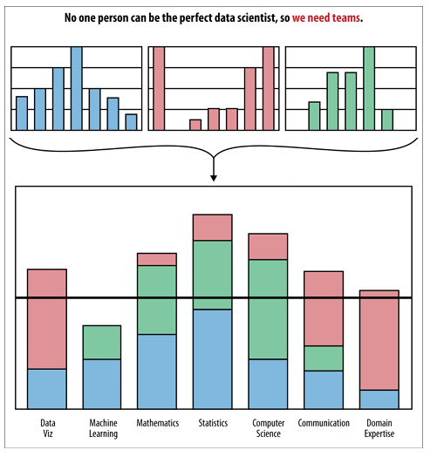
Fig: Data science team profiles can be constructed from data scientist profiles; there should be alignment between the data science team profile and the profile of the data problems they try to solve

Slide 41
Thought Experiment:
The "thought experiment" explores the idea of using data science itself to define what data science is - a meta-definition of sorts. Here are the key points regarding this thought experiment:
The experiment poses the open-ended question: "Can we use data science to define data science?"
One approach suggested is text mining - performing a Google search for "data science" and applying text mining models on the results
An alternative is to look at how practitioners of data science describe what they do (e.g. via word clouds) and compare.
This data could then be fed into clustering algorithms or other models to see if the model can accurately predict which field a person belongs to based on the "stuff they do."

Slide 42
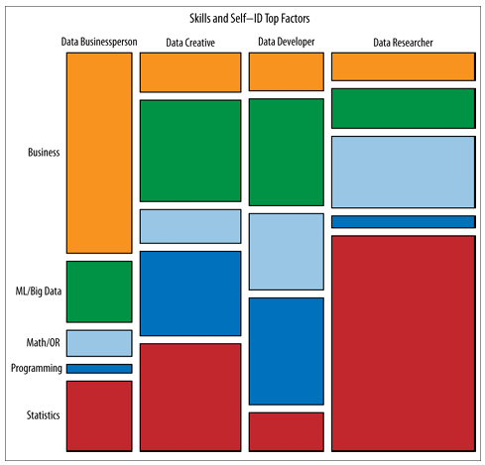
Harlan Harris, did survey and clustering to define sub-fields within data science (illustrated in Figure ).
In essence, the thought experiment explores using data-driven techniques like text mining, natural language processing, and clustering to analyze descriptions of what data scientists and other professionals do, in order to derive a definition of data science in a bottom-up manner from the data itself.

Slide 43
Who is Data Scientist in the context of academia and industry?
Data scientists in academia can be defined as interdisciplinary researchers working on computational challenges with large, complex datasets to solve real-world problems across domains.
In industry, especially tech, data scientists are depicted as strategic decision-makers and hands-on practitioners who wrangle data, build models, and communicate insights to drive data-driven products and decisions.
In general, a data scientist extracts meaning from data using statistics, machine learning, and domain knowledge. They spend significant time collecting, cleaning, and wrangling messy data, which requires persistence, statistics, and software engineering skills.

Slide 44
Academic
In Academic students interested in becoming data scientists come from diverse backgrounds like statistics, applied math, computer science, social sciences, journalism, biomedical informatics, etc. They are interested in using data to solve important real-world problems.
Academic data scientist can be defined as: "A scientist, trained in anything from social science to biology, who works with large amounts of data, and must grapple with computational problems posed by the structure, size, messiness, and the complexity and nature of the data, while simultaneously solving a real-world problem."

Slide 45
Industry
For the internet/online industry where the term originated, it describes data scientists at different levels of seniority.
A chief data scientist sets the company's data strategy, including data collection infrastructure, privacy concerns, user-facing data products, data-driven decision making, managing teams of engineers/scientists/analysts, communicating with leadership, patenting solutions, and setting research goals.
Key responsibilities include exploratory data analysis, visualization, finding patterns, building models/algorithms to understand product usage, designing experiments, and communicating insights clearly to teams and leadership through data visualizations.
The data scientist plays a critical role in data-driven decision making and prototyping data products to be integrated into the company's offerings.

Slide 46
What is Data Science?
Data science is an interdisciplinary field that involves using scientific methods, processes, algorithms, and systems to extract knowledge and insights from structured and unstructured data. It combines techniques and theories from statistics, mathematics, computer science, AI, information science, and domain-specific fields like business or healthcare to analyze complex data sets.
The main goal of data science is to turn raw data into actionable insights, predictions, and recommendations.

Slide 47
Various stages of data processing and analysis
Data Collection: Gathering data from various sources such as databases, APIs, sensors, or web scraping.
Data Cleaning: Preprocessing and preparing the data by handling missing values, removing duplicates, and transforming data into a suitable format for analysis.
Exploratory Data Analysis (EDA): Understanding the data through statistical summaries, visualizations, and identifying patterns or anomalies.
Feature Engineering: Creating new features or variables that can enhance the predictive power of machine learning models.
Machine Learning: Applying statistical models and algorithms to build predictive models and make data-driven decisions. This includes supervised learning (classification, regression), unsupervised learning (clustering, dimensionality reduction), and other techniques.
Data Visualization: Presenting findings and insights through charts, graphs, dashboards, and interactive visualizations.
Deployment and Monitoring: Integrating data science solutions into production systems and continuously monitoring model performance.

Slide 48
Terminology: Big Data
The different perspectives on what constitutes "Big Data":
"Big" is a relative term, not an absolute threshold like 1 petabyte. Data qualifies as "Big Data" when its size outgrows the current computational capabilities (memory, storage, processing speed) available to handle it effectively.
"Big Data" refers to datasets that can't fit or be processed on a single machine. Once data exceeds what a single computer can handle, new tools and methods are required to work with it, marking it as "Big Data."
Big Data is also described as a cultural phenomenon - it highlights how massive amounts of data have become pervasive in our lives due to rapid technology advances.

Slide 49
Key characteristics of Big Data
Big Data refers to datasets whose size or complexity is beyond the ability of traditional database software tools to capture, store, manage and analyze.
The 4 Vs are commonly used to characterize Big Data:
Volume (huge quantities): Big Data involves massive amounts of data, ranging from terabytes to petabytes or even more. This massive volume is generated from various sources like social media, sensors, digital transactions, etc.
Variety (diverse formats - structured, unstructured etc.): Big Data comes in different formats like structured data (databases), semi-structured (XML, JSON) and unstructured (text, audio, video, etc). This heterogeneity of data types makes processing complex.
Velocity (high speed of data generation/processing) : The speed at which Big Data is generated, accessed, processed and analyzed is extremely high and ever-increasing. Handling high velocity data for timely decision making is a challenge.
Value (analyzing for extracting valuable insights) : The core reason to deal with Big Data is to uncover hidden insights, patterns and correlations to extract substantial value from the ocean of data.

Slide 50
Definition of Big Data According to Steve Lohr
Steve Lohr defines Big Data as follows:
"A bundle of technologies" - This aligns with the technological aspect of Big Data, referring to the various tools, frameworks and platforms like Hadoop, Spark, NoSQL databases etc. that enable storage, processing and analysis of massive, complex datasets.
"A potential revolution in measurement" - This points to the transformative impact Big Data can have on measurement and metrics across industries/domains by allowing organizations to capture, quantify and analyze more data points than ever before.
"A philosophy about how decisions will/should be made" - This highlights the paradigm shift Big Data brings in terms of data-driven decision making. With insights extracted from large datasets, decisions can potentially be made based more on hard data/evidence rather than just intuition or experience alone.

Slide 51
Examples of Big Data
Social Media:
  Facebook processes over 500 terabytes of data every day from user activities like posts, comments, likes, shares, etc.
  Twitter generates over 12 terabytes of data every day from tweets, retweets, and other user interactions.
E-commerce:
  Amazon processes millions of transactions every day and captures vast amounts of data related to customer preferences, browsing histories, and purchase patterns.
  Walmart handles over 1 million customer transactions per hour, generating huge volumes of data related to inventory, sales, and customer behavior.

Slide 52
Examples of Big Data
Healthcare:
  Electronic Health Records (EHRs) store massive amounts of patient data, including medical histories, test results, imaging data, and treatment plans.
  Genomic sequencing projects like the Human Genome Project generate petabytes of data from DNA sequencing and analysis.
Internet of Things (IoT):
  Smart cities generate massive data streams from sensors monitoring traffic, weather, air quality, and infrastructure.
  Industrial IoT devices in manufacturing plants produce continuous data about machine performance, quality control, and supply chain operations.

Slide 53
Examples of Big Data
Scientific Research:
  The Large Hadron Collider at CERN generates around 30 petabytes of data annually from particle collisions and experiments.
  Astronomical projects like the Sloan Digital Sky Survey have captured terabytes of data from telescopic observations of galaxies and celestial objects.
Telecommunications : Telecom companies handle billions of call detail records, user locations, and network data every day from mobile devices and network infrastructure.
Finance and Banking: Financial institutions process millions of transactions, trades, and market data every minute, generating massive volumes of data for analysis and compliance.
Transportation and Logistics: Fleet management systems track real-time location, performance, and maintenance data from thousands of vehicles, generating terabytes of data.

Slide 54
New Kinds of Data
Traditional data: Numerical, categorical, or binary data.
Text data: Emails, tweets, news articles, etc.
Record data: User-level data, timestamped event data, JSON formatted log files.
Geo-based location data: Spatial data related to geographic locations.
Network data: Data representing connections and relationships between entities.
Sensor data: Data generated from various sensors and IoT devices.
Image data: Visual data in the form of images.

Slide 55
Statistical Thinking in the Age of Big Data
When developing skills as a data scientist one should have the following foundational skills:
  Statistics,
  Linear algebra, and
  Programming
Data scientists need to develop several interdependent skill sets in parallel, such as
  Data preparation,
  Modeling,
  Coding,
  Domain Knowledge,
  Visualization, and
  Communication.

Slide 56
Statistics for Data Science
Descriptive Statistics: Measures of central tendency (mean, median, mode) Measures of dispersion (variance, standard deviation, range)
Probability
Bayesian Statistics
Time Series Analysis
Multivariate Analysis

Slide 57
Statistical Inference
The world we live in is complex, random, and uncertain, but it is also a "data-generating machine" through various processes and activities. Some of the examples of potential data-generating processes are: Counting people passing by, collecting email data, or Analyzing DNA samples, etc.
The statistical inference is a discipline/field that deals with understanding and making sense of the complex, random, and uncertain real-world processes by collecting data, developing statistical procedures, methods, models and theorems for extracting meaningful information from the data generated by stochastic (random) processes.

Slide 58
What is Population?
A population refers to the entire group of individuals, objects, or items that a researcher is interested in studying. It is the complete set of elements that share some common characteristics, which the researcher wants to draw conclusions about.
Example: If you want to study the average height of all adults in a particular city, the population would be all the adults living in that city.

Slide 59
Sample:
A sample is a subset of the population that is selected for observation and analysis. It is a smaller, manageable group that represents the characteristics of the larger population.
Example: If the population is all adults in a city, a sample could be 500 randomly selected adults from different neighborhoods within that city.

Slide 60
The main reasons for using a sample instead of studying the entire population are:
Cost and time efficiency: Studying an entire population can be expensive and time-consuming, especially when the population is large.
Accessibility: In some cases, it may not be possible or practical to study the entire population due to geographical constraints or other limitations.
Destructive testing: If the study involves destructive testing, it is not feasible to test the entire population.

Slide 61
Goal of sampling
The goal of sampling is to select a representative sample from the population, so that the characteristics observed in the sample can be generalized to the larger population with a known degree of accuracy and precision.
Example: To estimate the average income of households in a city, a researcher might randomly select 1000 households from different neighborhoods and use their income data as a sample to make inferences about the entire population of households in that city.
In summary, the population is the entire group of interest, while a sample is a smaller, manageable subset selected from the population for the purpose of studying and making inferences about the population as a whole.

Slide 62
Example 1: Studying student performance in a school district
Population: All students enrolled in the school district
Sample: A random selection of 500 students from different schools within the district

Slide 63
Example 2: Estimating customer satisfaction for a retail chain
Population: All customers who have shopped at the retail chain in the last year
Sample: A random sample of 2,000 customers from the company's customer database

Slide 64
Example 3: Measuring public opinion on a political issue
Population: All eligible voters in a particular country
Sample: A representative sample of 1,500 voters from different regions, age groups, and demographic backgrounds

Slide 65
Example 4: Testing the effectiveness of a new medication
Population: All patients diagnosed with a specific medical condition
Sample: A random sample of 300 patients who meet the inclusion criteria for the clinical trial

Slide 66
Example 5: Analyzing consumer preferences for a new product
Population: All potential customers in the target market
Sample: A focus group of 20 individuals representative of the target demographic

Slide 67
Big Data Can Mean Big Assumptions
The major assumptions and pitfalls associated with Big Data analysis are as follows:
The claim that with Big Data we have "N=ALL" i.e. all the data
Data is not Objective:
Ignoring causation
User-level modelling (n=1)

Slide 68
Modeling
Modeling is a process of building models which are simplified representations or abstractions of reality that humans create to understand the world around them.
Modeling may include the designing architectural blueprints, molecular visualizations, statistical functions, mathematical functions, data structures etc..

Slide 69
The key aspects of modeling in data science include
Data Representation
Abstraction and Simplification
Variable Selection
Assumption Making
Model Fitting
Evaluation
Interpretation
Prediction

Slide 70
2.2.4 What is Model?
A model is a simplified representation or abstraction of reality that humans create in an attempt to understand the nature of the world around them.
It is an artificial construction that captures the essence of a phenomenon or process through a particular lens or perspective, such as architectural, biological, or mathematical.

Slide 71
Key points about models:
Models are human efforts to understand and represent reality by focusing on specific aspects
They involve removing or abstracting away extraneous details from the full complexity of reality.
Models in different domains serve this purpose - architects use blueprints, molecular biologists use 3D visualizations, statisticians use mathematical functions

Slide 72
Key points about models:
Models make assumptions and simplifications about the underlying reality. For example, a protein model may not account for quantum mechanics governing electron behaviour.
Statistical models aim to capture the uncertainty and randomness in data-generating processes using mathematical functions representing the data's shape and structure.

Slide 73
Statistical Modeling
Statistical modeling is the process of representing the underlying data-generating process or phenomenon using mathematical or statistical expressions

Slide 74
Key aspects of Statistical Modeling
Conceptualizing the Process
Mathematical Representation: These expressions contain parameters (represented by Greek letters like β) whose values are initially unknown and need to be estimated from the data
Variable Relationships: For example, if there is a hypothesized linear relationship between two variables x and y, it could be expressed as y = β0 + β1x, where β0 and β1 are the parameters to be estimated.
Visualizing Data Flow
Parameter Estimation: Estimate the values of the unknown parameters (like β0 and β1) using the available data

Slide 75
Key points: How to build a Model?
Model building is not straightforward, and there are no global standards or obvious starting points. It requires making assumptions about the underlying structure of reality.
Exploratory data analysis (EDA), which involves plotting and visualizing the data, can help build intuition about the dataset and guide the modeling process.
The recommended approach is to start simple and then gradually increase the complexity of the model
Writing down assumptions in the form of equations and code
There is a trade-off between simplicity and accuracy in modeling

Slide 76
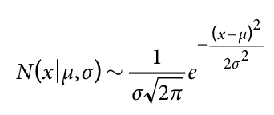
Probability Distributions
They describe the probability of different outcomes or values of a random variable. Many common probability distributions like normal, Poisson, Weibull, etc.
For example, the normal or Gaussian distribution was named after Gauss who noticed human, heights followed a bell-shaped curve. For instance, if X represents human height, it can be modeled by a normal distribution:

Slide 77
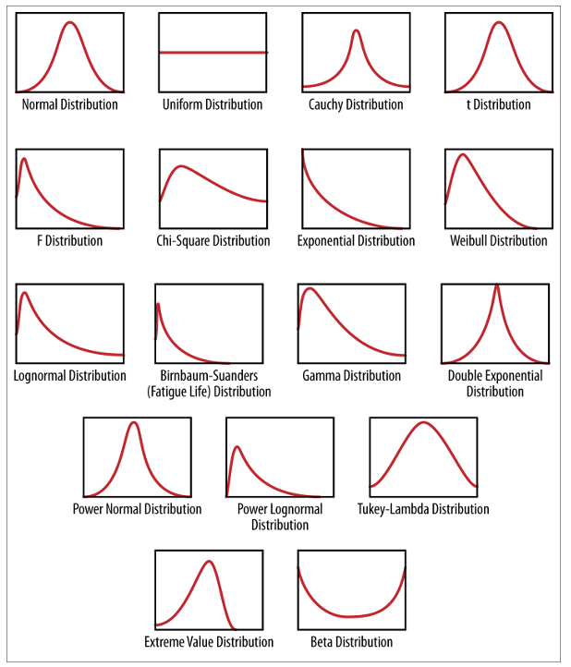

Slide 78


Discrete and Continuous Probability Distributions
For discrete X, the probability distribution is described by:
where f(x) is the probability mass function.
For continuous X, the probability distribution is described by:
where f(x) is the probability density function.

Slide 79


Example 1 (Discrete): Consider a fair six-sided die roll 𝑋. The probability distribution P(X) can be described as:
Example 2 (Continuous): Suppose X follows a normal distribution N(μ,σ²), where μ is the mean and 𝜎² is the variance. The probability distribution P(X) is given by its probability density function:

Slide 80
Univariate Probability distribution
A univariate probability distribution describes the probabilities associated with a single random variable
Let a single variable X represent the heights of adult males. X can be modeled by a normal distribution, with parameters μ (mean height) and σ (standard deviation of heights) estimated from data.

Slide 81
Multivariate Probability Distribution
A multivariate probability distribution describes the probabilities associated with multiple random variables simultaneously.
Example: Let X represent the heights of individuals and Y represent their weights. The joint distribution of X and Y can be modeled by a bivariate normal distribution, with parameters μ_x, μ_y (means for height and weight), σ_x, σ_y (standard deviations for height and weight), and ρ (correlation coefficient between height and weight).

Slide 82
Conditional Probability Distribution
Conditional probability distribution refers to the probability distribution of one or more random variables given specific values or conditions of other random variables.
Example: Let X represent the insurance claims of drivers. The condition is whether the driver is over 65 years old or not, represented by a binary variable A (1 for over 65, 0 for under 65).
P(X|A==1) or P(X|A==0)

Slide 83
Fitting a Model:
Fitting a model involves estimating the parameters of a mathematical model using observed or given data.
Estimating Parameters: When fitting a model, you estimate parameters (like coefficients in a regression model) , The aim is to find the best-fitting model that explains the relationship between variables based on the assumption of a certain mathematical form (e.g., linear, exponential).
Expressing the Model: Once the model is fitted, it can be expressed in a mathematical form like 𝑦 = 7.2 + 4.5𝑥.
Coding the Model: Implementing the fitted model involves coding the specified mathematical form (e.g., y=7.2+4.5x) into programming languages like R or Python.

Slide 84
Fitting a Model:
Optimization Methods: Optimization methods are used to find the best values of model parameters that maximize the likelihood of observing the given data.
Sophistication and Expertise: As you become more experienced or specialized in modeling, you may explore and customize optimization methods.
In summary, fitting a model involves the iterative process of parameter estimation, model specification, coding, and optimization to develop a statistical representation that explains the relationship within the observed data.

Slide 85
Overfitting
Sometimes the machine learning model performs well with the training data but does not perform well with the test data. It means the model is not able to predict the output when deals with unseen data by introducing noise in the output, and hence the model is called overfitted.

Slide 86
Overfitting
Overfitting in model development refers to the phenomenon where a model learns not only the underlying patterns in the training data but also captures noise, random fluctuations, or outliers that are specific to the training dataset. This results in a model that performs extremely well on the training data but fails to generalize effectively to new, unseen data.
When a model is overfitted, it may exhibit poor performance when applied to new data that was not part of the training dataset.
Overfitted models tend to be too complex, capturing spurious relationships and details that are not reflective of the true underlying patterns in the data.
Overfitting can lead to misleading conclusions and inaccurate predictions when deployed in real-world scenarios.

Slide 87
Strategies to Mitigate Overfitting and Improve Model Generalizability:
Simplify the Model:
Regularization:
Cross-Validation:
Feature Selection
Early Stopping

Slide 88
Regularization
Regularization is one of the most important concepts of machine learning. It is a technique to prevent the model from overfitting by adding extra information to it.

Slide 89
Library Assignment #1 [ on or before 15/5/2024]
Student Details
Name:
USN:
Sem:
Date and Time Of Library Visit:
Questions:
Explain how Cross validation and regularization are used to avoid overfitting in Data Science With Examples.
Discuss different types of Regularization (like L1/L2/Elastic Net/Dropout ) in Data Science with examples.

Slide 90
Module1 : Introduction to Data Science and Statistical Inference Needed:
Introduction : What is Data Science? Big Data and Data Science hype – and getting past the hype, Why now? Datafication, Current landscape of perspectives, Skill sets.
Needed Statistical Inference: Populations and samples, Statistical modelling, probability distributions, fitting a model.

Slide 91
Data Scientist Profile
The key elements that define the Data Scientist Profile are:
  Computer science skills
  Mathematical skills
  Statistical skills
  Machine learning skills
  Domain expertise (subject matter knowledge)
  Communication and presentation skills
  Data visualization skills

Slide 92
What is Data Science?
Data science is an interdisciplinary field that involves using scientific methods, processes, algorithms, and systems to extract knowledge and insights from structured and unstructured data. It combines techniques and theories from statistics, mathematics, computer science, AI, information science, and domain-specific fields like business or healthcare to analyze complex data sets.
The main goal of data science is to turn raw data into actionable insights, predictions, and recommendations.

Slide 93
Various stages of data processing and analysis
Data Collection: Gathering data from various sources such as databases, APIs, sensors, or web scraping.
Data Cleaning: Preprocessing and preparing the data by handling missing values, removing duplicates, and transforming data into a suitable format for analysis.
Exploratory Data Analysis (EDA): Understanding the data through statistical summaries, visualizations, and identifying patterns or anomalies.
Feature Engineering: Creating new features or variables that can enhance the predictive power of machine learning models.
Machine Learning: Applying statistical models and algorithms to build predictive models and make data-driven decisions. This includes supervised learning (classification, regression), unsupervised learning (clustering, dimensionality reduction), and other techniques.
Data Visualization: Presenting findings and insights through charts, graphs, dashboards, and interactive visualizations.
Deployment and Monitoring: Integrating data science solutions into production systems and continuously monitoring model performance.

Slide 94
Model Questions
What is Data Science? Explain the Venn Diagram of data Science.
Explain in detail about BigData and Data Science Hype. Why Hype? How to get past this hype?
Explain the Data Science Profile. Explain the work of the Data Scientist in academia and industry.
“The Data Scientists play a major role in Academics and industry”. Justify.
Explain the concept of Datafication with example. Why it is required in the current scenario?
Discuss in detail about the current landscape of perspectives and skill sets.

Slide 95
Model Questions
There are varieties of types of data that a Data Scientist has to deal”, explain the statement with examples.
Explain the following concepts involved in building models:
    Statistical modeling.
    Probability distributions
    Fitting and overfitting
What is Statistical Thinking? Discuss in details statistical inferences and also explain about population and Samples
What is Statistical Modelling? How do you build a model?
Explain in detail about probability distribution with examples and fitting a model. Write about over fitting.
Explain the following concepts with examples
    Statistical inference
    Population
    Samples
    Types of Data

Slide 96
End of Module1

