Slide 1
Introduction to Quantum Computing
Dr. Thyagaraju G S
Professor and HoD, Department of CSE,
SDM Institute Of Technology, Ujire-574240
Mobile : 9480123526
E- Mail : profthyagu@gmail.com
Website: https://tocxten.com/

Slide 2
Topics :
Introduction to Quantum Computing
  Why Quantum Computing?
  What is Quantum Computing ?
  Fundamental Principles of Quantum Computing
Qubits
Introduction to Python Qiskit
Quantum Gates and Quantum Circuits
Introduction to Quantum Algorithms
Future Directions and Research Opportunities

Slide 3
1.0 Why Quantum Computing?

Slide 4
1.1 Primary reasons
Enhanced Problem-Solving/Computing Capabilities
  Solving complex problems that involve numerous variables and uncertainties
Exponential Scaling
  Power of quantum computers increases exponentially with the addition of qubits
Energy Efficiency
  Lower energy consumption and reduced carbon emissions
Communication
  Provide better security and improved long-distance communications,
Sensing
  Extremely precise measurements

Slide 5
1.2 Primary Applications
Chemistry and Materials Science
  Aiding in drug discovery and materials development
Logistics and Optimization
  Optimize logistics and route planning
Cryptography
  Quantum-resistant algorithms, secure communication networks using quantum key distribution (QKD)
4. Artificial Intelligence
  Handling complex datasets and Models
5. Weather Forecasting and Climate Change/Disaster Management
  by simulating complex atmospheric and oceanic systems more accurately

Slide 6
3.0 What is Quantum Computing ?

Slide 7
3.1 What is Quantum ?
The term "quantum” (plural: quanta) originates from the Latin word for "how much.“
Quantum refers to the smallest possible discrete unit of any physical property, usually related to energy and matter.
Example :
  A quantum of light is a photon, and
  A quantum of electricity is an electron
Quantum Particles
  Fermions (Particles that make up matter): Electrons , Protons , Neutrons, Quarks, Neutrinos
  Bosons (Force-carrying particles): Photons, Gluons, W and Z Bosons, Higgs Boson, Gravitons (Theoretical)
  Composite Particles: Mesons, Baryons

Slide 8
3.2 What is Quantum Computing?
Quantum computing is a type of computing that leverages the principles of quantum mechanics to process the information.
Quantum mechanics is the theory that describes the behavior of microscopic systems, such as photons, electrons, atoms, molecules, etc.

Slide 9
Principles of Quantum Mechanics
(Unique Characteristics of Quantum Particles)
Wave-Particle Duality
Superposition
Entanglement
Quantization
Uncertainty Principle
Probability and Wave functions

Slide 10
Feature | Conventional Computing | Quantum Computing
Basic Unit | Bit | Qubit
State | Either 0 or 1 | Can be in multiple states simultaneously due to superposition
Logical Operations | Boolean Logic (AND, OR, NOT) | Quantum Gates (Hadamard, CNOT, etc.)
Speed | Limited by classical physics | Can perform certain calculations much faster than classical computers
Memory | Stored in binary digits | Stored in qubits
Entanglement | Not possible | Allows two or more qubits to be correlated
Error sensitivity | Not as sensitive | Extremely sensitive to noise and errors
Applications | Software, gaming, simulations, etc. | Cryptography, chemistry, machine learning, etc.

Slide 11
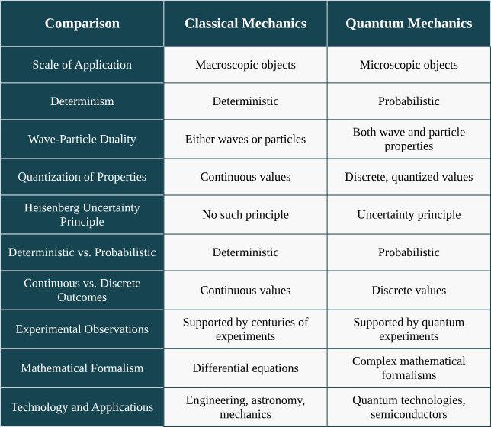

Slide 12
4.0 Fundamental Principles of Quantum Computing
4.1 Qubits
4.2 Superposition
4.3 Entanglement
4.4 Quantum Interference
4.5 Decoherence
4.6 Quantum Tunneling
4.7 Measurement and Collapse

Slide 13
Core Components of Quantum Computer
A quantum computer is a device that exploits quantum mechanical phenomena, such as superposition and entanglement, to perform computations.
Qubits
Quantum Registers
Quantum Gates
Quantum Circuits
Quantum Processing Unit (QPU)
Measurement Devices

Slide 14
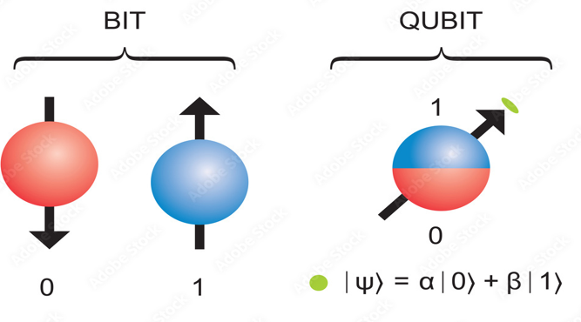
1. What is a Qubit?
A qubit, or quantum bit, is the fundamental unit of information in quantum computing, analogous to a classical bit in traditional computing.

Slide 15
Key Characteristics of Qubits
Superposition: A qubit can exist in a superposition of both states simultaneously. This means that a qubit can represent 0, 1, or any combination of the two at the same time.
  Mathematically, a qubit can be expressed as:∣ψ⟩=α∣0⟩+β∣1⟩
  where α and β are complex numbers representing the probability amplitudes of the qubit being in state |0⟩ or |1⟩, respectively.
Entanglement: Qubits can be entangled, meaning the state of one qubit is directly related to the state of another, regardless of the distance separating them.
Measurement: When a qubit is measured, it collapses from its superposition state to one of the basis states (either |0⟩ or |1⟩). The outcome of the measurement is probabilistic.

Slide 16
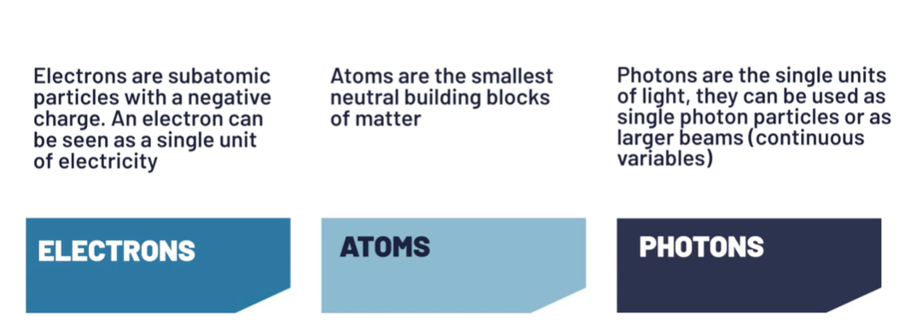
Type of particles used to build Qubits
Source: Quantum Computing Hardware - An Introduction (youtube.com)

Slide 17
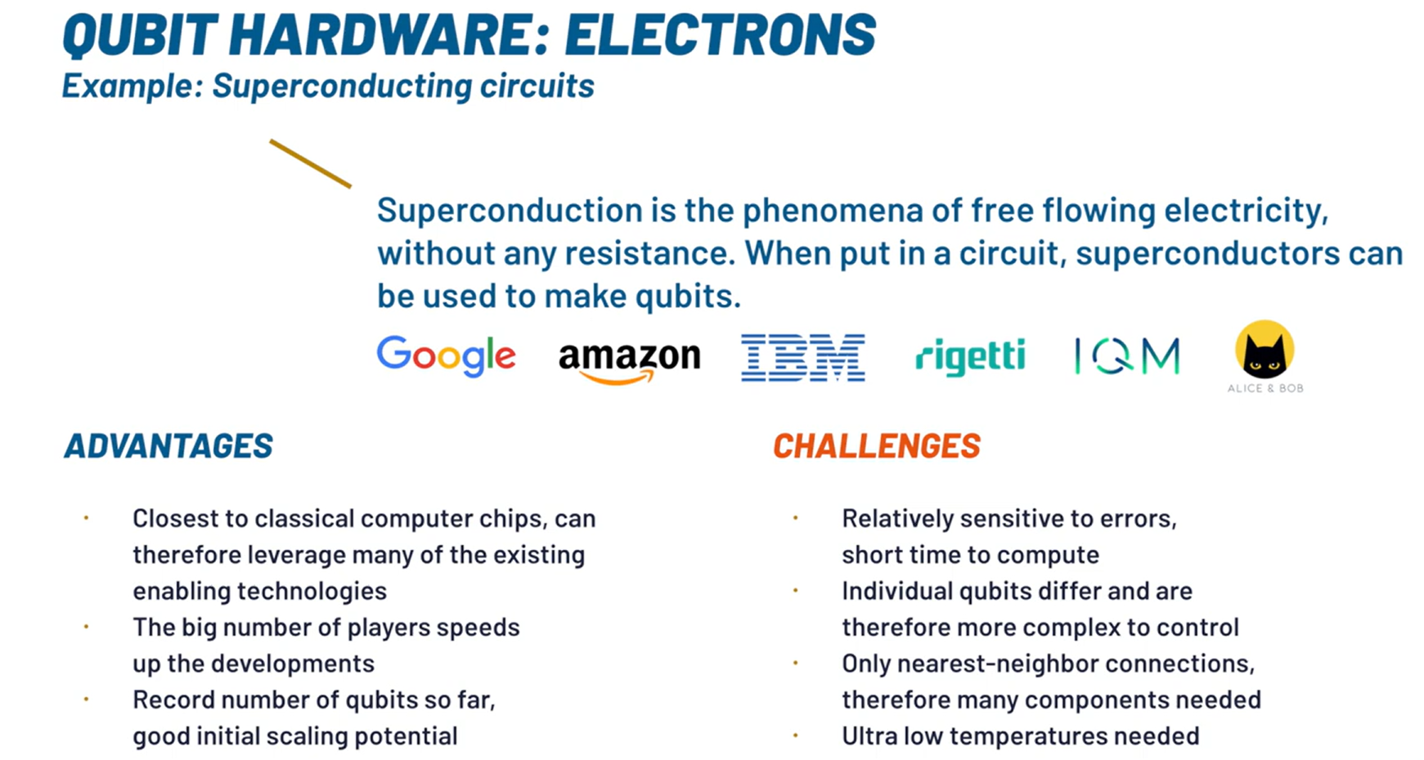
Superconducting qubits: IBM creates transmon qubits using niobium and aluminium on a silicon substrate
Source: Quantum Computing Hardware - An Introduction (youtube.com)

Slide 18
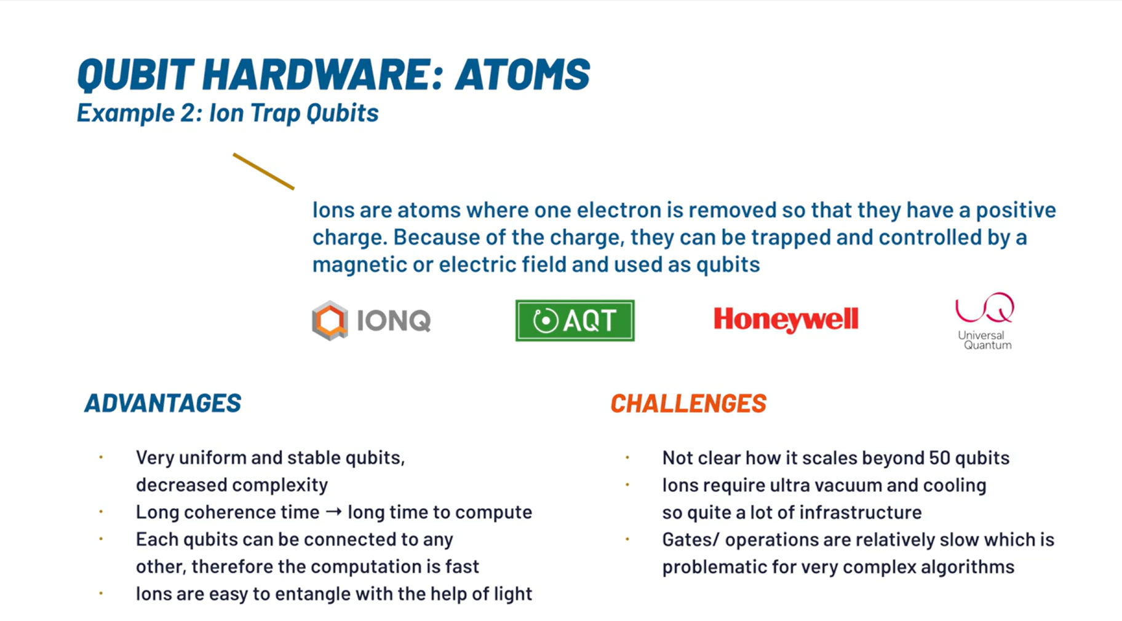
Source: Quantum Computing Hardware - An Introduction (youtube.com)
Trapped –ion qubits: Quantinuum and IonQ create qubits using ionized ytterbium atoms

Slide 19
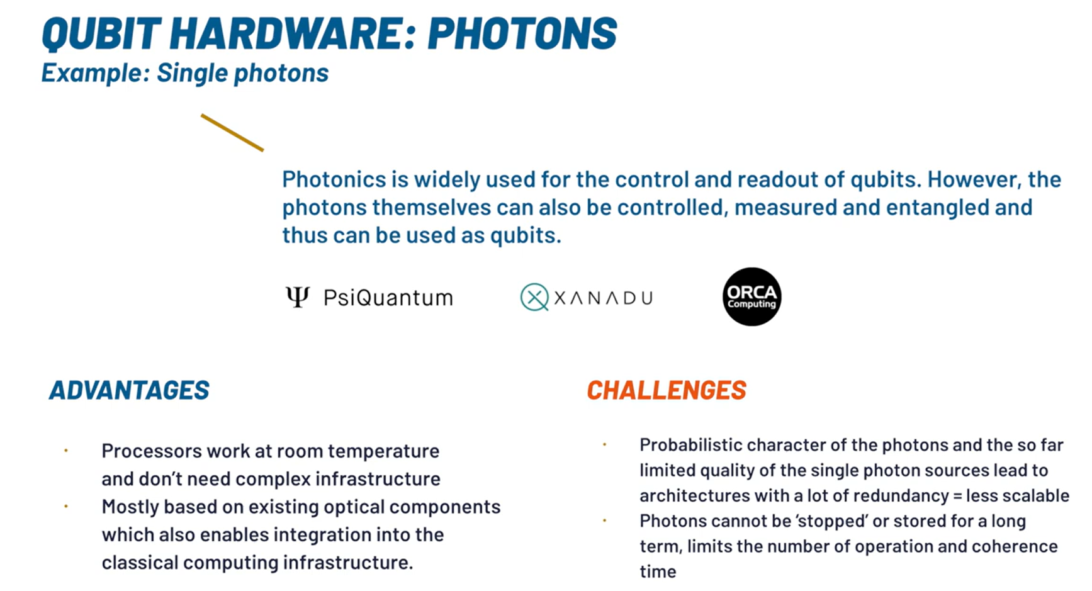
Source: Quantum Computing Hardware - An Introduction (youtube.com)
Xanadu creates qubits by squeezing laser light using ring resonators

Slide 20
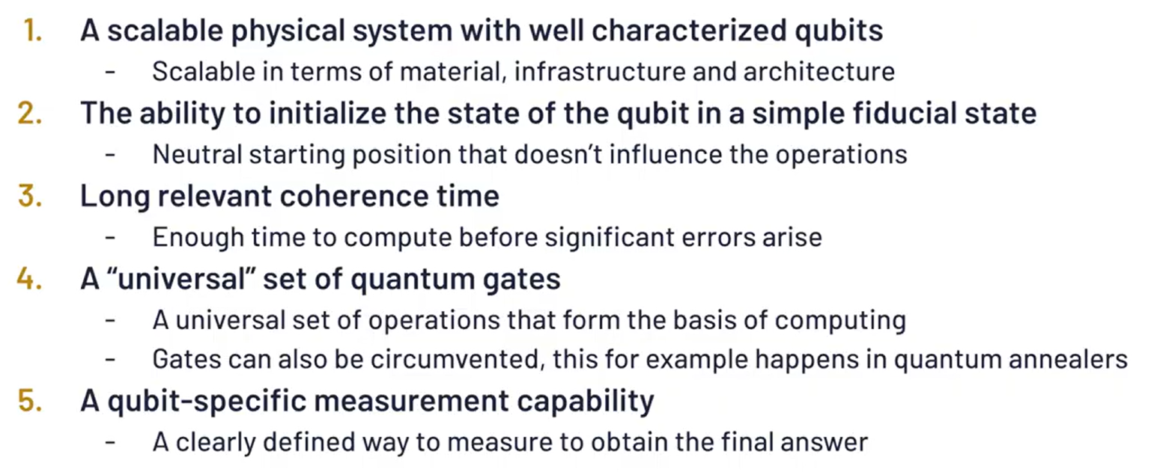
QC Hardware : Basic Requirements

Slide 21
Year | Qubit Size | Milestone
1998 | 9 | First demonstration of quantum error correction using 9 physical qubits to encode 1 logical qubit.
2016 | 5 | IBM introduces the 5-qubit IBM Q 5 Tenerife and IBM Q 5 Yorktown processors.
2017 | 14 | IBM launches the 14-qubit IBM Q 14 Melbourne processor.
 | 16 | IBM introduces the 16-qubit IBM Q 16 Rüschlikon processor.
 | 17 | IBM unveils the 17-qubit IBM Q 17 processor.
 | 20 | IBM releases the 20-qubit IBM Q 20 Tokyo processor.
2018 | 20 | IBM releases the 20-qubit IBM Q 20 Austin processor.
 | 50 | IBM introduces the 50-qubit IBM Q 50 Prototype.
2019 | 53 | IBM launches the 53-qubit IBM Q 53 processor.
 | 53 | Google claims quantum supremacy with its 53-qubit Sycamore processor.
2020 | 27 | IBM achieves a Quantum Volume of 64 with a 27-qubit processor.
2021 | 127 | IBM releases the 127-qubit IBM Quantum Eagle processor.
2022 | 433 | IBM unveils the 433-qubit IBM Quantum Osprey processor.
2023 | 1,121 | IBM presents the 1,121-qubit IBM Quantum Condor processor.
 | 1,305 | Researchers at TU Darmstadt demonstrate a 1,305-qubit array based on optical tweezers.
 | 1,180 | Atom Computing announces a 1,180-qubit array based on Rydberg atoms.
2024 | Up to 8 | Researchers fuse small quantum states into states with up to eight qubits.

Slide 22
Challenges and Considerations
Decoherence: Quantum systems are sensitive to their environment, and maintaining coherence is critical for reliable computations.
Error Correction: Quantum computations are prone to errors, necessitating the development of quantum error correction codes and fault-tolerant techniques.
Scalability: As quantum computers grow in size and complexity, challenges related to maintaining qubit coherence and reducing noise become increasingly significant.

Slide 23
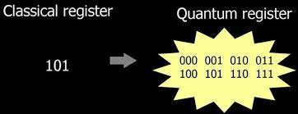
2. Quantum Register
A quantum register is a system comprising multiple qubits, serving as the quantum analogue of the classical processor register.
Source: Google Images

Slide 24
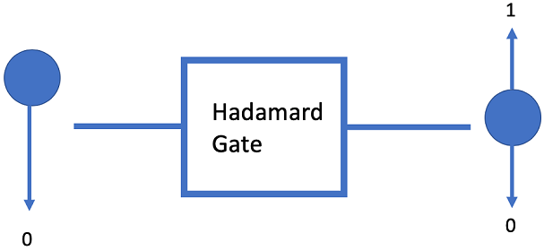
3. Quantum Gates
Quantum gates is a mathematical operation that acts on the state of one or more qubits, and it can be represented by a matrix.

Slide 25
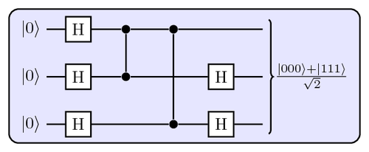
4. Quantum Circuits
Quantum circuits are composed of quantum gates and are used to perform quantum algorithms.
A quantum circuit is a series of quantum gates that act on one or more qubits.
The gates are arranged in a specific order, and the circuit is executed in a specific sequence.

Slide 26
5. Quantum Processing Unit
A quantum processing unit (QPU) is a computational unit that relies on quantum principles to perform a task. The QPU includes the:
QRAM (register + gates)
Quantum control unit (QCU) which drives the system to the desired state.
Classical controller interface which defines the interaction between the host CPU and the QPU

Slide 27
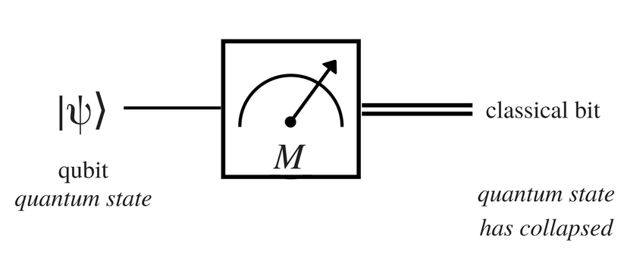
6. Measurement Devices
Quantum measurement is all about obtaining information about the state of a quantum system
Quantum Sensors, Quantum Microscopes, Quantum Clocks, Quantum Gravimeters and Gyroscopes.

Slide 28
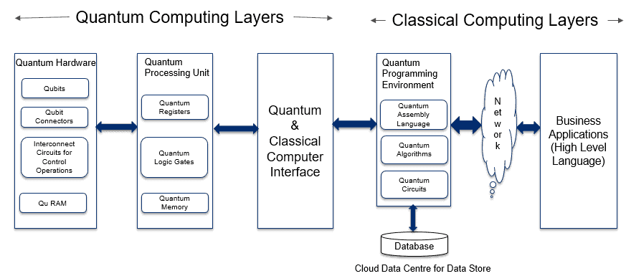
3.3 Architecture of Quantum Computer
1. Application Layer 2. Classical Processing Layer 3. Quantum Computing Layers
Source: Overview of Quantum Computer Platform (analyticsinsight.net)

Slide 29
Quantum Computer Cooling Systems
Quantum bits, or qubits, typically operate at extremely low temperatures to maintain their quantum states and minimize thermal noise.
The operational temperature for most superconducting qubits is around 10 to 20 milliKelvin (mK), which is just above absolute zero (approximately -273.15°C)
There are advancements in quantum technology that allow for operation at higher temperatures. For instance, silicon qubits have been shown to function at temperatures up to 10 Kelvin (K).

Slide 30
Quantum Computer Cooling Systems
Cooling System | Minimum Temperature Achievable | Type of Qubits
Dilution Refrigerator | ~10 mK (10 milliKelvin) | Superconducting qubits
Adiabatic Demagnetization Refrigeration (ADR) | < 2 K (2000 milliKelvin) | Various types of qubits
Pulse Tube Refrigeration (PTR) | < 4 K (4000 milliKelvin) | Superconducting qubits
Laser Cooling | Near absolute zero | Trapped ions, atomic qubits
2D Quantum Cooling System | 100 mK (100 milliKelvin) | Various types of qubits
Immersion Cooling with Helium-3 | < 1 K (1000 milliKelvin) | Superconducting qubits

Slide 31
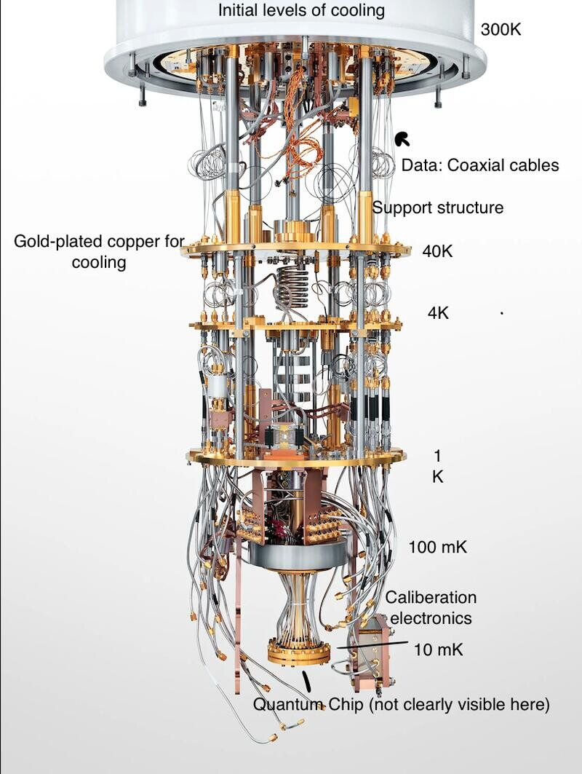
Source: (4) Quantum Computing 1: Breaking down the process | LinkedIn

Slide 32
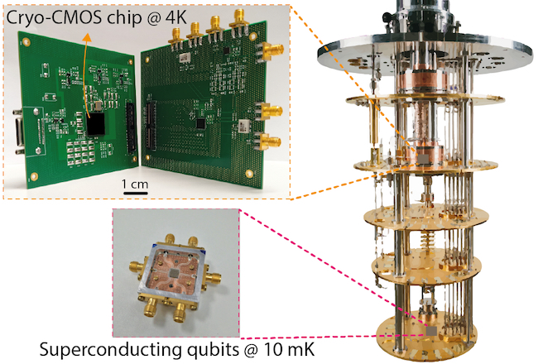
Image Source: University of Glasgow - University news - Archive of news - 2021 - November - UofG lends support to £6.5m quantum computing consortium

Slide 33
Quiz 1

Slide 34
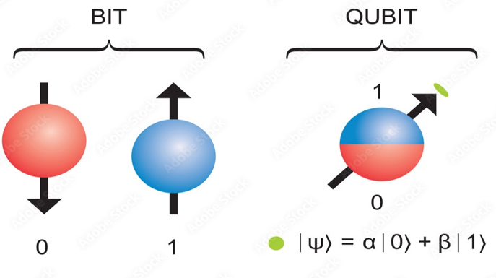
2. Qubit: Topics
1.Qubits and States
2.Representation of Qubits :
  State Vectors
  Dirac Notation : Basic Elements
  Representing General Qubit States
  Common Qubit states
  Measurement in Qubit Notation
3. Inner Product and Outer Product
4. Perpendicular and Parallel Qubit Vectors
5. Magnitude and Normalization of the Qubit Vector
6. Angle between two Qubit vector using Dot Product
7. Linear Combination of two qubit vectors
8. Superposition of Qubits
9. Hilbert Space
10. Basis
11. Tensor Products
12. Entanglement of Qubits in Hilbert Space
13. Bell State
14. Complex numbers in Polar Form
15. Representing Qubits states in Bloch Sphere
A qubit, or quantum bit, is the fundamental unit of information in quantum computing, analogous to a classical bit in traditional computing.

Slide 35
N-qubit | Number of states | States | Examples
1 | 2^1 = 2 | |0⟩ and |1⟩ | A single qubit can be used as a highly sensitive quantum sensor to measure magnetic fields, electric fields, temperature, pressure and other quantities with extremely high precision
2 | 2^2 = 4 | |00⟩, |01⟩, |10⟩, and |11⟩ | Used to create entangled states, such as the Bell state 1/sqrt(2)*(∣00⟩+∣11⟩).
3 | 2^3 = 8 | |000⟩, |001⟩, |010⟩, |011⟩, |100⟩, |101⟩, |110⟩, and |111⟩ | A 3-qubit quantum computer can be used to simulate the behavior of a simple molecule like hydrogen (H2)
4 | 2^4 = 16 | |0000⟩, |0001⟩, |0010⟩, |0011⟩, |0100⟩, |0101⟩, |0110⟩, |0111⟩, |1000⟩, |1001⟩, |1010⟩, |1011⟩, |1100⟩, |1101⟩, |1110⟩, and |1111⟩. | A 4-qubit computer can be used to implement Grover's algorithm, which searches an unsorted database
8 | 2^8 = 256 |  | An 8-qubit quantum computer can be used to factor large numbers using Shor's algorithm,
30 | 2^30 = 1 billion |  | Could be used to simulate the behavior of complex molecules and materials, which is crucial for developing new drugs, batteries, and other technologies

Slide 36
Classical 2-Bit Example:
In classical computing, two bits can represent four distinct states:
  00, 01, 10, and 11 whose binary values are 0,1,2 and 3.
  Each bit is either 0 or 1.
Each state represents a unique combination of the two bits, corresponding to a specific decimal value from 0 to 3.
The system can only be in one of these states at a time.

Slide 37
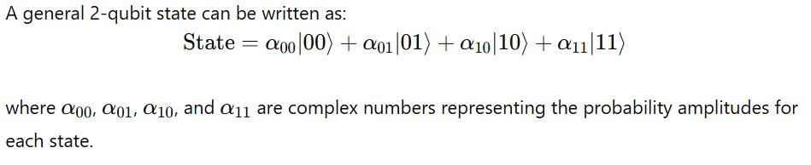
Quantum 2-Qubit System:
In quantum computing, two qubits can represent a superposition of all four states (00, 01, 10, and 11) simultaneously.
The state of the qubits is described as a linear combination of these basis states.

Slide 38
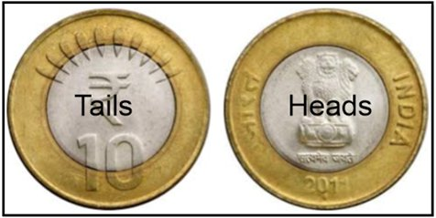
2.2 Representation of Qubits
State Vector : Each element in the state vector represents probability of being in that particular state.
State vector = [ H T]
If the coin is in the head’s state , state vector = [1 0]
If the coin is in the tail’s state , state vector = [0 1]
State vector is used to represent the state of quantum systems

Slide 39
Dirac Notation
Dirac notation, also known as bra-ket notation, is a standard way to represent quantum states and operations in quantum mechanics. It is particularly useful in describing qubits and quantum systems.
Ket ∣ψ⟩ : Column Vector
Bra ⟨ψ∣ : Row Vector
Bra-Ket : ⟨ψ∣ ψ⟩ Inner Product
Ket- Bra: ∣ψ⟩ ⟨ψ∣ Outer Product

Slide 40

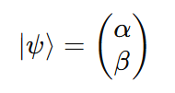
Basic Elements of Dirac Notation
Ket |ψ⟩:
Represents a column vector (a quantum state).
Bra ⟨ψ|: Represents the conjugate transpose (row vector) of the ket.
where α∗ and β∗ are the complex conjugates of α and β.

Slide 41
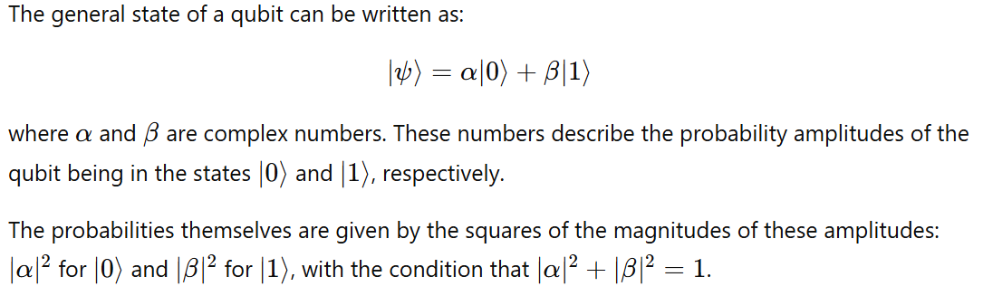
Qubit States

Slide 42
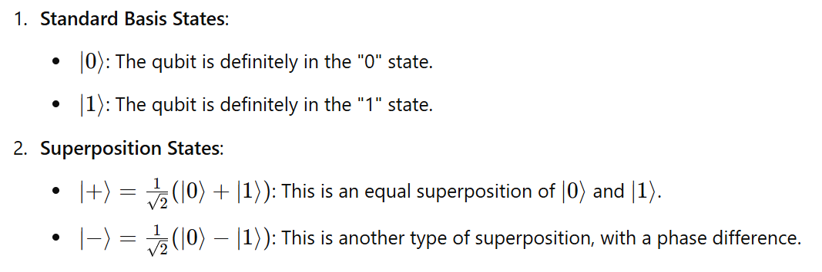
Common Qubit States

Slide 43

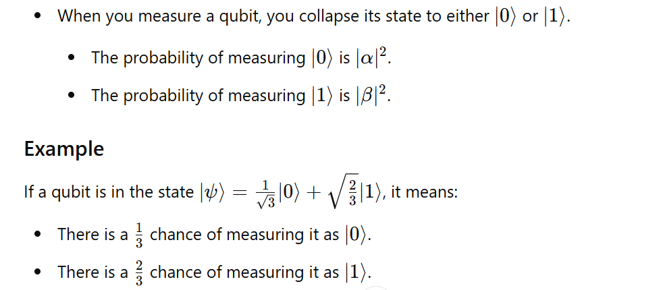
Measurement in Qubit Notation

Slide 44
2.3 Inner Product and Outer Product

Slide 45
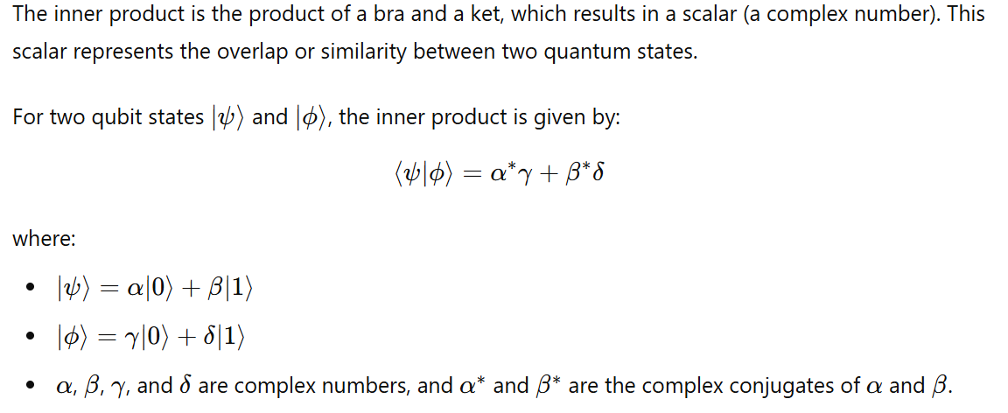
Bra-Ket: Inner Product (⟨ψ|ϕ⟩)

Slide 46
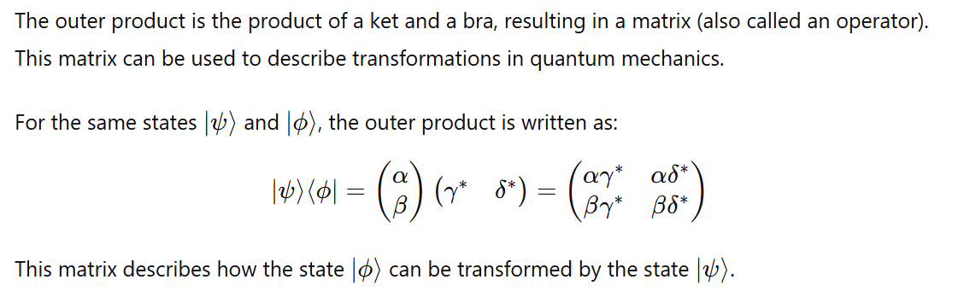
Ket-Bra: Outer Product (|ψ⟩⟨ϕ|)

Slide 47
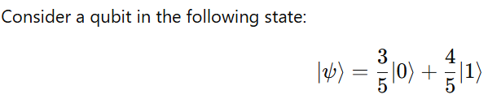




Inner Product Example

Slide 48
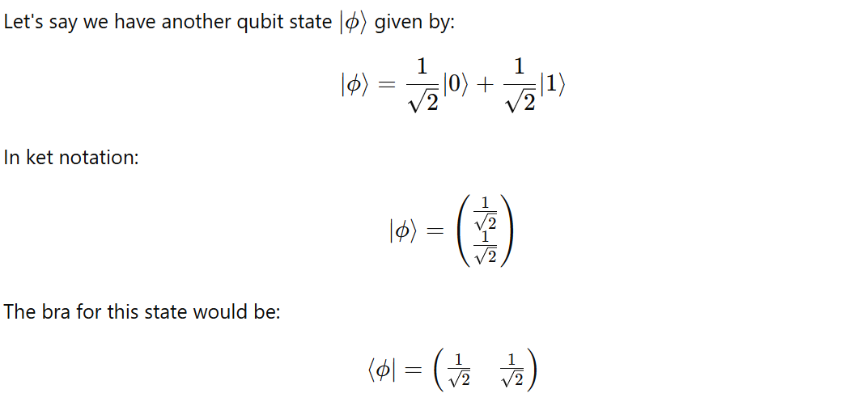
Inner Product Example

Slide 49
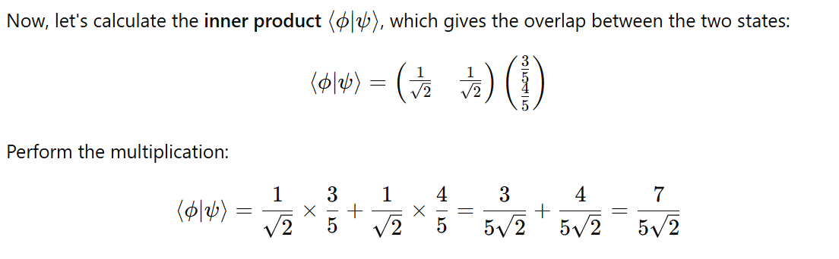
Inner Product Example

Slide 50
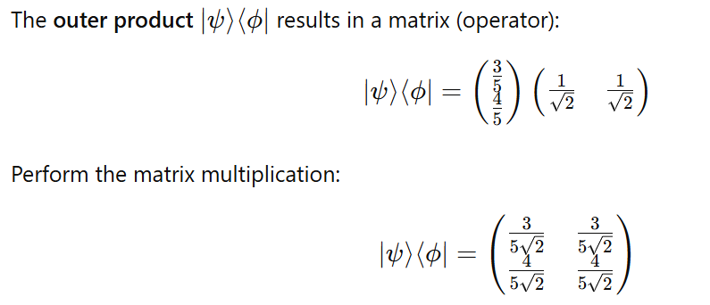
Outer Product Example

Slide 51
2.4 Perpendicular and Parallel Qubit Vectors

Slide 52
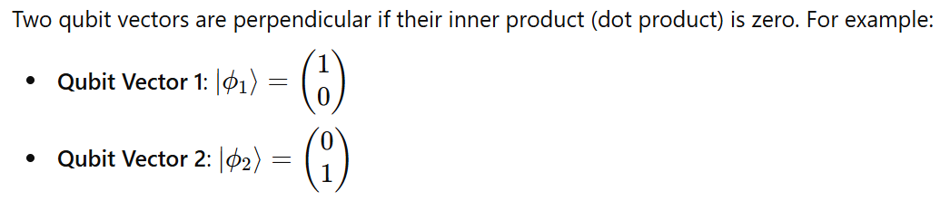

Perpendicular Qubit Vectors

Slide 53
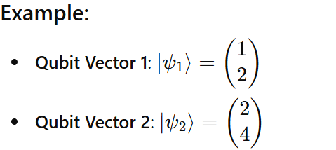
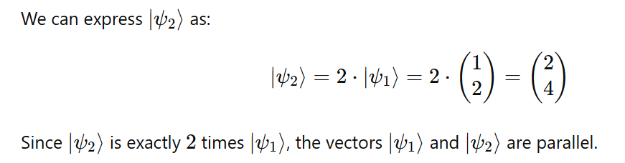
Two Parallel Qubit Vectors

Slide 54
2.5 Magnitude and Normalization of the Qubit Vector

Slide 55
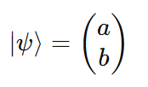
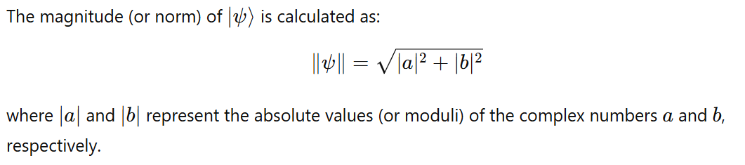
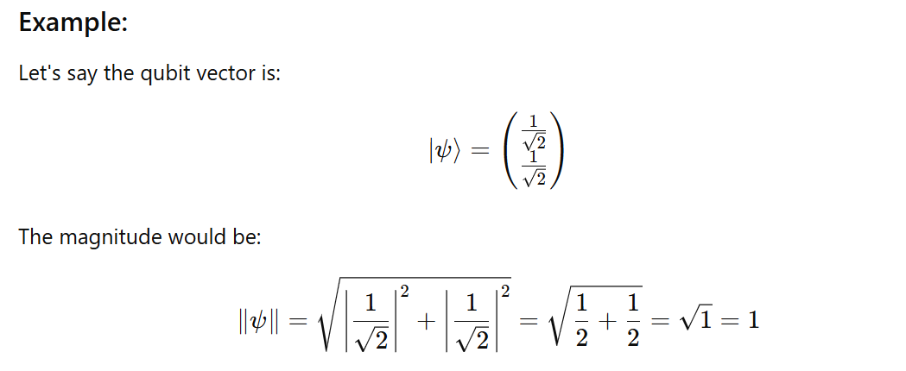
Magnitude of the Qubit Vector

Slide 56
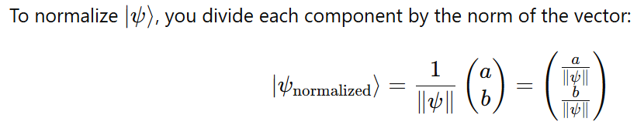
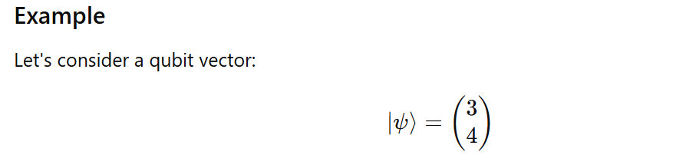
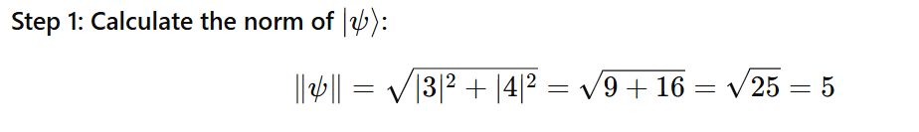
Normalization Process

Slide 57
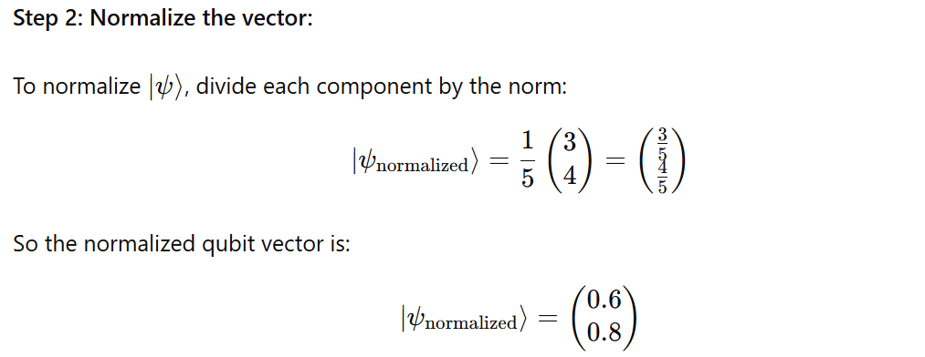
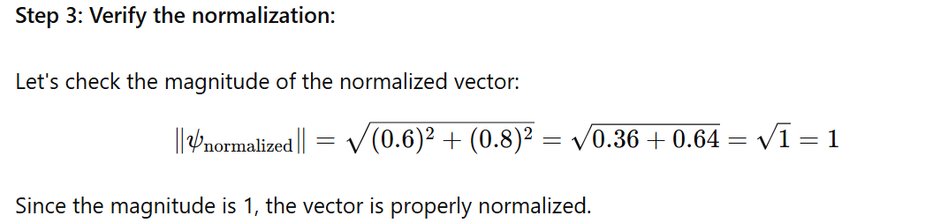
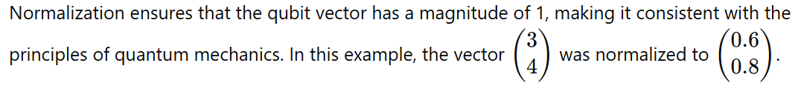

Slide 58
2.6 Angle between two Qubit vector using Dot Product

Slide 59
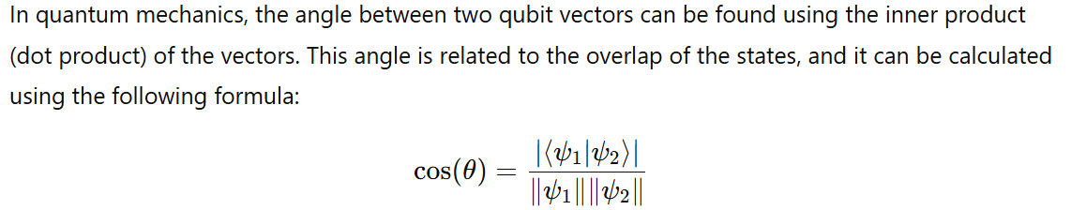
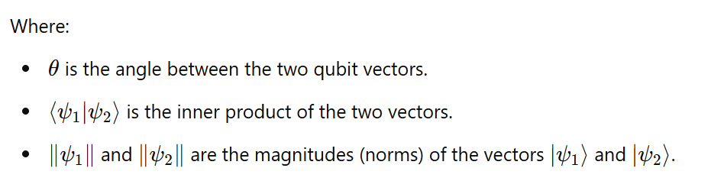
Finding the Angle Between Two Qubit Vectors Using the Dot Product

Slide 60
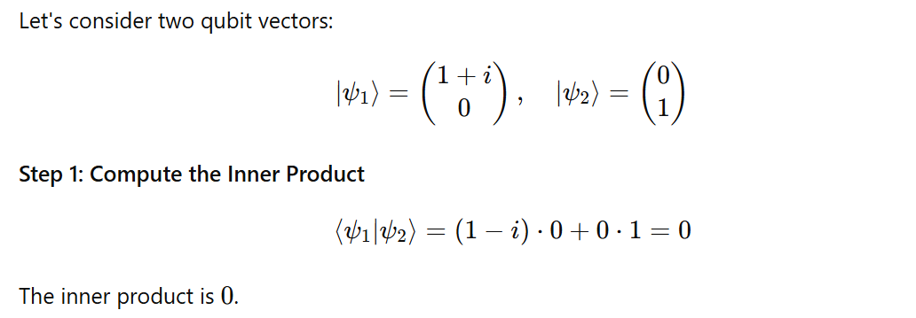
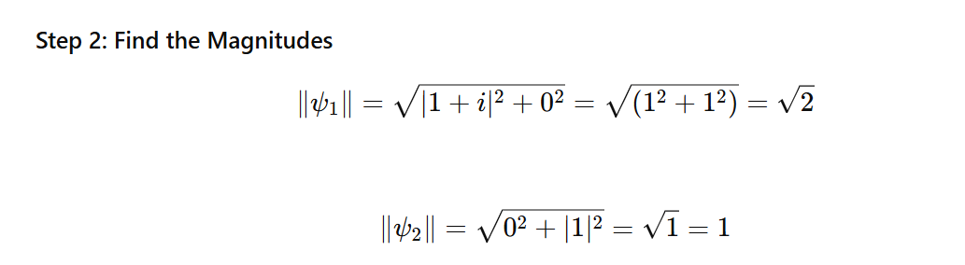
Example

Slide 61
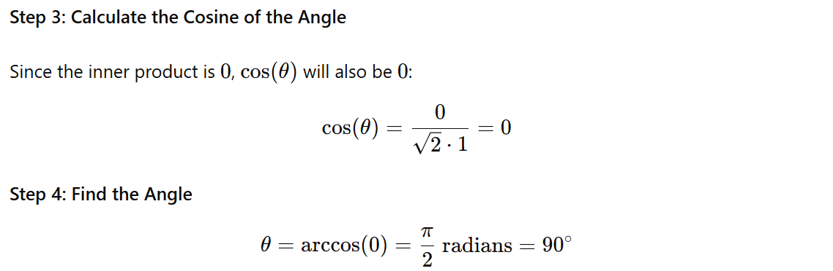
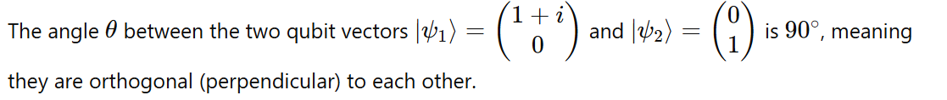

Slide 62
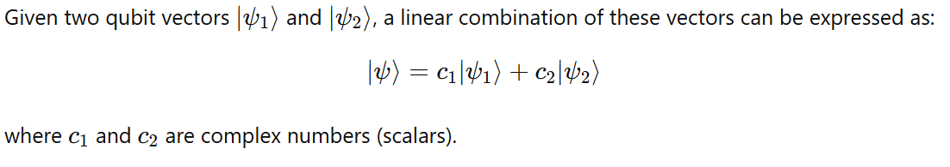
2.7 Linear Combination of Two Qubit Vectors
A linear combination of two qubit vectors involves creating a new qubit vector by adding the vectors together, each multiplied by a scalar (which can be a complex number).

Slide 63
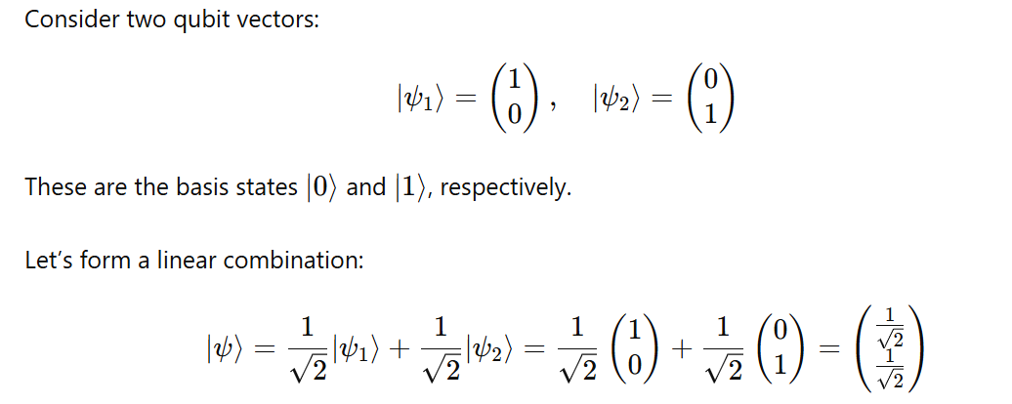
Example

Slide 64
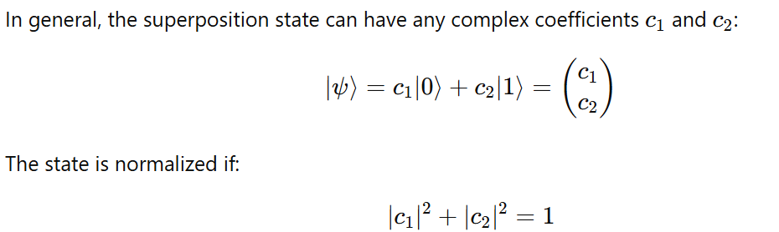
2.7 Superposition of Qubits

Slide 65
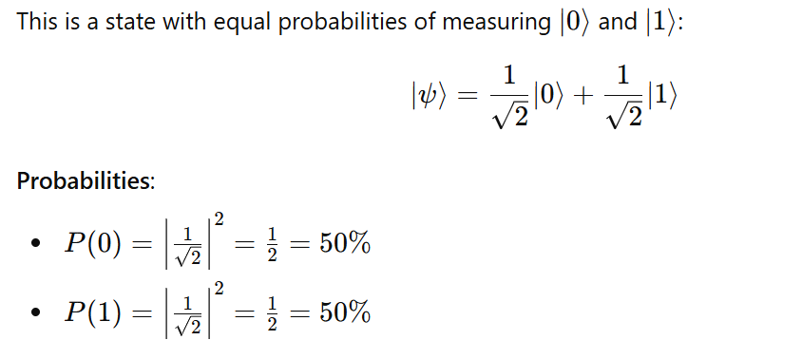
1. Equal Superposition

Slide 66
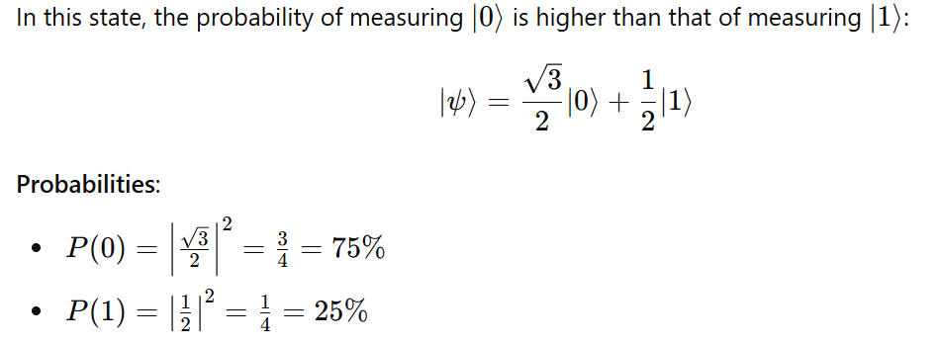
2. Biased Towards ∣0⟩

Slide 67

3. Biased Towards ∣1⟩

Slide 68

4. Closer to ∣0⟩

Slide 69

5. Very Close to ∣1⟩

Slide 70
Note
Ket notation ∣𝜓⟩: Represents the state as a column vector.
Bra notation ⟨𝜓∣: Represents the conjugate transpose of the ket as a row vector.
Inner product ⟨𝜙∣𝜓⟩: Gives a scalar, indicating the overlap between two quantum states.
Outer product ∣𝜓⟩⟨𝜙∣: Results in a matrix, useful for constructing quantum operators.

Slide 71
2.9 Hilbert Space in Quantum Computing
A Hilbert space in quantum computing is a mathematical framework used to describe the state space of quantum systems. It is a complete inner product space where:
  Vectors represent quantum states.
  Inner product defines the overlap or similarity between states.
  Norm of a vector represents the probability amplitude of finding the system in that state.
  Unitary Operators represent quantum gates.
  Projection Operators represent measurements.
  Probabilities are calculated based on the norms and inner products.

Slide 72

Hilbert Space in Quantum Computing

Slide 73
2.10 Basis in Quantum Mechanics
In quantum mechanics, a basis typically refers to a set of orthonormal vectors in a Hilbert space.
For qubits, the basis vectors are often represented as ∣0⟩ and ∣1⟩, which are the standard basis vectors for a single qubit

Slide 74

|0> and |1> are ortho normal basis

Slide 75

|0> and |1> are ortho normal basis

Slide 76
2.11 Tensor Products
If we have two vector spaces V and W, their tensor product of V and W is a new vector space formed from all possible combinations of vectors from V and W.
The dimension of the tensor product space is the product of the dimensions of the individual spaces.
For example, if V has dimension m and W has dimension n, then tensor product of V and W has dimension m×n.

Slide 77

Tensor Product Notation

Slide 78

Example 1 :

Slide 79

Example 2:

Slide 80

Example 3:

Slide 81


Example 4:

Slide 82




Example 5:

Slide 83
2.12 Entanglement of Qubits in Hilbert Space
Entanglement is a quantum phenomenon where two or more qubits become linked in such a way that the state of one qubit is dependent on the state of the other, no matter the distance between them.
This relationship persists even if the qubits are separated by large distances, leading to correlations in their measurements.
In quantum computing, entangled states are described using the Hilbert space of multiple qubits.
Entanglement involves quantum states that cannot be factored into separate states of individual qubits:

Slide 84

Entanglement of Qubits in Hilbert Space
Entanglement is a quantum phenomenon where two or more qubits become linked in such a way that the state of one qubit is dependent on the state of the other, no matter the distance between them.
Entanglement involves quantum states that cannot be factored into separate states of individual qubits.
Example :

Slide 85
2.13 What is Bell State?
The Bell states are specific quantum states of two qubits that are maximally entangled.
They are named after physicist John Bell, who studied the implications of entanglement for quantum mechanics and classical physics.
There are four Bell states, each representing a different kind of entanglement between the two qubits.

Slide 86


Slide 87


Slide 88


Slide 89


Slide 90


Prove that The Bell State is entangled state

Slide 91





Slide 92



Slide 93



Slide 94


2.14 Complex Numbers in Polar Form

Slide 95


2.15 Representing QuBits states using Bloch Sphere
The state of a qubit can be represented as a point on the Bloch Sphere
It is a unit sphere, where r=1.

Slide 96



Slide 97




Slide 98
Representing QuBits states using Bloch Sphere
A Bloch sphere uses its three axes to represent a qubit’s state. The state vector originates in the center of the sphere and terminates at a point with z, x, and y coordinates.
The z-axis represents the probability of the qubit being measured as a 0 or a 1.
The x-axis represents the real part of the state vector.
The y-axis represents the imaginary part of the state vector.

Slide 99

Qubit State in Polar Coordinates

Slide 100




Slide 101









Slide 102







Slide 103
Quiz 2

Slide 104
Open Source SDKs for Quantum Computing
There are several open-source SDKs (Software Development Kits) available for quantum computing, each designed to help developers and researchers build, test, and run quantum algorithms on various quantum hardware and simulators.

Slide 105
Open Source SDKs for Quantum Computing
Sl.NO | SDK | Developer | Language
1 | Qiskit | IBM Research and the Qiskit community. | Python
2 | Cirq | Google | Python
3 | Braket | Amazon | Python
4 | Forest | Rigetti Computing | Python
5 | Ocean | D-Wave Systems. | Python
6 | ProjectQ | ETH Zurich | Python
7 | QDK | Microsoft | Q#
Others : Strawberry Fields (Xanadu)(Python), Quipper (Haskel), PennyLane(Python),etc.

Slide 106
Qiskit Key Features
Components: Includes
  Terra[ Earth] : circuit construction
  Aer [ Air] : simulation,
  Ignis [Fire ] : error mitigation, and
  Aqua [Water] : application-specific algorithms.
Ecosystem: Supports a wide range of quantum algorithms and applications, including finance, chemistry, and machine learning.
Community: Strong community support with extensive tutorials and resources.
Use Cases: Suitable for both beginners and advanced users, enabling access to IBM's quantum hardware and simulators.

Slide 107
Installing Qiskit
pip install qiskit
  [ This This will install the latest stable version of Qiskit, including: Qiskit Terra, Qiskit Aer, Qiskit Ignis and Qiskit Aqua]
  Upgrading qistkit: pip install --upgrade qiskit
Installing Individual Components
  pip install qiskit-terra
  pip install qiskit-aer
  pip install qiskit-ignis
  pip install qiskit-aqua

Slide 108

Verifying the Installation

Slide 109

Verifying the Installation

Slide 110
Qiskit Python Programs to representing Single Qubit States
|0⟩ state
|1⟩ state
|i⟩ state
|-i⟩ state
|+⟩ state
|-⟩ state

Slide 111


1. Qiskit Python program to represent the |0⟩ state vector

Slide 113



Slide 114



Slide 115



Slide 116



Slide 117



Slide 118
Quiz 3

Slide 119
Quantum Gates and Quantum Circuits
Dr. Thyagaraju G S
Professor and HoD, Department of CSE,
SDM Institute Of Technology, Ujire-574240

Slide 120

Unitary Operations

Slide 121
1. Quantum Gates
Pauli Gates (X, Y, Z)
Hadamard Gate (H)
Phase Gates (S, T)
Controlled Gates(CX,XZ)
Swap Gate
Toffoli Gate (CCNOT)
Fredkin Gate (CSWAP)
Identity Gate (I)
Rotation Gates (Rx, Ry, Rz)

Slide 122


1.1.1 Pauli X Gate

Slide 123

Pauli X Gate

Slide 124


1.1.2 Y Gate (Pauli-Y)

Slide 125


1.1.3 Z Gate (Pauli-Z)

Slide 126



1.2 Hadamard Gate (H)

Slide 127

1.3.1 S Gate (Phase Gate)

Slide 128

1.3.2 T Gate (Phase Gate)

Slide 129


Note

Slide 130




Slide 131



1.4.1 CNOT Gate (Controlled-X)
The Controlled-NOT (CNOT) gate, also known as the Controlled-X gate, is a two-qubit gate that flips the state of the target qubit if the control qubit is in the state ∣1>

Slide 132


CNOT Gate Matrix Representation

Slide 133




Slide 134

1.4.2 Controlled-Z Gate (CZ)
The Controlled-Z (CZ) gate is a two-qubit quantum gate that applies a Z gate (also known as a phase-flip gate) to the second qubit, but only if the first qubit (the control qubit) is in the state ∣1⟩|1\rangle∣1⟩. Otherwise, it leaves both qubits unchanged.

Slide 135


Applying the CZ Gate to Basis States

Slide 136


Applying the CZ Gate to Basis States

Slide 137

1.5 Swap Gate

Slide 138


Applying the Swap Gate to Basis States

Slide 139



Slide 140

1.6 Toffoli Gate (CCNOT)

Slide 141



The Toffoli gate performs the following operation on the computational basis states:
The target qubit (third qubit) is flipped only when both control qubits (first and second qubits) are ∣1⟩.

Slide 142

State Vector ∣110⟩:
The state ∣110⟩ corresponds to the following column vector (indexing from 0):

Slide 143


Slide 144

1.7 Identity Gate (I)

Slide 145

1.8.1 Rx Gate

Slide 146


The Rx gate is a single-qubit rotation gate that rotates the state of a qubit around the X-axis of the Bloch sphere

Slide 147


Example 1: Rx Gate on ∣0⟩

Slide 148


Example 2: Rx Gate on ∣1⟩

Slide 149

1.8.2 Ry Gate

Slide 150

1.8.3 Rz Gate

Slide 151

Single-qubit gates are generally shown as squares with a letter indicating which operation it is, like this:

Slide 152

Not gates (also known as X gates) are also sometimes denoted by a circle around a plus sign:

Slide 153

Swap gates are denoted as follows:

Slide 154

Controlled-gates, meaning gates that describe controlled-unitary operations, are denoted by a filled-in circle (indicating the control) connected by a vertical line to whatever operation is being controlled. For instance, controlled-NOT gates, controlled-controlled-NOT (or Toffoli) gates, and controlled-swap (Fredkin) gates are denoted like this:

Slide 155

Arbitrary unitary operations on multiple qubits may be viewed as gates. They are depicted by rectangles labeled by the name of the unitary operation. For instance, here is a depiction of an (unspecified) unitary operation U as a gate, along with a controlled version of this gate:

Slide 156


Slide 157
Basic Structure of a Quantum Circuit
A quantum circuit typically consists of:
Qubits: The basic unit of quantum information, analogous to bits in classical computing. Qubits can exist in superposition states.
Quantum Gates: Operations that change the state of qubits.
  Single-qubit gates (e.g., Hadamard, Pauli-X, Y, Z)
  Multi-qubit gates (e.g., CNOT, SWAP)
Measurement: The final step in a quantum circuit, where the qubits are measured to produce a classical output. The process of observing qubit states, collapsing superpositions.
Circuit diagram: A visual representation of qubit operations over time.
Initialization: Setting qubits to known starting states.
Quantum register: A collection of qubits used in the circuit.
Classical register: Stores measurement results for further processing.

Slide 158

Ex1

Slide 159

Ex2

Slide 160

Ex3:

Slide 161

Ex4:

Slide 162

Ex5:

Slide 163

Ex6:

Slide 164

Ex7:

Slide 165

If we wish to choose our own name we can do this using the Quantum Register class like this:

Slide 166


Program to create a new circuit with two new qubits, then displays the circuit's qubits attribute

Slide 167


Slide 168



Slide 169



Slide 170



Slide 171


Slide 172



Circuit with Hadmard and Control Gate

Slide 173
Types
Quantum circuits can be categorized based on their functionality and the types of operations they perform.
Here are some simple types of quantum circuits:

Slide 174
1. Basic Quantum Circuits
These circuits perform simple quantum operations such as initializing qubits, applying single-qubit gates, and measuring the output.
Example: Basic Quantum Circuit
Circuit: Apply a Hadamard gate to a single qubit, then measure the result.
Operation: This circuit creates a superposition state

Slide 175


Slide 176




Slide 177
2. Entanglement Circuits
These circuits involve creating entangled states between two or more qubits, where the state of one qubit is dependent on the state of another. The most common example is the Bell state.
Example: Entanglement Circuit
Circuit: Apply a Hadamard gate to the first qubit and a CNOT gate to entangle it with the second qubit.
Operation: This circuit creates an entangled Bell state.

Slide 178

Another example of a quantum circuit, this time with two qubits
As always, the gate labeled H refers to a Hadamard operation, while the second gate is a two-qubit gate: it's the controlled-NOT operation, where the solid circle represents the control qubit and the circle resembling the symbol ⊕ denotes the target qubit.

Slide 179
Another example of a quantum circuit, this time with two qubits
Above circuit describes an operation on a pair of qubits (X,Y) — and if the input to the circuit is a quantum state ∣ψ⟩∣ϕ⟩, then this means that the lower qubit X starts in the state ∣ψ⟩ and the upper qubit Y starts in the state ∣ϕ⟩.

Slide 180

The first operation is a Hadamard operation on Y:
When applying a gate to a single qubit like this, nothing happens to the other qubits — and nothing happening is equivalent to the identity operation being performed.

Slide 181


The first operation is a Hadamard operation on Y:
In our circuit there is just one other qubit, X, so the dotted rectangle in the figure above represents this operation:
Note that the identity matrix is on the left of the tensor product and H is on the right, which is consistent with Qiskit's ordering convention.

Slide 182

The second operation is the controlled-NOT operation, where Y is the control and X is the target:

Slide 183

The controlled-NOT gate's action on standard basis states is as follows:

Slide 184


Given that we order the qubits as (X,Y), the matrix representation of the controlled-NOT gate is this:
The unitary operation of the entire circuit, which we'll call U,U, is the composition of the operations:

Slide 185

In particular, recalling our notation for the Bell states,

Slide 186

We get

Slide 187

In general, quantum circuits can contain any number of qubit wires. We may also include classical bit wires, which are indicated by double lines like in this example:

Slide 188
Sometimes it is convenient to depict a measurement as a gate that takes a qubit as input and outputs a classical bit (as opposed to outputting the qubit in its post-measurement state and writing the result to a separate classical bit).
This means the measured qubit has been discarded and can safely be ignored thereafter.

Slide 189

For example, the following circuit diagram represents the same process as the one in the previous diagram, but where we ignore X and Y after measuring them:

Slide 190


Slide 191




Slide 192
Quiz 4

Slide 193
Introduction to Quantum Algorithms
Dr. Thyagaraju G S
Professor and HoD, Department of CSE,
SDM Institute Of Technology, Ujire-574240

Slide 194
Quantum Algorithms
Quantum algorithms are procedures that run on quantum computers and take advantage of quantum mechanics' principles to solve problems more efficiently than classical algorithms.
These algorithms utilize the unique properties of quantum bits (qubits), such as superposition, entanglement, and interference, to perform computations that are infeasible or extremely slow on classical computers.

Slide 195
Types of Quantum Algorithms
Quantum Search Algorithms
Quantum Factoring Algorithms
Quantum Simulation Algorithms:
Quantum Optimization Algorithms
Quantum Machine Learning Algorithms:
Quantum Fourier Transform (QFT)
Quantum Cryptography Algorithms

Slide 196
2. Quantum Factoring Algorithms:
Shor's Algorithm: This algorithm can factor large integers exponentially faster than the best-known classical algorithms. It's particularly significant because it could potentially break widely used cryptographic systems like RSA, which relies on the difficulty of factoring large numbers.

Slide 197
3. Quantum Simulation Algorithms:
Quantum Simulations: Quantum computers can simulate quantum systems much more efficiently than classical computers. Algorithms in this category are used to model molecular structures, chemical reactions, and other quantum systems, which has applications in materials science, chemistry, and drug discovery.

Slide 198
4. Quantum Optimization Algorithms:
Quantum Approximate Optimization Algorithm (QAOA): This algorithm is used to solve combinatorial optimization problems by finding approximate solutions more efficiently than classical methods.
Variational Quantum Eigensolver (VQE): VQE is used to find the ground state energy of a quantum system, which is crucial in quantum chemistry.

Slide 199
5. Quantum Machine Learning Algorithms
Quantum Support Vector Machine (QSVM): An adaptation of classical support vector machines, QSVMs leverage quantum computing to classify data points more efficiently.
Quantum Neural Networks (QNNs): These networks combine quantum computing with the principles of neural networks to potentially outperform classical neural networks in certain tasks.

Slide 200
6. Quantum Fourier Transform (QFT):
QFT is a quantum version of the discrete Fourier transform and is a crucial component of several quantum algorithms, including Shor's algorithm. It is used for transforming quantum states into their frequency components, which is essential in solving problems related to periodicity and number theory.

Slide 201
7. Quantum Cryptography Algorithms:
Quantum Key Distribution (QKD): QKD uses quantum mechanics to create secure communication channels, ensuring that any eavesdropping attempts can be detected. The most famous QKD protocol is BB84.

Slide 202
1. Quantum Search Algorithms:
Grover's Algorithm: One of the most famous quantum algorithms, Grover's algorithm provides a quadratic speedup for unstructured search problems.
For example, if a classical algorithm needs N steps to search a list of N items, Grover's algorithm can do it in sqrt(N)​ steps.

Slide 203

Grover’s Algorithm
Grover's algorithm is a quantum algorithm that provides a significant speedup for searching an unsorted database or solving unstructured search problems. It is particularly known for its quadratic speedup compared to classical algorithms.

Slide 204


Steps of Grover's Algorithm

Slide 205


Steps of Grover's Algorithm

Slide 206
Example: Searching a Database
Here's an implementation of Grover's Algorithm using Qiskit to search for a marked state in an unsorted database.
The example circuit is designed to find the state |11⟩ out of the four possible states |00⟩, |01⟩, |10⟩, and |11⟩ using Grover's algorithm.

Slide 207


Slide 208


Slide 209


Slide 210



Slide 211
Quiz 5

Slide 212
Future Directions and Research Opportunities in Quantum Computing
Dr. Thyagaraju G S
Professor and HoD, Department of CSE,
SDM Institute Of Technology, Ujire-574240

Slide 213
Key areas
Quantum Algorithms
Quantum Error Correction
Quantum Hardware Development
Quantum Communication and Cryptography
Quantum Simulation
Quantum Machine Learning
Topological Quantum Computing
Quantum Metrology and Sensing
Quantum Ethics and Governance
Quantum Education and Workforce Development

Slide 214
1. Quantum Algorithms
New Algorithms Development
  Focus on optimization, machine learning, cryptography
Hybrid Classical-Quantum Algorithms
  Benefits of combining classical and quantum computing

Slide 215
2. Quantum Error Correction
Improving Error Correction Codes
  Importance of mitigating quantum noise
Fault-Tolerant Quantum Computing
  Steps toward reliable quantum computation

Slide 216
3. Quantum Hardware Development
Scalability of Quantum Processors
  Challenges and research focus
Exploring Qubit Technologies
  Superconducting, trapped ions, topological qubits
Quantum Interconnects
  Connecting multiple quantum processors

Slide 217
4. Quantum Communication and Cryptography
Quantum Internet
  Secure long-distance communication
Quantum Key Distribution (QKD)
  Integration with classical networks

Slide 218
5. Quantum Simulation
Simulating Complex Systems
  Applications in materials science, chemistry, drug discovery
Digital vs. Analog Simulations
  Comparison of approaches

Slide 219
6. Quantum Machine Learning
Quantum-enhanced Machine Learning
  Advantages for large datasets, complex problems
Variational Quantum Algorithms
  Optimization of machine learning models

Slide 220
7. Topological Quantum Computing
Topological Qubits
  Error resistance and stability
Majorana Fermions
  Research in creating protected qubits

Slide 221
8. Quantum Metrology and Sensing
High-Precision Measurements
  Leveraging quantum properties for accuracy
Applications in Medicine and Environmental Science
  Early disease detection, environmental monitoring

Slide 222
9. Quantum Ethics and Governance
Ethical Considerations
  Privacy, cybersecurity, and societal impact
Policy and Regulation
  Frameworks for responsible development

Slide 223
10. Quantum Education and Workforce Development
Expanding Educational Programs
  Preparing the next generation of quantum experts
Interdisciplinary Research
  Collaboration across physics, computer science, and engineering

Slide 224
Quiz5

Slide 225
Questions?

Slide 226
References
ChatGPT
Perplexity
Claude
Qiskit | IBM Quantum Computing
Qubits: What is a Qubit and How Qubits Work? - MAKB Tech (makb183.com)
Qubit (devopedia.org)
Cryogenic measurements of semiconductor devices - NPL

Slide 227
References
Google's Quantum Lab in California holds the future of computing (youtube.com)
Quantum Computers, explained with MKBHD (youtube.com)
The Map of Quantum Computing - Quantum Computing Explained (youtube.com)
Quantum Computing Hardware - An Introduction (youtube.com)
Decoded: How Does a Quantum Computer Work? (youtube.com)
Quantum Computing: Algorithm, Programming and Hardware, an Introduction (youtube.com)
Inside a Quantum Computer! with Andrea Morello (Part 1 of 2) (youtube.com)
L2-1 Quantum Computing Hardware: An Overview (youtube.com)
What Would a Quantum Internet Look Like? (youtube.com)

Slide 228
References
Mapping the qubit state onto the Bloch Sphere (youtube.com)
qiskit-tutorials/reference/tools/getting_started.ipynb at 66ab9961e5e25f8712819cd212351ee077a811ae · Qiskit/qiskit-tutorials · GitHub
qiskit-tutorials/reference/tools/quantum_gates_and_linear_algebra.ipynb at 66ab9961e5e25f8712819cd212351ee077a811ae · Qiskit/qiskit-tutorials · GitHub
textbook/notebooks/ch-states/single-qubit-gates.ipynb at main · Qiskit/textbook · GitHub
textbook/notebooks/ch-prerequisites at main · Qiskit/textbook · GitHub

Slide 229
Thank you

